Slide 1





Economic Measurement and Statistics
Foundations, Challenges, and Innovations in the United States
Prepared by: Economic Statistics Research Team
July 7, 2025

Slide 2

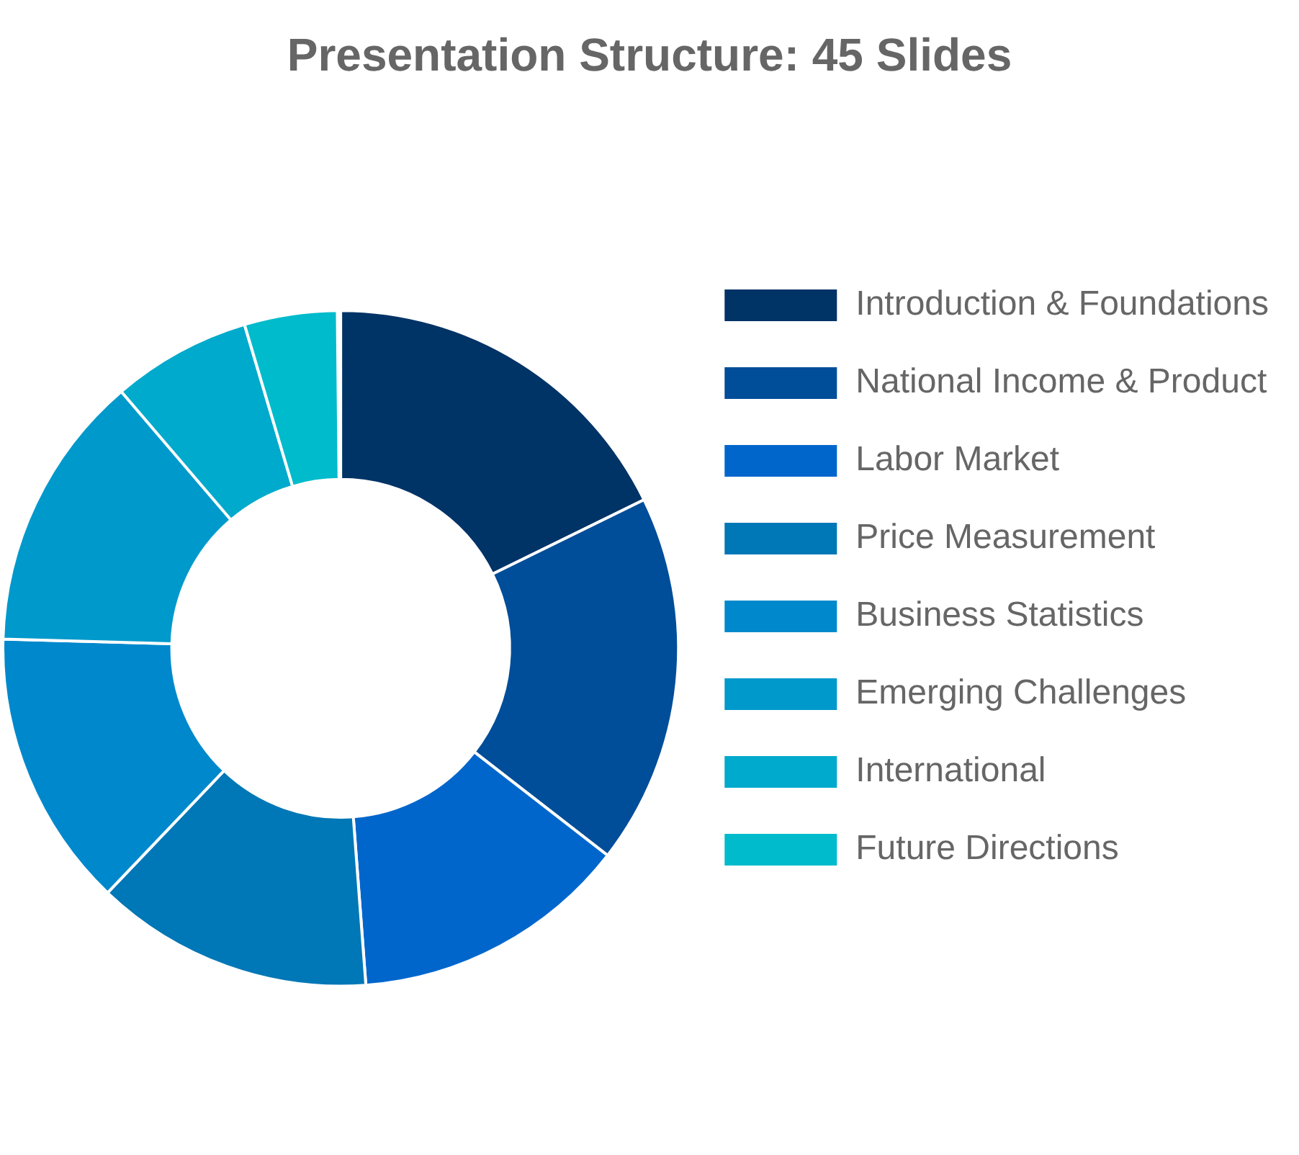
Presentation Overview
This presentation explores economic measurement and statistics with a focus on the United States, examining historical foundations, current methodologies, emerging challenges, and future directions.
I. Introduction and Foundations (Slides 1-8)
Historical evolution, US statistical system, international standards
II. National Income and Product Accounts (Slides 9-16)
NIPA framework, GDP, GDO, PCE, investment, government
III. Labor Market and Employment Statistics (Slides 17-22)
Employment measurement, productivity, compensation
IV. Price Measurement and Inflation (Slides 23-28)
CPI, PPI, quality adjustments, core inflation, housing costs
V. Business Statistics and Economic Indicators (Slides 29-34)
Business dynamics, industry statistics, financial statistics
VI. Emerging Challenges and Innovations (Slides 35-40)
Digital economy, big data, environmental accounting, well-being
VII. International Perspectives (Slides 41-43)
UN Statistical Commission, OECD practices
VIII. Future Directions and Conclusions (Slides 44-45)
Future of economic statistics, key takeaways

Slide 3

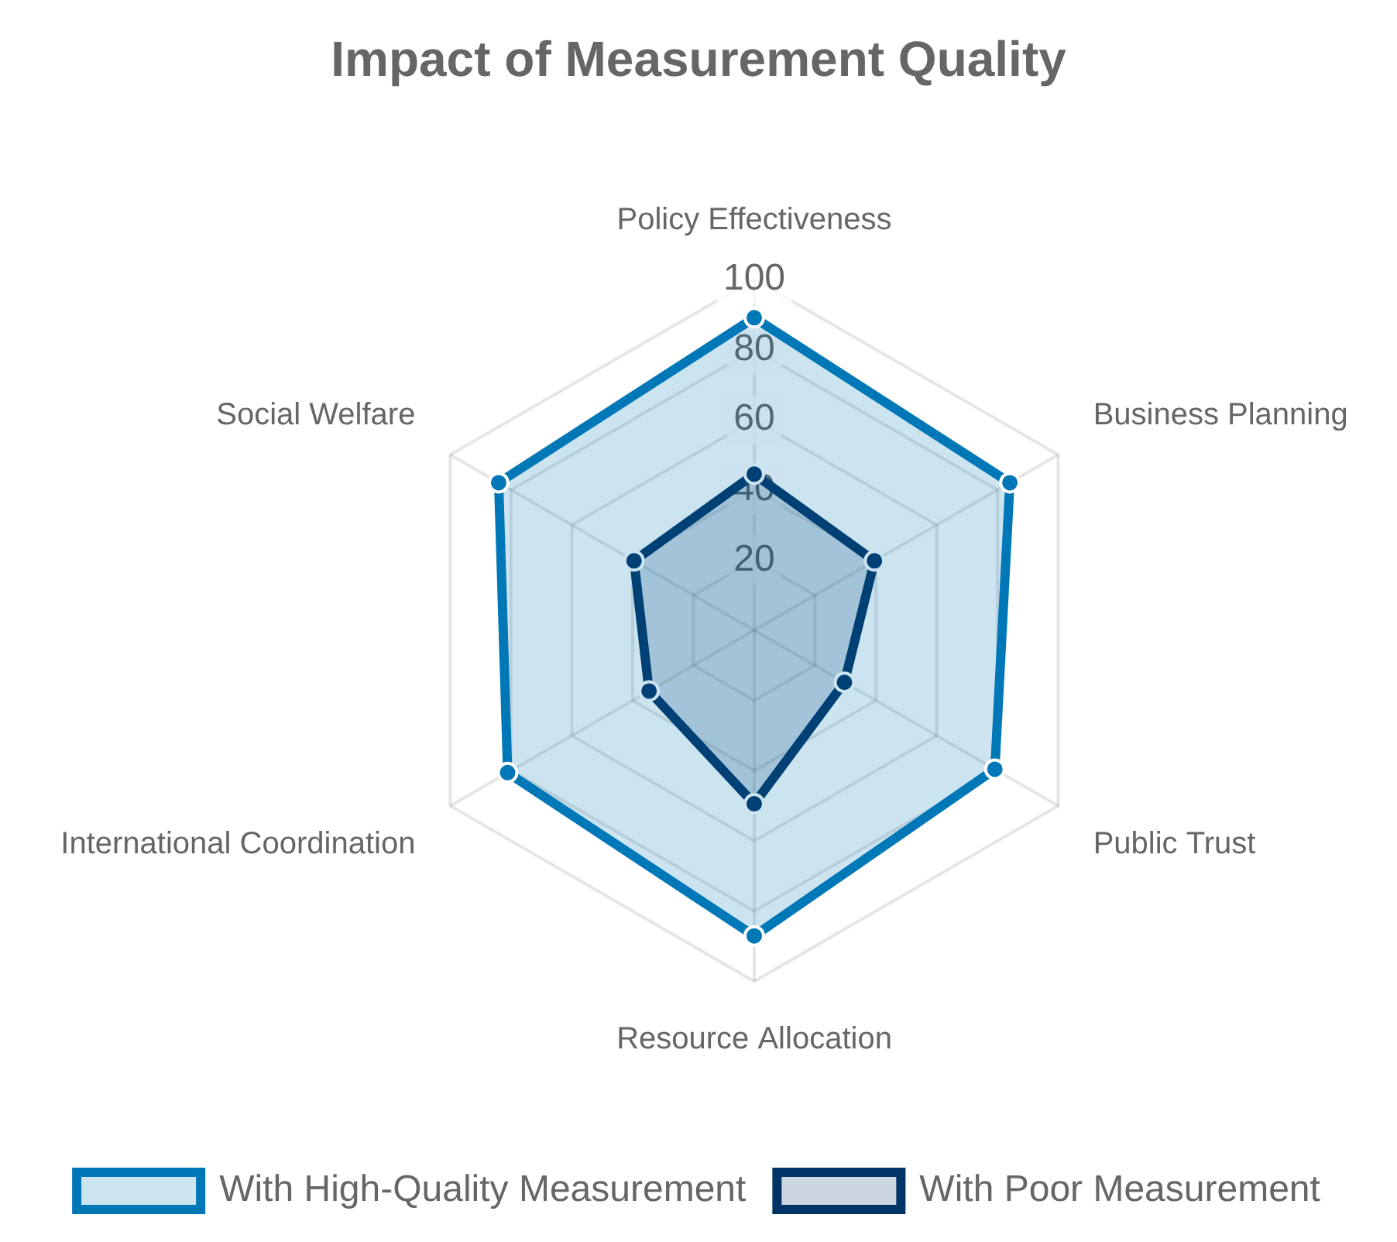
Why Economic Measurement Matters
"What we measure affects what we do; and if our measurements are
flawed, decisions may be distorted."
— Stiglitz-Sen-Fitoussi Commission, 2009
Policy Decisions:
Economic statistics guide monetary policy, fiscal planning,
and regulatory frameworks. Inaccurate measurements can lead to
misaligned policies and unintended consequences.
Business Strategy:
Firms rely on economic indicators for investment
decisions, market entry, and resource allocation. Better measurements
enable better business planning.
Public Understanding:
Economic statistics shape public perception of
prosperity, inequality, and progress. The gap between official statistics and
lived experience can erode trust.
International Comparisons:
Standardized measurements allow for
meaningful cross-country analysis and coordination of global economic
policies.

Slide 4

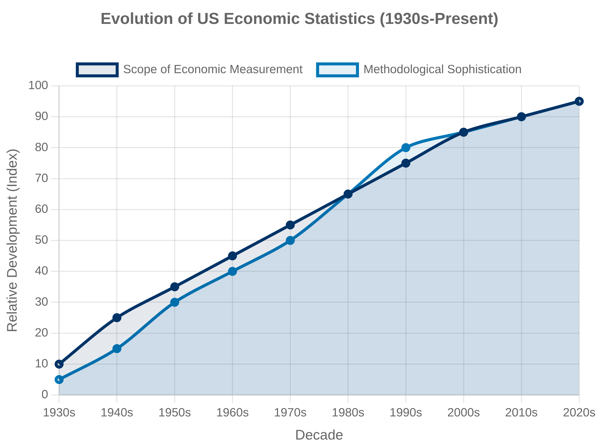
Historical Evolution of Economic Statistics
The development of economic measurement in the United States has evolved from early national income estimates to a comprehensive system of accounts, driven by economic crises, policy needs, and technological advances.
1930s
Great Depression prompts first official national income estimates by Simon Kuznets at the NBER, leading to the establishment of national accounting frameworks
1940s
World War II drives expansion of economic statistics for mobilization planning; Department of Commerce develops first comprehensive national income and product accounts
1950s-1960s
Refinement of national accounts; input-output tables introduced; establishment of international standards through UN System of National Accounts (1953, 1968)
1970s-1980s
Improvements in price indices and inflation measurement; development of productivity statistics; enhanced regional economic accounts
1990s-2000s
Major methodological revisions including capitalization of software and R&D; introduction of chain-weighted price indices; improved measurement of services
2010s-Present
Digital economy measurement initiatives; development of well-being indicators; enhanced distributional accounts; big data integration

Slide 5
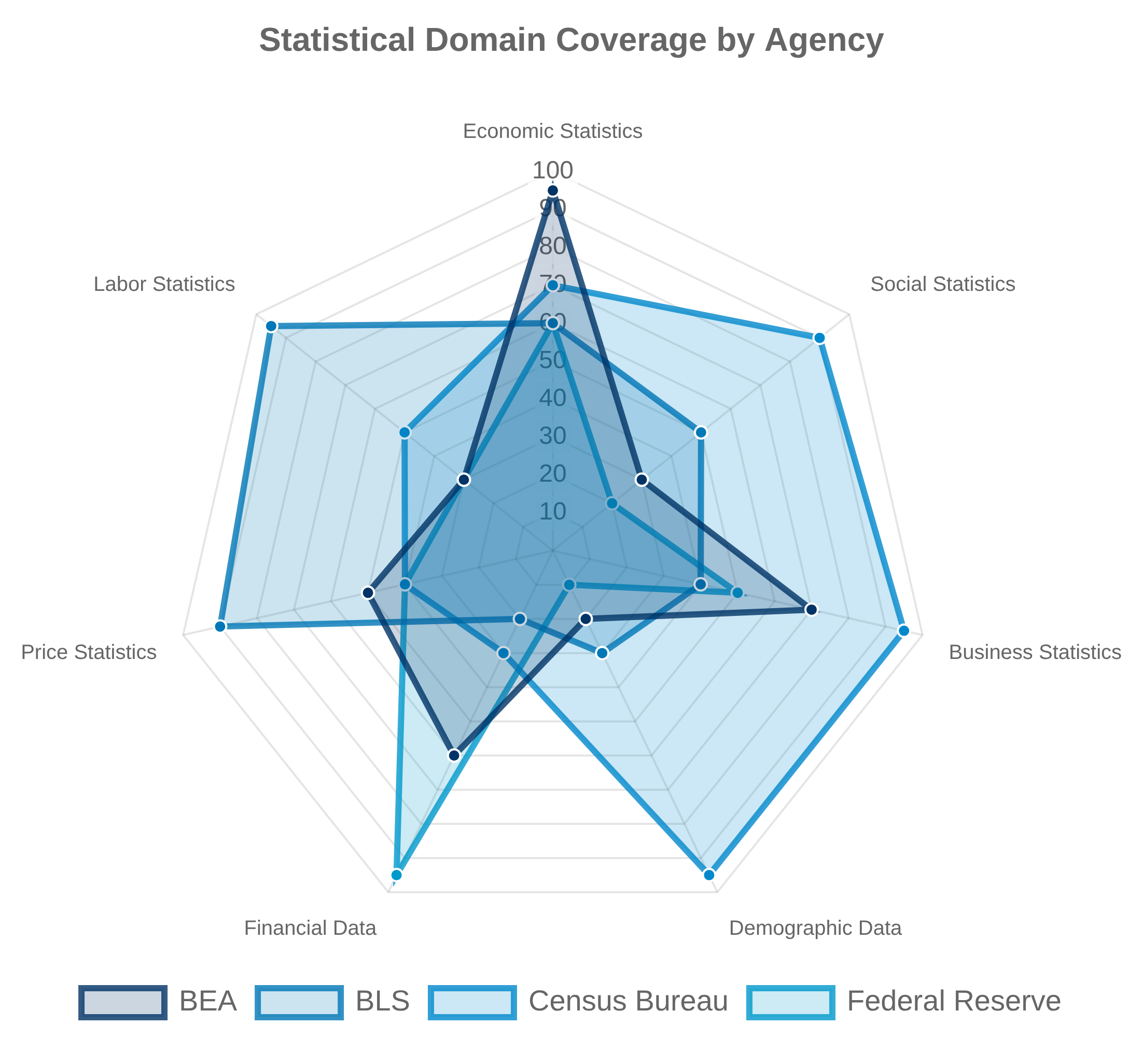





The US Statistical System Architecture
Decentralized Statistical System
The United States maintains a decentralized statistical system with specialized agencies responsible for different domains of economic and social statistics, coordinated through interagency councils and committees.
Key Statistical Agencies
Bureau of Economic Analysis (BEA)
: National accounts, GDP,
regional economic statistics
Bureau of Labor Statistics (BLS)
: Labor market, prices,
productivity
Census Bureau
: Population, housing, business, economic census
Federal Reserve
: Financial accounts, monetary statistics
Bureau of the Fiscal Service
: Federal government finances
Coordination Mechanisms
Interagency Council on Statistical Policy (ICSP) and Federal Committee on Statistical Methodology (FCSM) provide coordination, standards, and best practices across agencies.

Slide 6

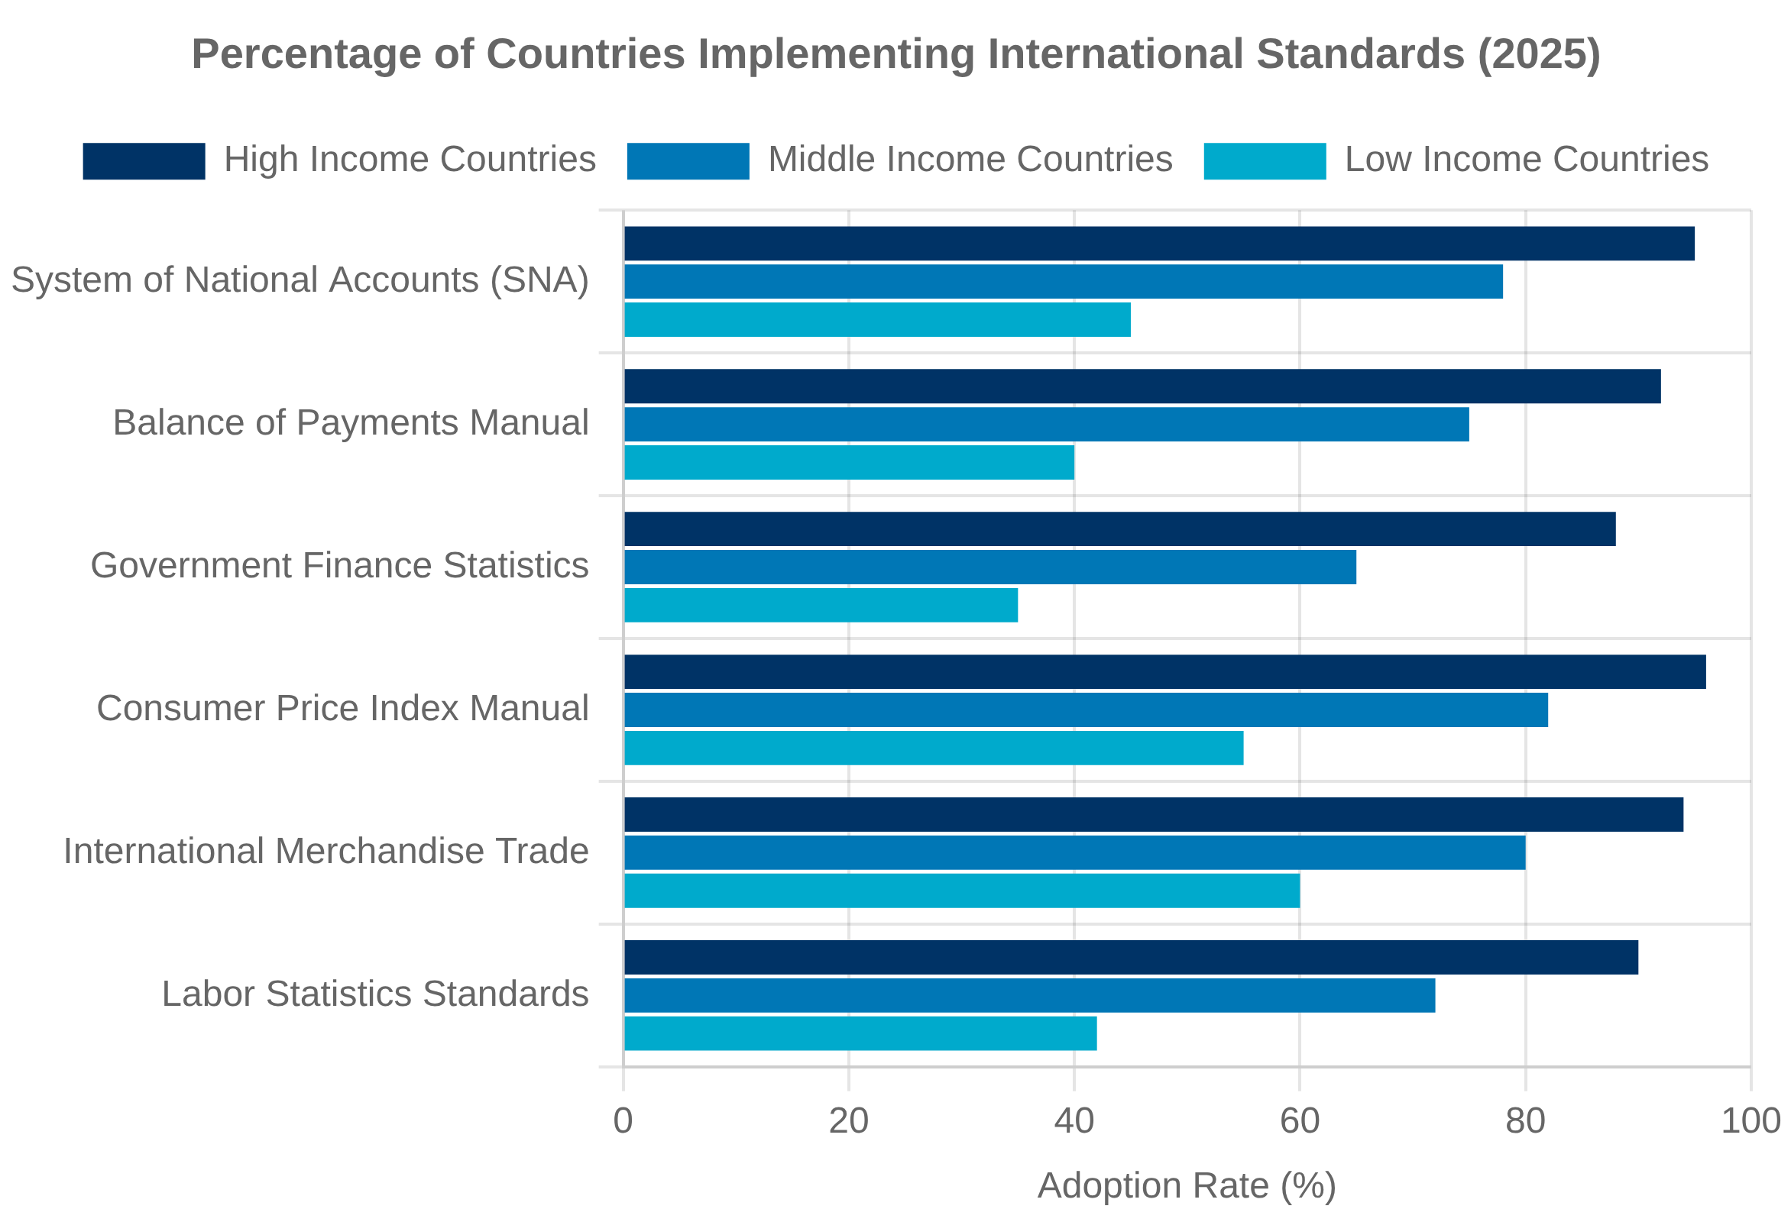
International Standards and Frameworks
UN System of National Accounts (SNA)
International Statistical Standards Adoption
The SNA is the internationally agreed standard set of recommendations on how to compile measures of economic activity, providing a comprehensive framework for economic statistics.
Latest revision (2008 SNA) with 2025 update in progress
Harmonizes national accounting practices globally
OECD Guidelines and Best Practices
The OECD provides methodological guidance on economic statistics, productivity measurement, and price indices to ensure comparability across member countries.
Specialized manuals for digital economy, globalization
Regular peer reviews of national statistical systems
Harmonization Challenges
Balancing international comparability with national needs
Adapting to digital economy and globalization
Resource constraints in implementation

Slide 7

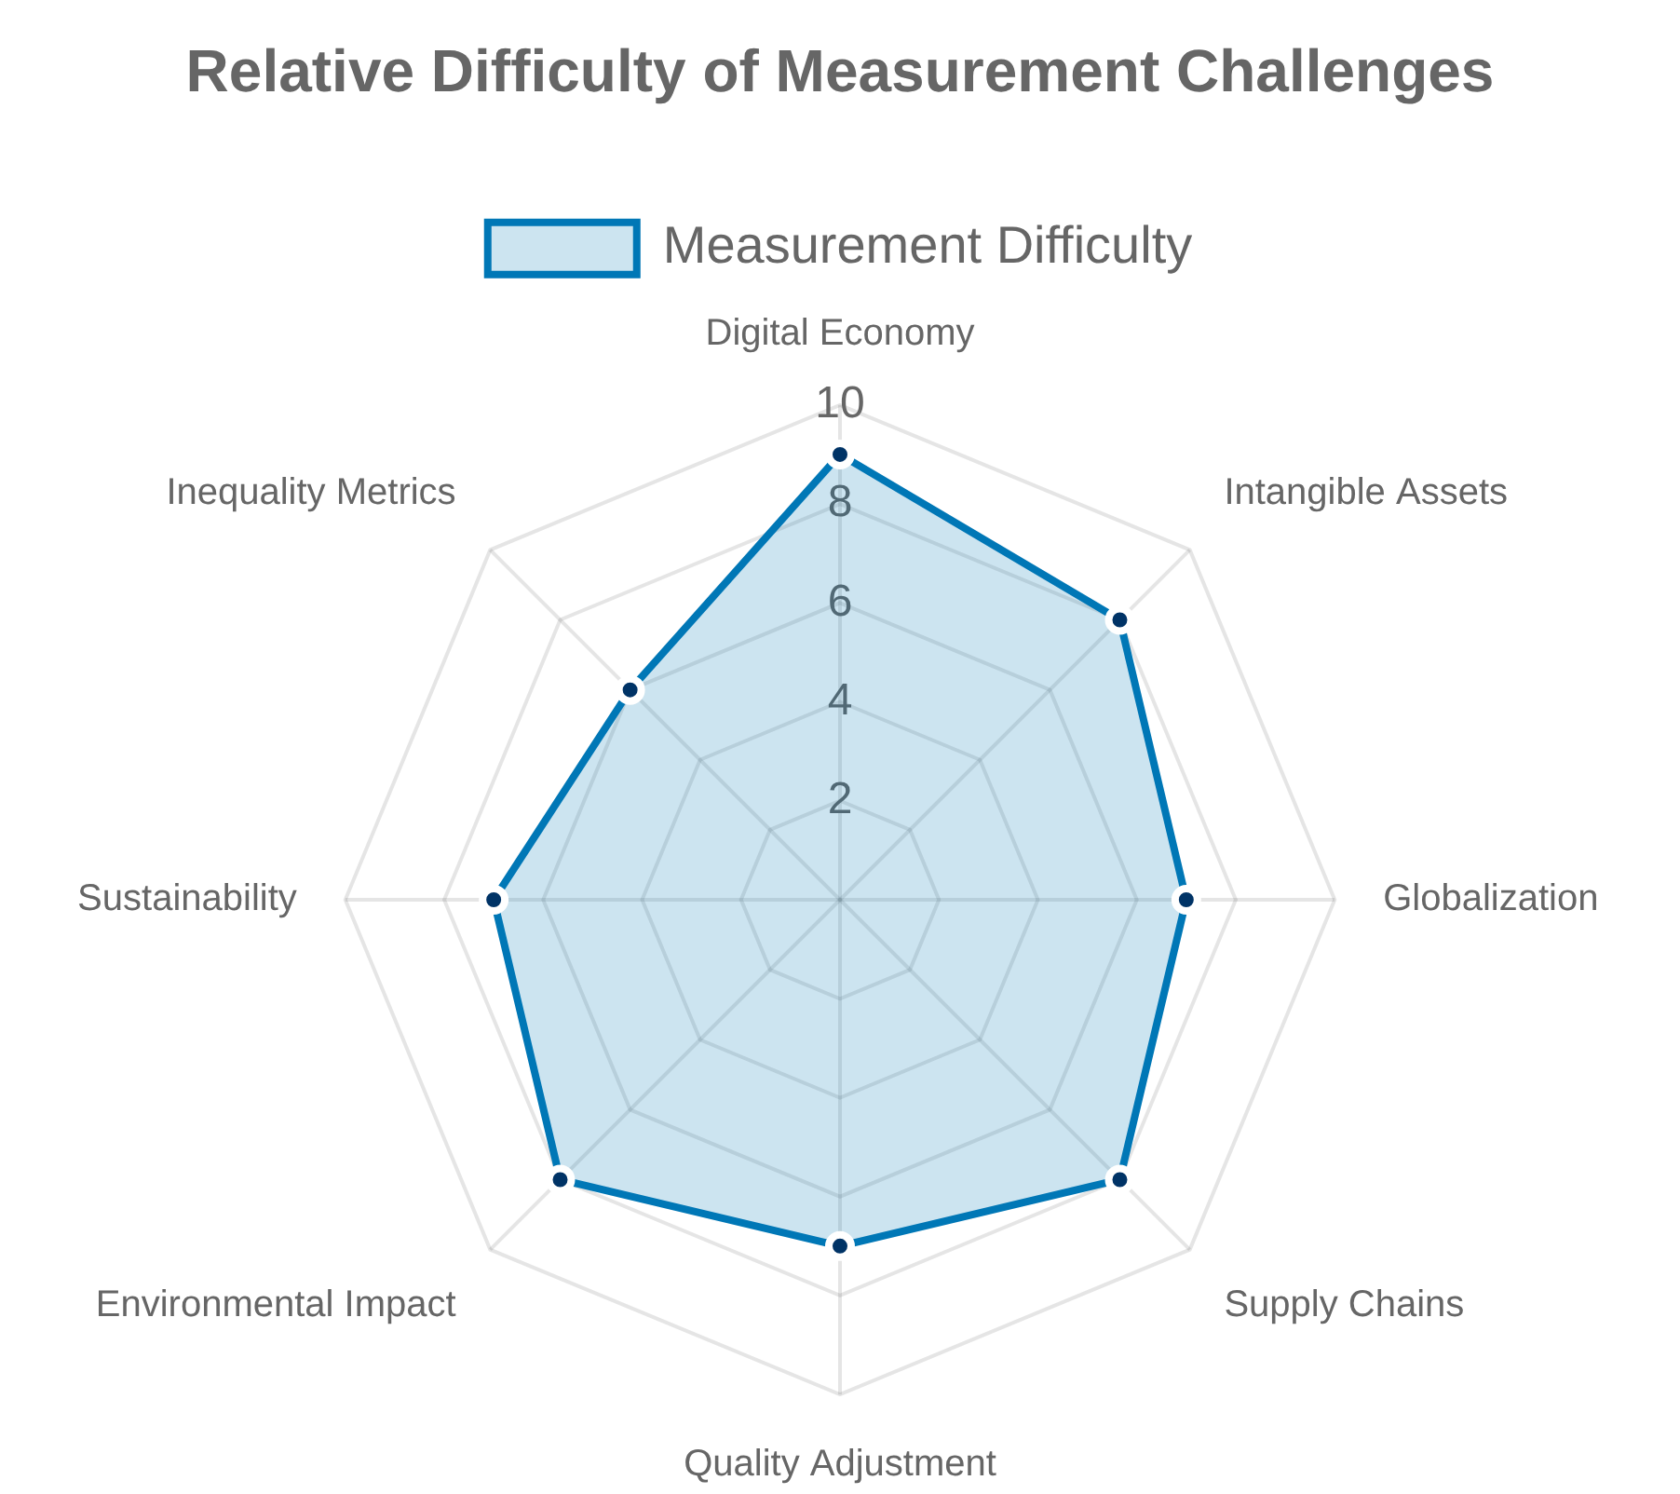



Key Measurement Challenges in the 21st Century
Digital Economy and Intangible Assets
Measuring value creation in digital platforms, free digital services, and data as an asset. Capturing investment in intangible capital including software, R&D, and organizational capital.
Globalization and Supply Chain Complexity
Tracking multinational enterprises, transfer pricing, and global value chains. Attributing production and income across national boundaries in increasingly complex networks.
Quality Adjustments and Technological Change
Accounting for rapid quality improvements in technology products and services. Developing appropriate hedonic methods for new and evolving products, especially in healthcare and digital services.
Environmental and Sustainability Considerations
Integrating natural capital and ecosystem services into economic accounts. Measuring climate impacts, carbon accounting, and sustainability metrics alongside traditional economic indicators.

Slide 8


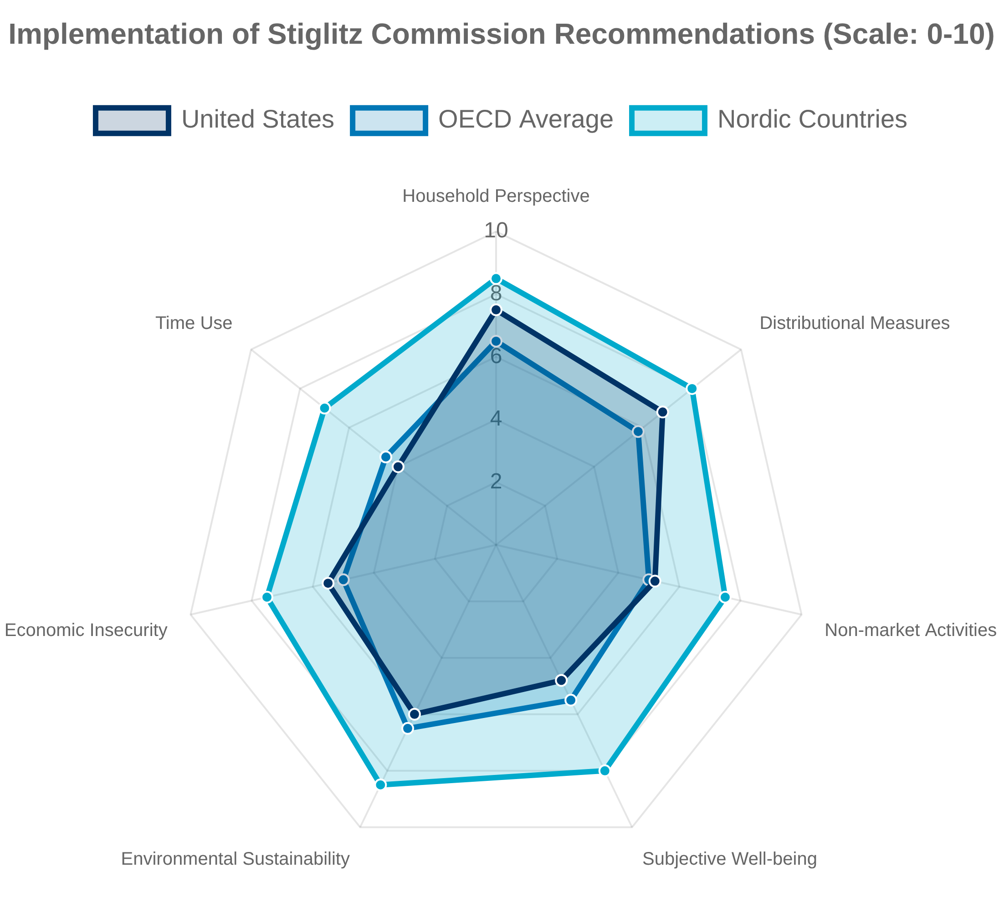



The Stiglitz Commission Legacy
"What we measure affects what we do; and if our measurements are flawed, decisions may be distorted." — Stiglitz-Sen-Fitoussi Commission
Origins and Purpose
The Commission on the Measurement of Economic Performance and Social Progress was established in 2008 by French President Nicolas Sarkozy, led by Nobel laureate economists Joseph Stiglitz, Amartya Sen, and Jean-Paul Fitoussi.
Addressed limitations of GDP as a measure of economic performance and social progress
Published influential report in 2009 that transformed economic measurement globally
The Three Pillars
The Commission's recommendations were organized around three main conceptual pillars that continue to guide statistical innovation today.
Classical GDP issues: improving measurement within the existing framework
Quality of life: incorporating broader measures of well-being
Sustainable development and environment: assessing intergenerational equity
Impact on U.S. Statistics
The Commission's work has influenced numerous initiatives in the U.S. statistical system to expand beyond traditional economic measures.
BEA's development of distributional national accounts and satellite accounts
Enhanced focus on household perspective in economic statistics

Slide 9


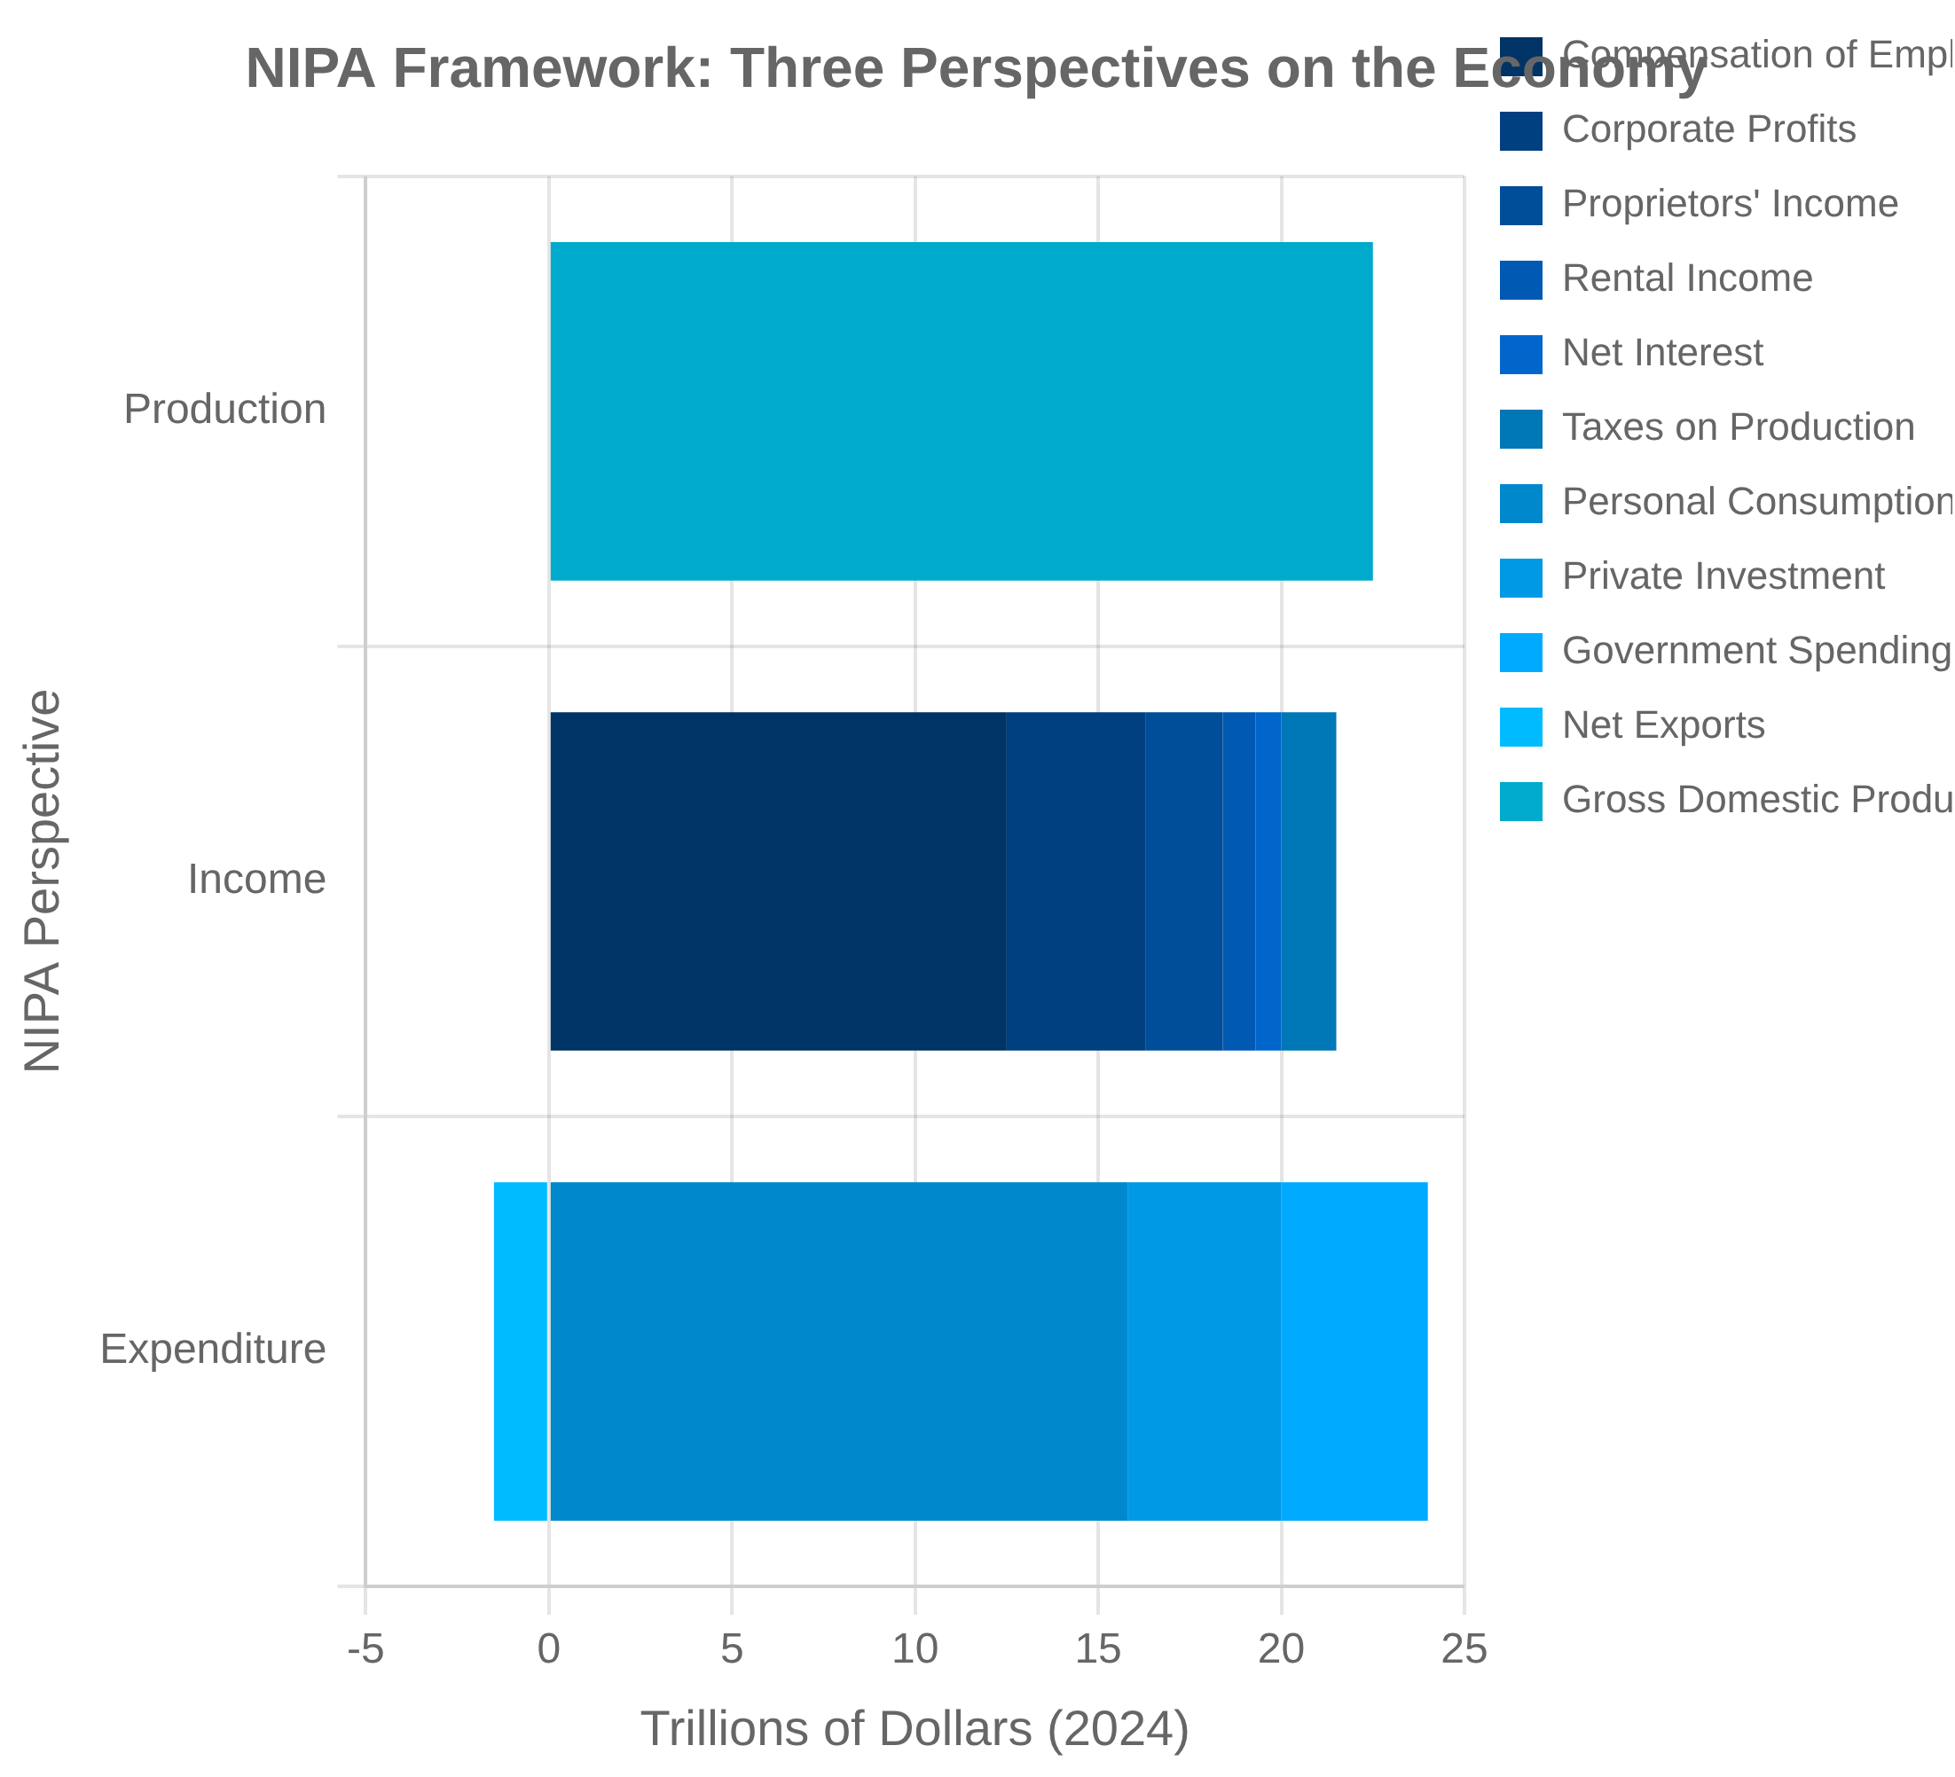


The NIPA Framework
Structure and Organization
The National Income and Product Accounts (NIPAs) provide a comprehensive framework for tracking economic activity in the United States, organized around a set of integrated accounts that show production, income, and expenditure flows.
Seven major account types: domestic income and product, personal income and outlay, government, foreign transactions, saving and investment, and private enterprise
Double-entry accounting system ensures internal consistency across accounts
Temporal Dimensions
The NIPAs are produced at multiple frequencies to support different analytical needs, with varying levels of detail and revision schedules.
Quarterly estimates (advance, second, third) with monthly indicators
Annual revisions each July and comprehensive revisions approximately every 5 years
Valuation Concepts
The NIPAs employ several valuation approaches to measure economic activity, each serving different analytical purposes.
Market prices for final goods and services (GDP)
Factor costs for income measures (GDI)
Current dollars (nominal) and chained dollars (real) measures

Slide 10


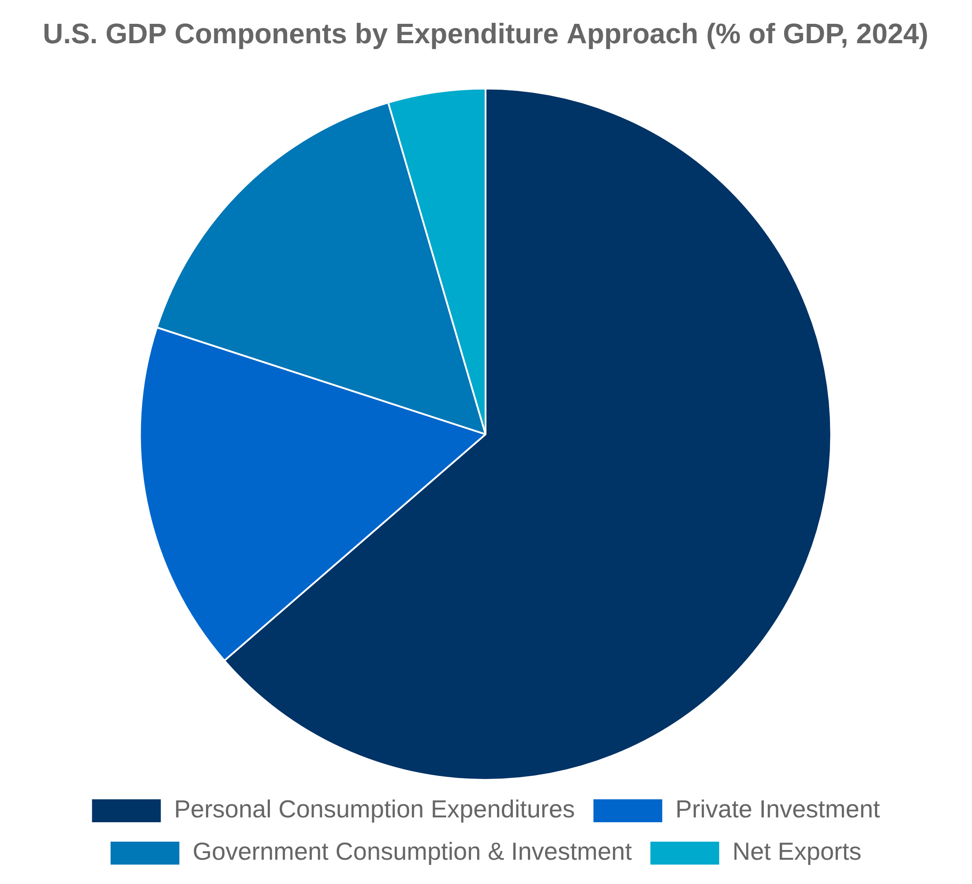




Gross Domestic Product (GDP)
Definition and Concept
Gross Domestic Product (GDP) is the market value of all final goods and services produced within a country's borders in a specific time period, typically a quarter or year.
Measures production, not sales or transactions
Focuses on final goods to avoid double-counting
Measurement Approaches
GDP can be measured using three equivalent approaches, each providing a different perspective on economic activity.
Expenditure approach: sum of all spending on final goods and services (C + I + G + X - M)
Income approach: sum of all income earned in production (wages, profits, interest, rent, taxes)
Production approach: sum of value added across all industries
Limitations and Challenges
Despite its widespread use, GDP has several well-known limitations as a measure of economic welfare and activity.
Excludes non-market activities like household production
Does not account for income distribution or sustainability
Challenges in measuring quality improvements and new goods

Slide 11


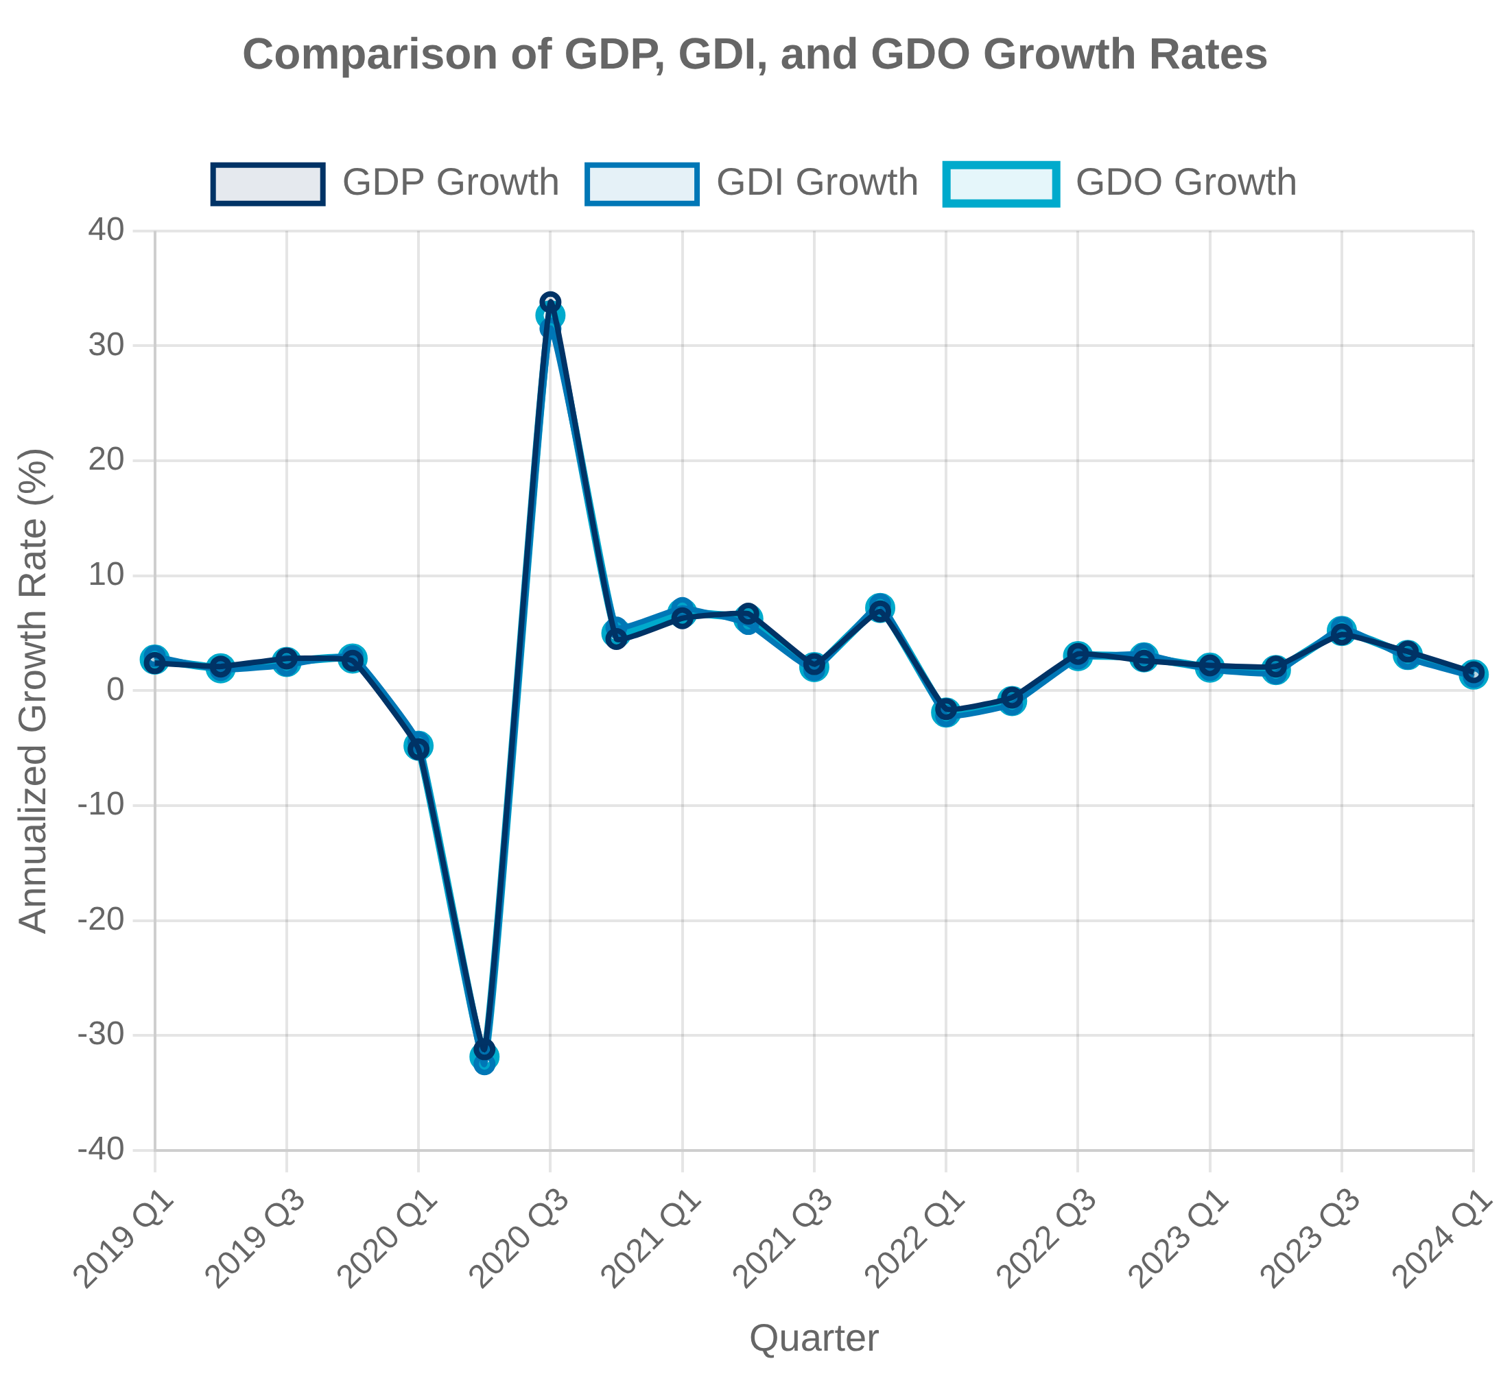


Gross Domestic Output (GDO) - A New Measure
Concept and Rationale
Gross Domestic Output (GDO) is a relatively new economic measure introduced by the Bureau of Economic Analysis (BEA) that averages Gross Domestic Product (GDP) and Gross Domestic Income (GDI) to provide a more comprehensive view of economic activity.
Addresses the "statistical discrepancy" between GDP and GDI measures
Combines expenditure and income perspectives for a more robust measure
Methodology
GDO is calculated as a simple average of GDP and GDI, reflecting the theoretical equivalence of these two measures in a complete accounting system.
GDO = (GDP + GDI) ÷ 2
Published quarterly alongside traditional GDP and GDI measures
Performance and Benefits
Research has shown that GDO often provides a more accurate picture of the economy's direction and strength, particularly during turning points and periods of economic stress.
More reliable predictor of business cycle turning points
Less subject to revision than either GDP or GDI alone
Provides early signals of economic slowdowns and recessions

Slide 12

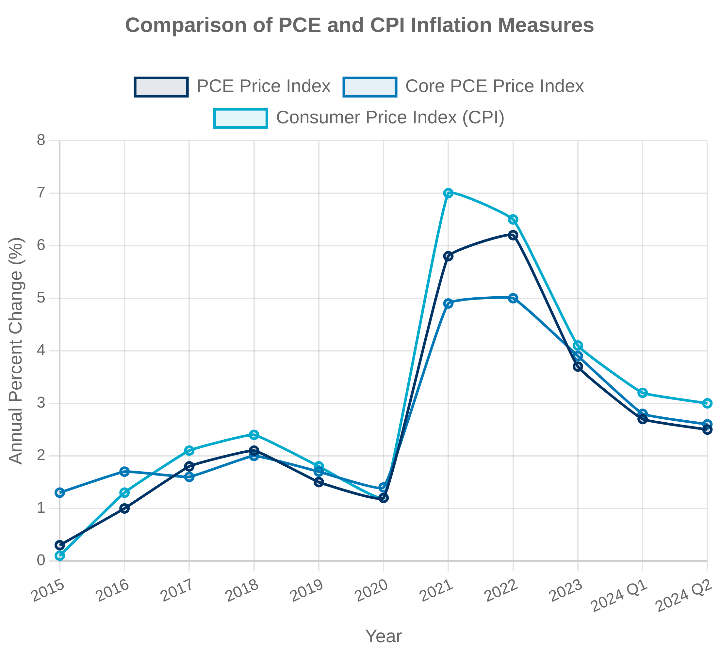


Personal Consumption Expenditures (PCE)
Definition and Importance
Personal Consumption Expenditures (PCE) measures household spending on goods and services in the U.S. economy, accounting for approximately 70% of GDP and serving as a critical indicator of economic health.
Includes all household purchases of durable goods, nondurable goods, and services
Also captures spending by nonprofit institutions serving households (NPISH)
Measurement Methodology
The Bureau of Economic Analysis (BEA) uses a commodity-flow approach to measure PCE, drawing on a wide range of data sources.
Primarily based on business surveys rather than household surveys
Incorporates data from Census Bureau, IRS, and industry sources
PCE Price Index
The PCE Price Index measures price changes for goods and services purchased by consumers and is the Federal Reserve's preferred inflation measure.
Broader coverage than CPI, including rural consumers and third-party payments
Uses chain-weighting to account for consumer substitution behavior
Core PCE (excluding food and energy) closely watched for underlying inflation trends

Slide 13


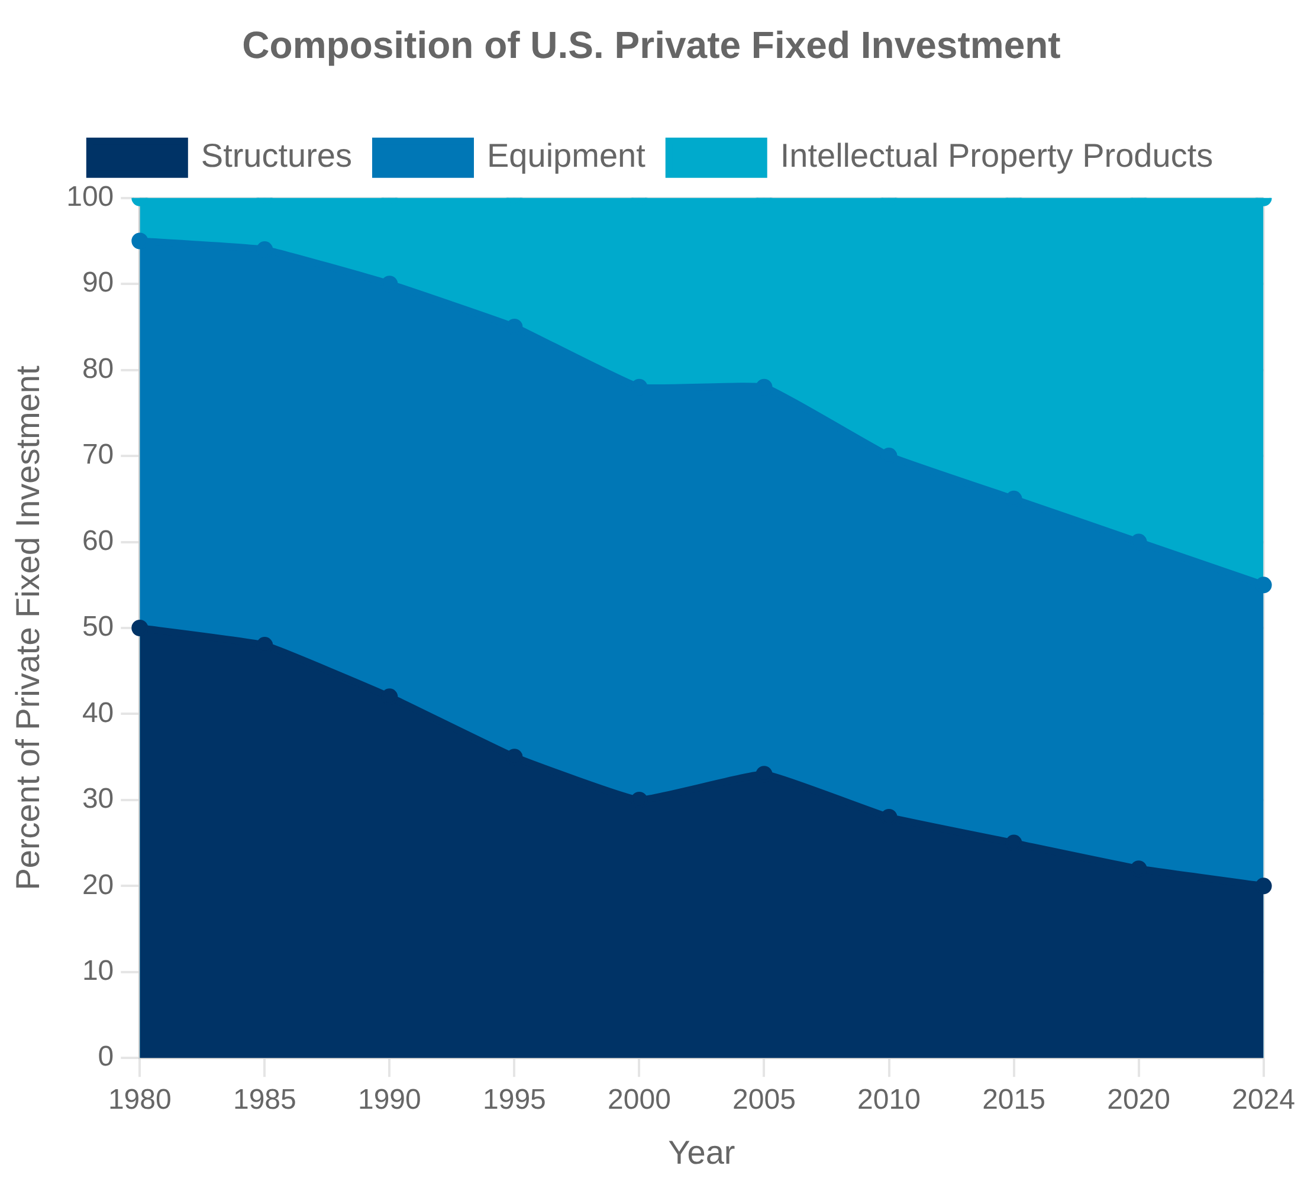



Investment and Capital Formation
Private Fixed Investment
Private fixed investment measures business and household spending on fixed assets that contribute to future production capacity, accounting for approximately 18% of U.S. GDP.
Includes structures, equipment, and intellectual property products
Measured primarily through Census Bureau surveys and IRS tax data
Intellectual Property Products
The Bureau of Economic Analysis (BEA) has progressively expanded the treatment of intellectual property products as investment in the national accounts, recognizing their growing importance in the modern economy.
Software expenditures capitalized since 1999
R&D recognized as investment since 2013 comprehensive revision
Entertainment, literary, and artistic originals also treated as capital assets
Measurement Challenges
Despite significant progress, several challenges remain in measuring investment and capital formation in the modern economy.
Many intangible investments still not captured (organizational capital, brand equity)
Difficulty measuring depreciation rates for knowledge assets
Globalization complicates tracking of investment flows and ownership

Slide 14


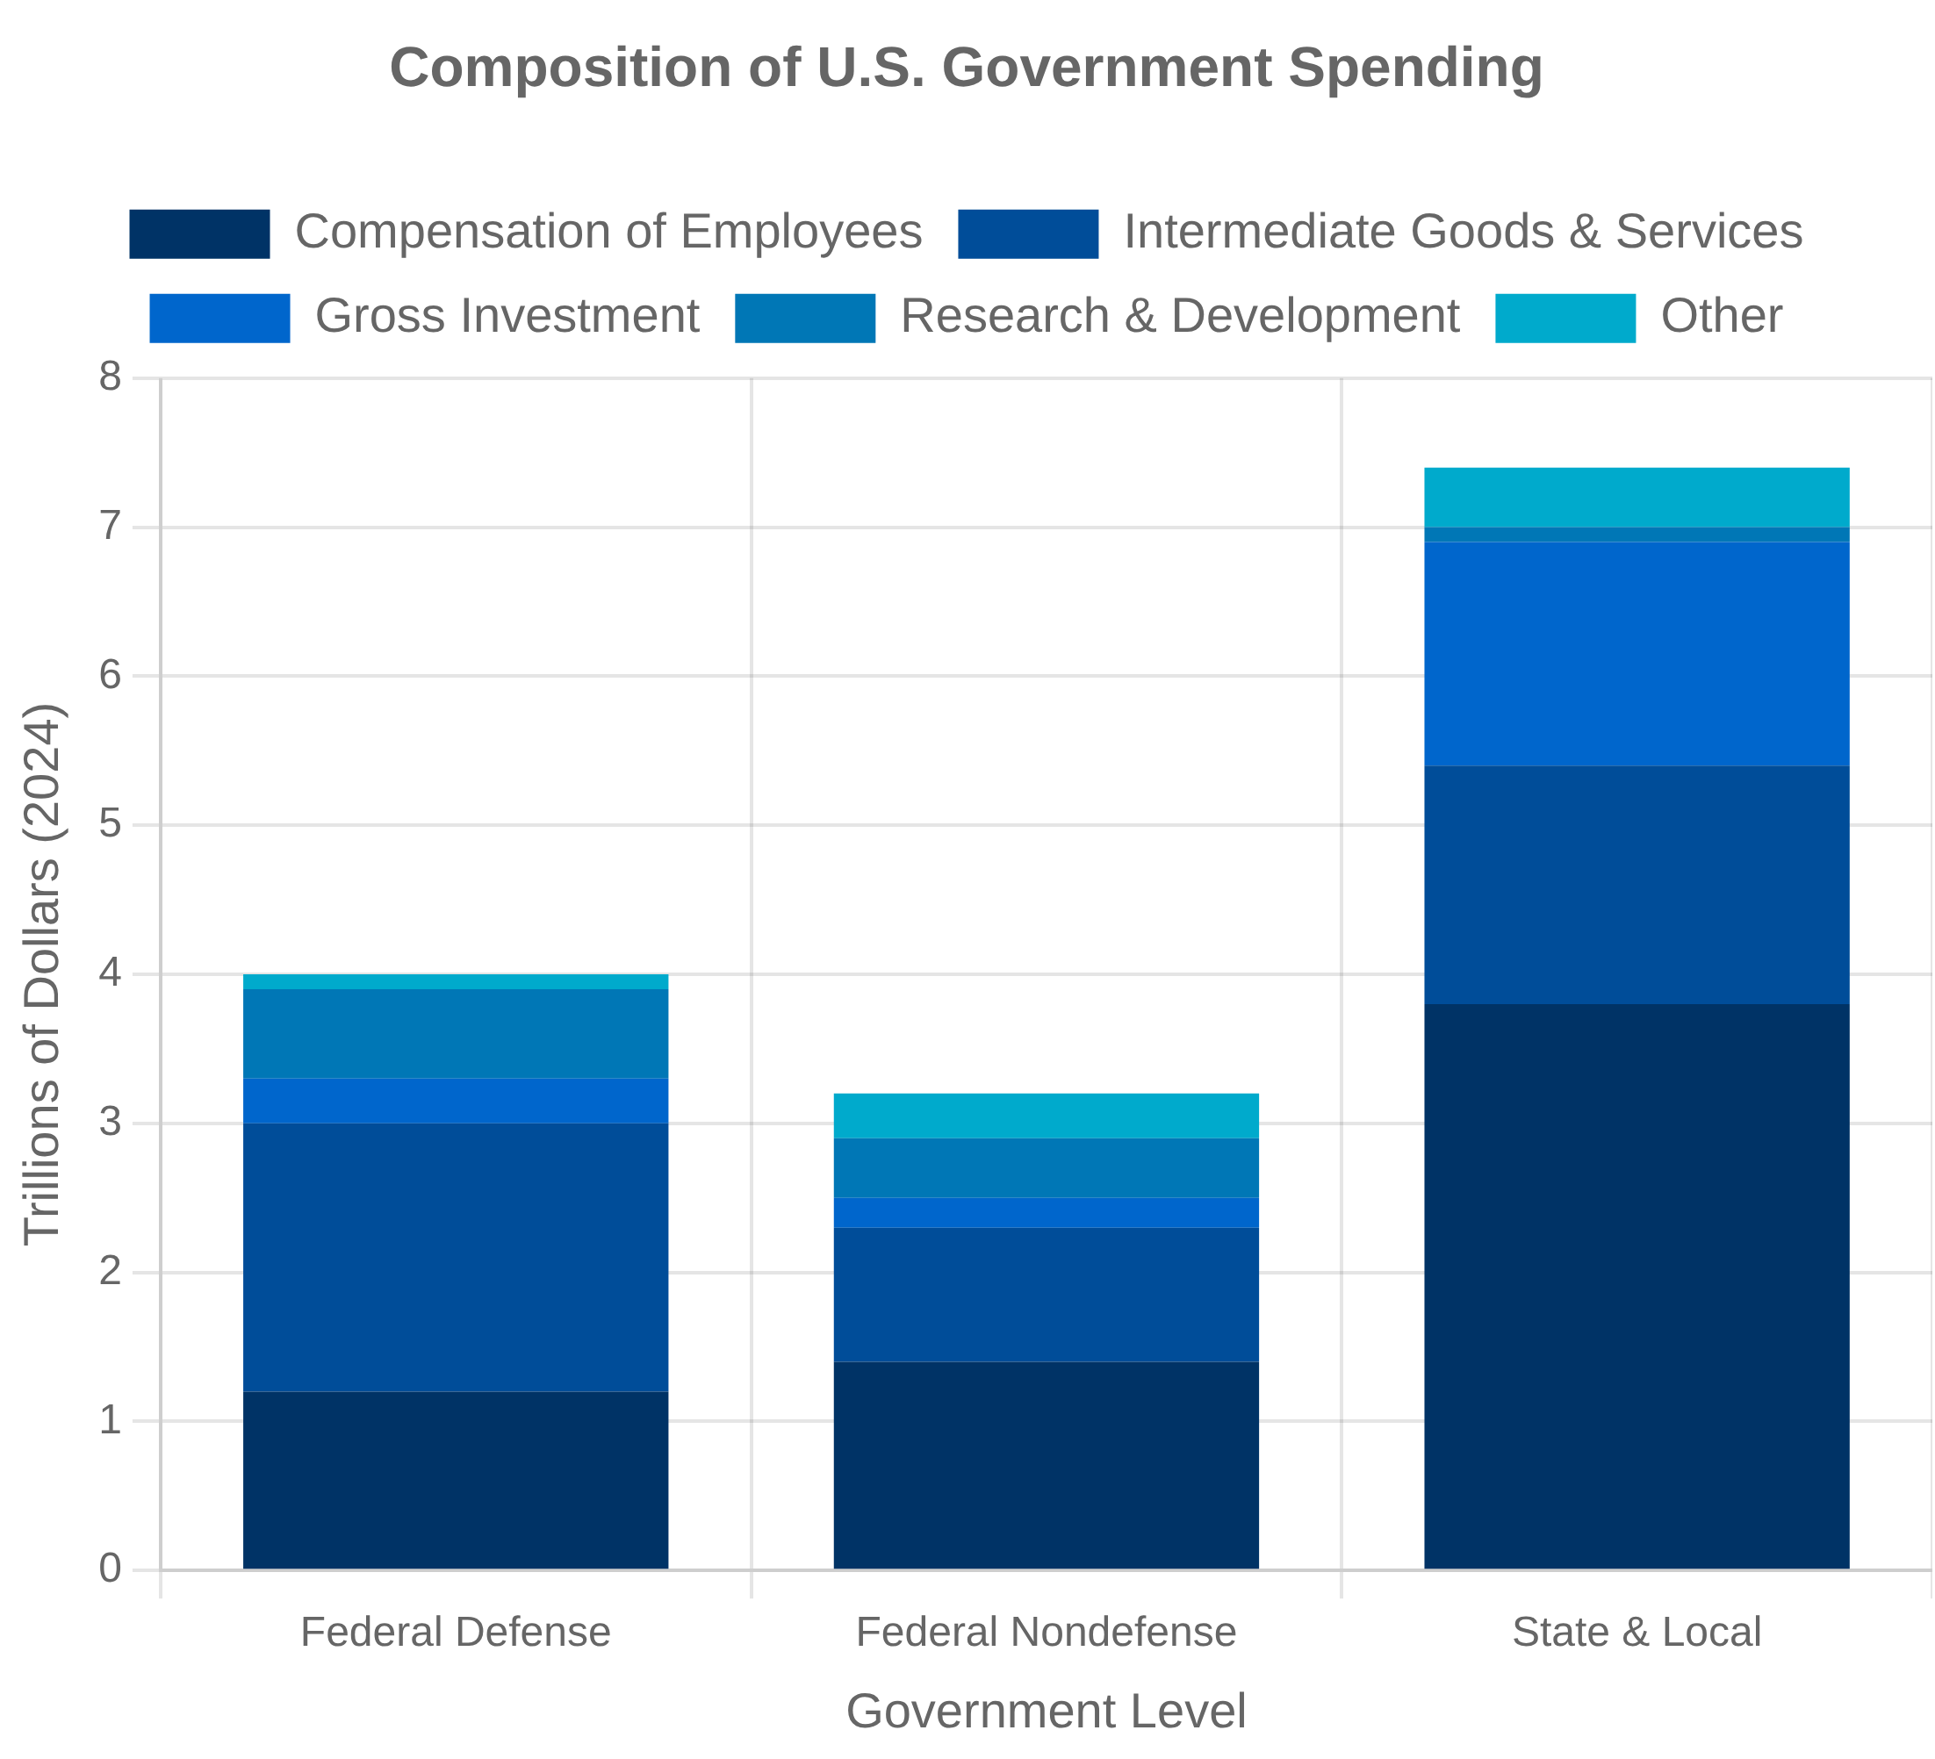
Government Sector Measurement
Government in the National Accounts
Government activity represents approximately 17% of U.S. GDP and is measured through a combination of consumption expenditures and gross investment across federal, state, and local levels.
Government consumption expenditures: employee compensation, intermediate goods and services
Government gross investment: structures, equipment, intellectual property products
Data Sources and Methodology
The Bureau of Economic Analysis (BEA) relies on a variety of administrative data sources to measure government economic activity.
Federal: Budget of the United States, Monthly Treasury Statement
State and local: Census Bureau surveys of government finances
Measurement Challenges
Measuring government output and productivity presents unique challenges compared to market-based sectors of the economy.
Most government services lack market prices, requiring input-based valuation
Difficulty measuring quality changes in government services
Limited direct productivity measures for government activities
Challenges in valuing public goods and collective services

Slide 15


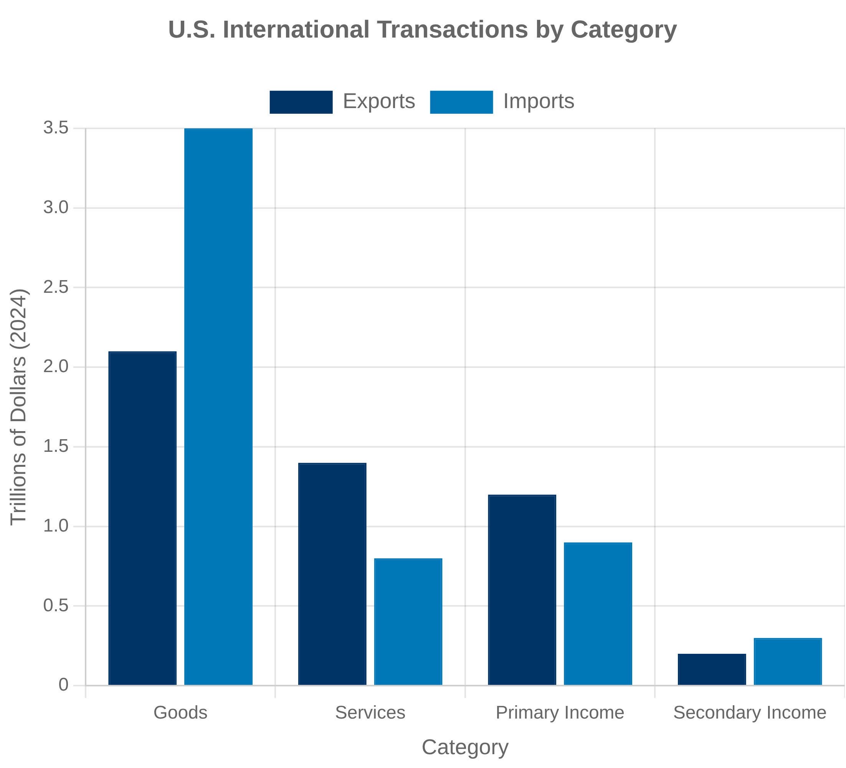


International Trade in National Accounts
Measurement Framework
International trade is measured in the national accounts through exports and imports of goods and services, with net exports (exports minus imports) contributing to GDP.
Goods trade data primarily from Census Bureau and Customs and Border Protection
Services trade data from BEA surveys and Treasury International Capital system
Global Value Chains
The fragmentation of production across international borders creates significant measurement challenges for national accounts and trade statistics.
Gross trade flows overstate domestic value added in exports
Difficulty attributing value added to specific countries in complex supply chains
BEA developing Trade in Value Added (TiVA) statistics to address these issues
Transfer Pricing and Measurement Challenges
Multinational enterprises' internal pricing practices create significant challenges for accurate trade and GDP measurement.
Transfer pricing may not reflect true economic value of transactions
Profit shifting through intellectual property location distorts trade statistics
Digital services trade particularly difficult to capture accurately

Slide 16


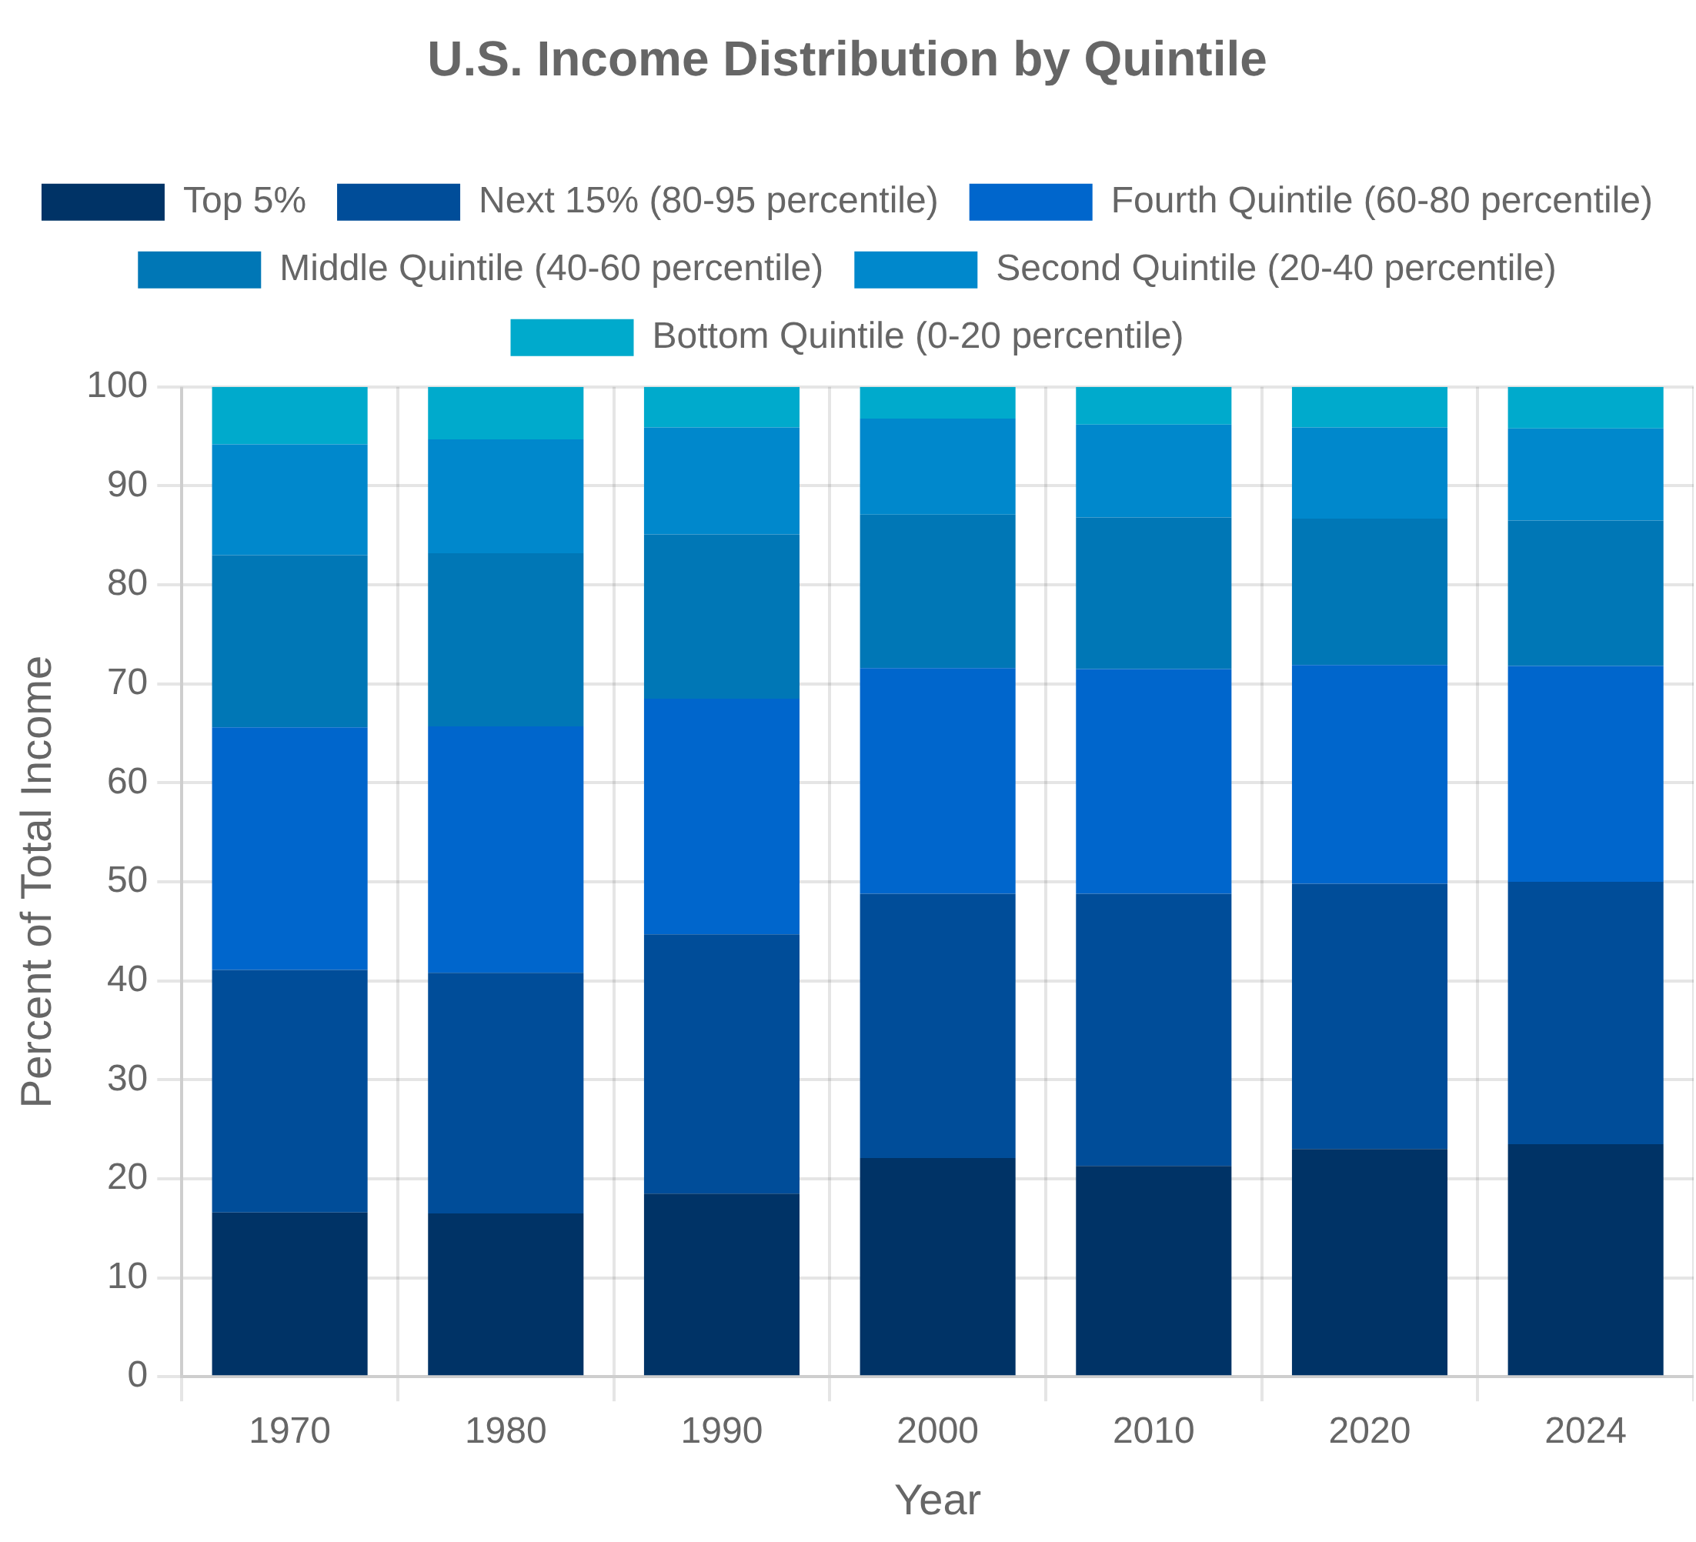


Income Distribution and Household Perspective
Beyond Aggregate Measures
While aggregate measures like GDP provide valuable information about overall economic performance, they reveal nothing about how economic gains are distributed across households and individuals.
Growing recognition that distribution matters for economic welfare assessment
Stiglitz Commission emphasized need for household perspective in economic statistics
Distributional National Accounts
The Bureau of Economic Analysis (BEA) has developed prototype Distributional National Accounts to show how personal income and its components are distributed across households.
Combines national accounts data with household survey and tax data
Provides income distribution by quintile, race, age, and education
Allows tracking of inequality trends consistent with national accounts totals
Key Inequality Metrics
Various statistical measures are used to quantify income and wealth inequality, each with different properties and interpretations.
Gini coefficient: summary measure of overall inequality (0-1 scale)
Income shares: percentage of total income received by different groups
Percentile ratios: compare incomes at different points in the distribution

Slide 17


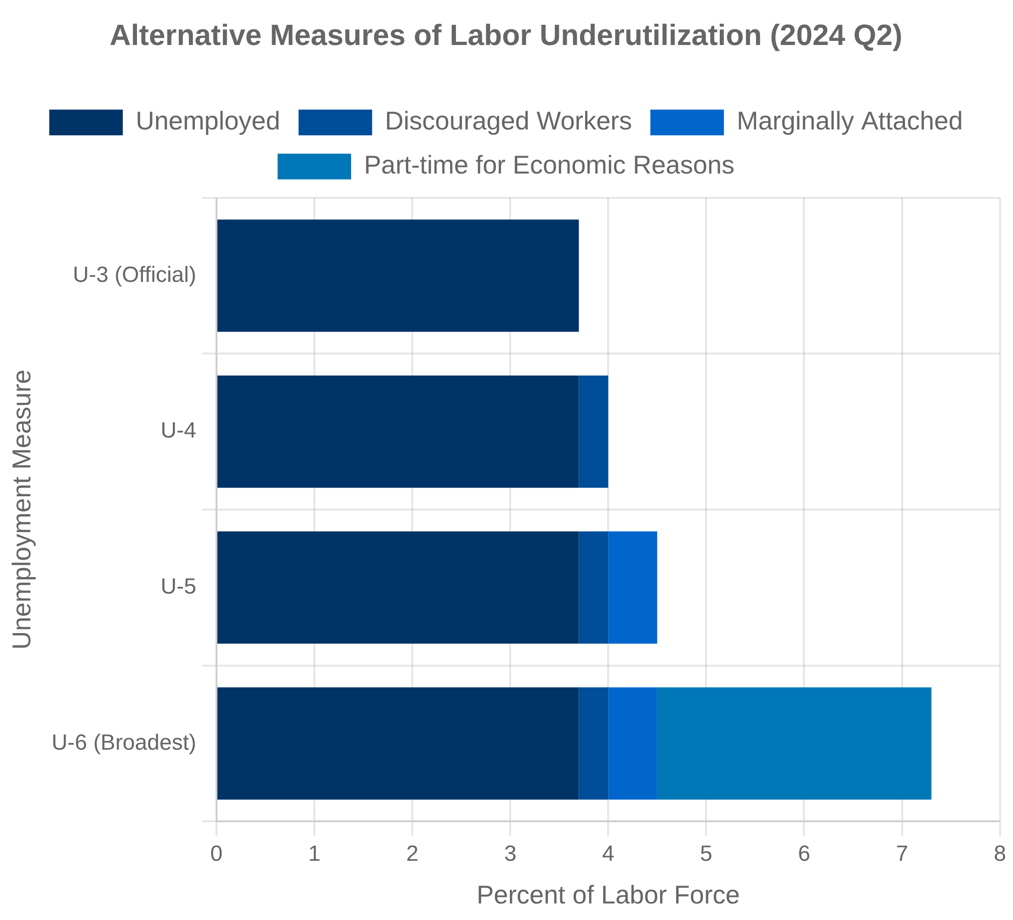

Employment and Unemployment Measurement
Current Population Survey (CPS)
The Current Population Survey is a monthly household survey conducted by the Census Bureau for the Bureau of Labor Statistics (BLS) that serves as the primary source of labor force statistics in the United States.
Monthly sample of approximately 60,000 households
Reference period is the week containing the 12th day of the month
Labor Force Concepts
The BLS uses specific definitions to classify the working-age population into mutually exclusive categories for statistical purposes.
Employed: worked at least 1 hour for pay or profit during reference week
Unemployed: not employed, available for work, and actively seeking work
Not in labor force: neither employed nor unemployed
Measurement Challenges
The changing nature of work creates significant challenges for traditional employment statistics.
Gig economy and platform work often not fully captured
Multiple jobholding and hybrid work arrangements difficult to measure
Alternative measures (U-1 through U-6) provide broader perspectives on labor underutilization

Slide 18

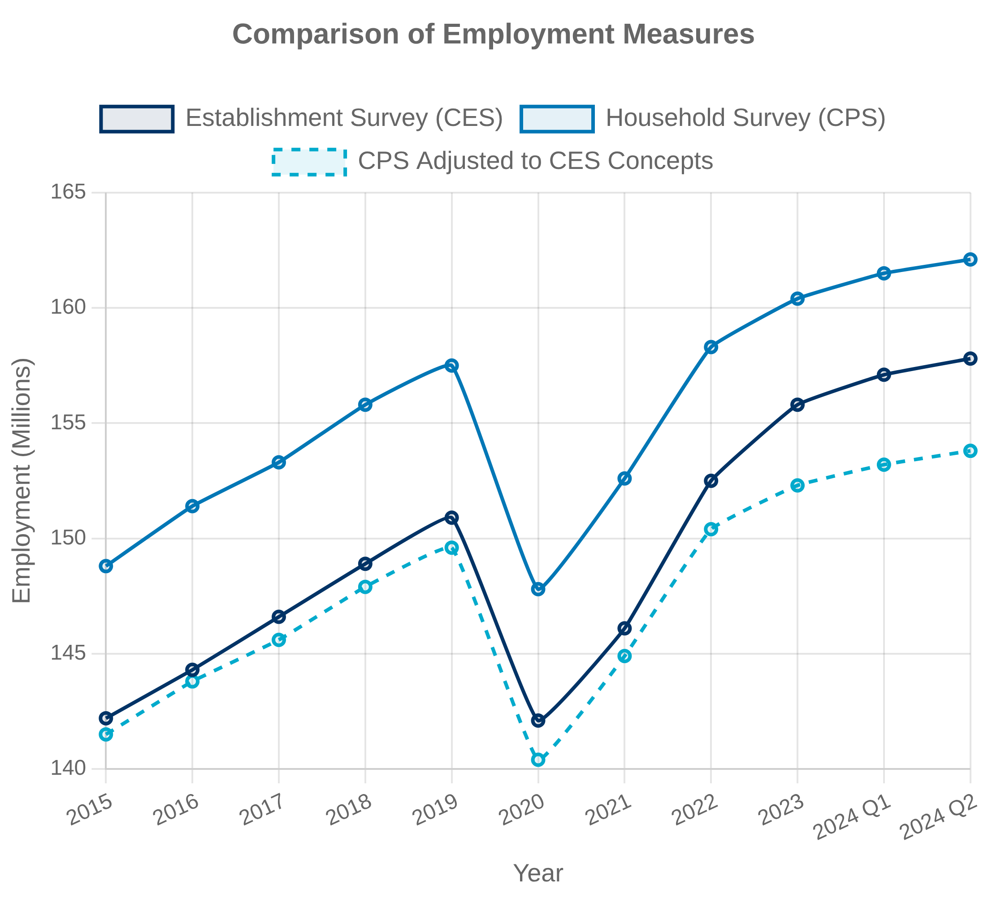


Establishment vs. Household Employment Data
Current Employment Statistics (CES)
The Current Employment Statistics survey, also known as the "establishment" or "payroll" survey, collects data from approximately 122,000 businesses and government agencies representing 666,000 worksites.
Counts jobs, not people (multiple jobholders counted multiple times)
Provides detailed industry data and earnings information
Current Population Survey (CPS)
The Current Population Survey, or "household survey," interviews approximately 60,000 households monthly to measure employment status of the population.
Counts employed people, regardless of how many jobs they hold
Includes self-employed, agricultural workers, and unpaid family workers
Reconciling the Differences
The Bureau of Labor Statistics regularly analyzes and explains differences between the two surveys, which can sometimes show divergent trends.
Adjustments for conceptual differences (coverage, multiple jobholding)
Sampling and non-sampling errors contribute to discrepancies
Both surveys provide valuable, complementary information
Feature
Establishment Survey (CES)
Household Survey (CPS)
Sample Size
122,000 businesses
60,000 households
Unit Counted
Jobs
People
Self-Employed
Excluded
Included
Agricultural Workers
Excluded
Included

Slide 19


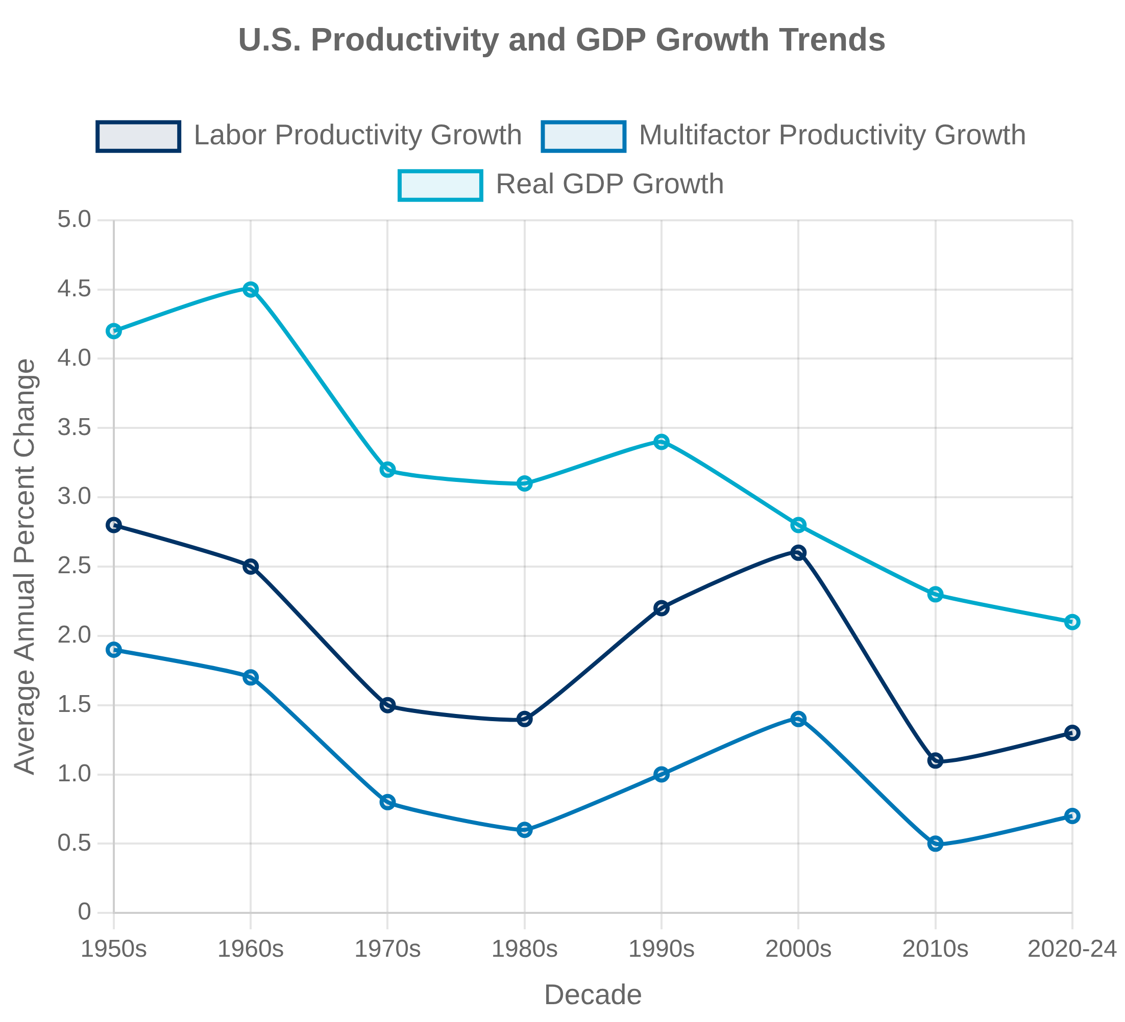


Productivity Measurement
Labor Productivity
Labor productivity measures the efficiency with which labor input is used to produce output, and is the most widely used and frequently updated productivity measure.
Labor Productivity = Output / Hours Worked
BLS publishes quarterly labor productivity for business, nonfarm business, manufacturing, and major industries
Output from BEA, hours worked from CES and CPS surveys
Multifactor Productivity (MFP)
Multifactor productivity measures the efficiency with which combined inputs (labor, capital, and intermediate purchases) are used to produce output.
MFP = Output / (Combined Inputs)
Captures technological change and efficiency improvements
Published annually with longer time lag than labor productivity
The Productivity Paradox
Despite rapid technological advancement, measured productivity growth has slowed in recent decades, creating a puzzle for economists and statisticians.
Measurement challenges: quality improvements, free digital services
Adoption lags: time required for new technologies to affect productivity
Distributional effects: productivity gains concentrated in specific sectors

Slide 20


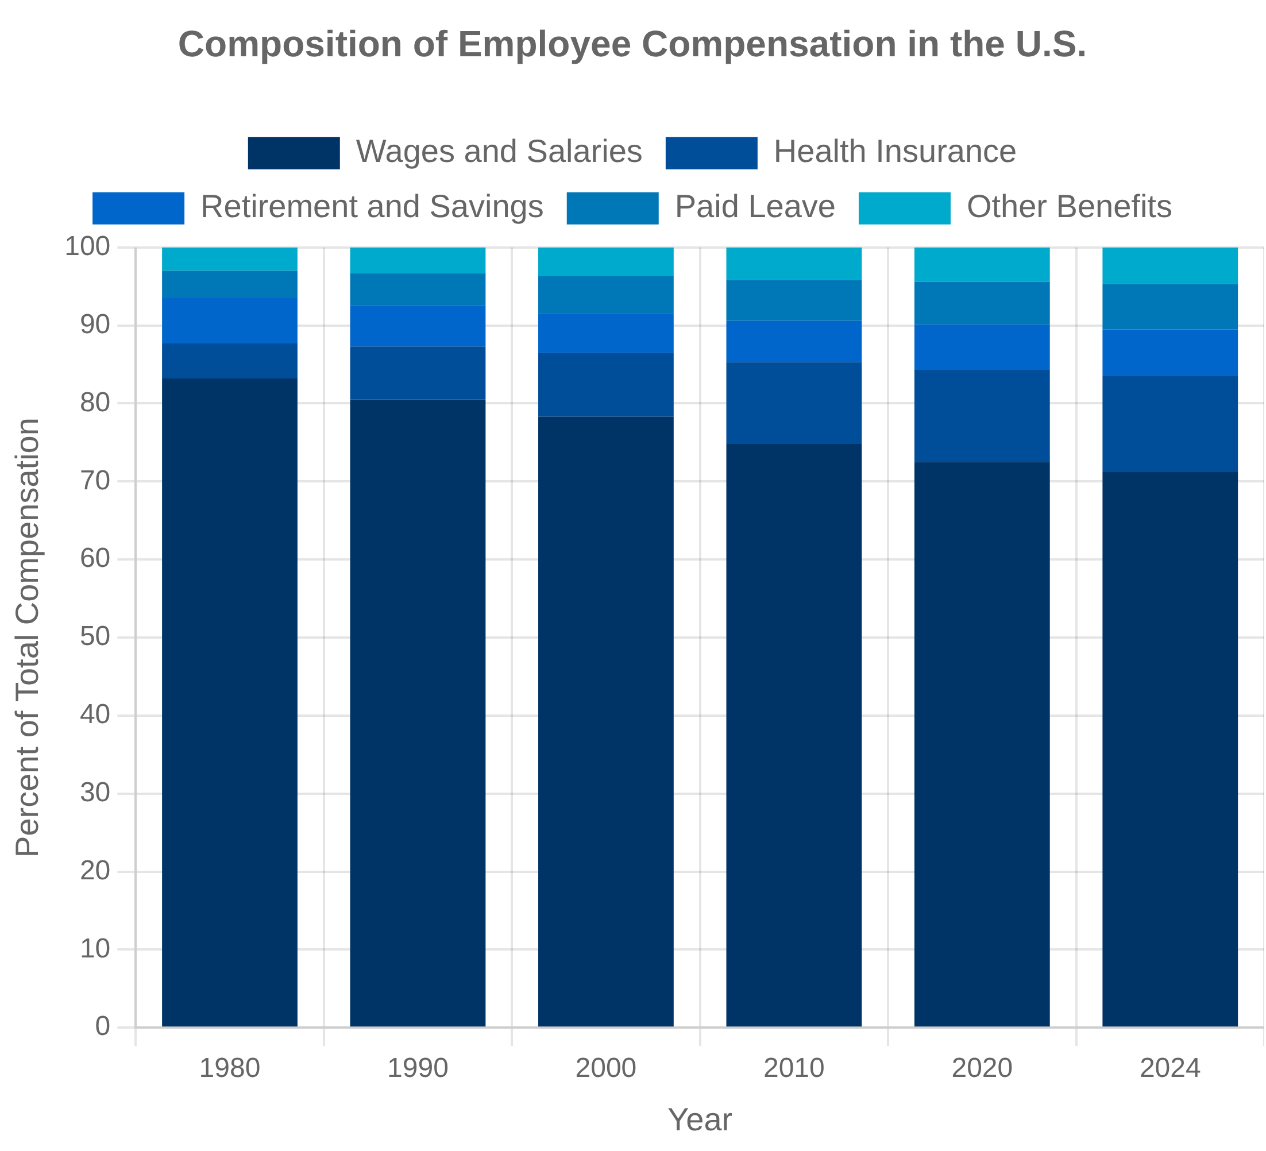


Compensation and Benefits
Employment Cost Index (ECI)
The Employment Cost Index is a quarterly measure of changes in labor costs produced by the Bureau of Labor Statistics (BLS), widely used for economic analysis and policy decisions.
Measures changes in both wages and benefits for civilian workers
Controls for employment shifts among occupations and industries
Federal Reserve closely monitors ECI for inflation signals
Non-Wage Benefits Measurement
Non-wage benefits represent an increasing share of total compensation, creating both conceptual and practical measurement challenges.
Health insurance: employer costs vs. employee value
Retirement benefits: defined benefit vs. defined contribution plans
Paid leave: increasing variety of leave types and policies
Regional Wage Differentials
The BLS produces detailed geographic data on wages and compensation through several programs, revealing significant regional variations.
Occupational Employment and Wage Statistics (OEWS) program
National Compensation Survey (NCS) for benefits coverage
Regional Price Parities (RPPs) help adjust for cost-of-living differences

Slide 21

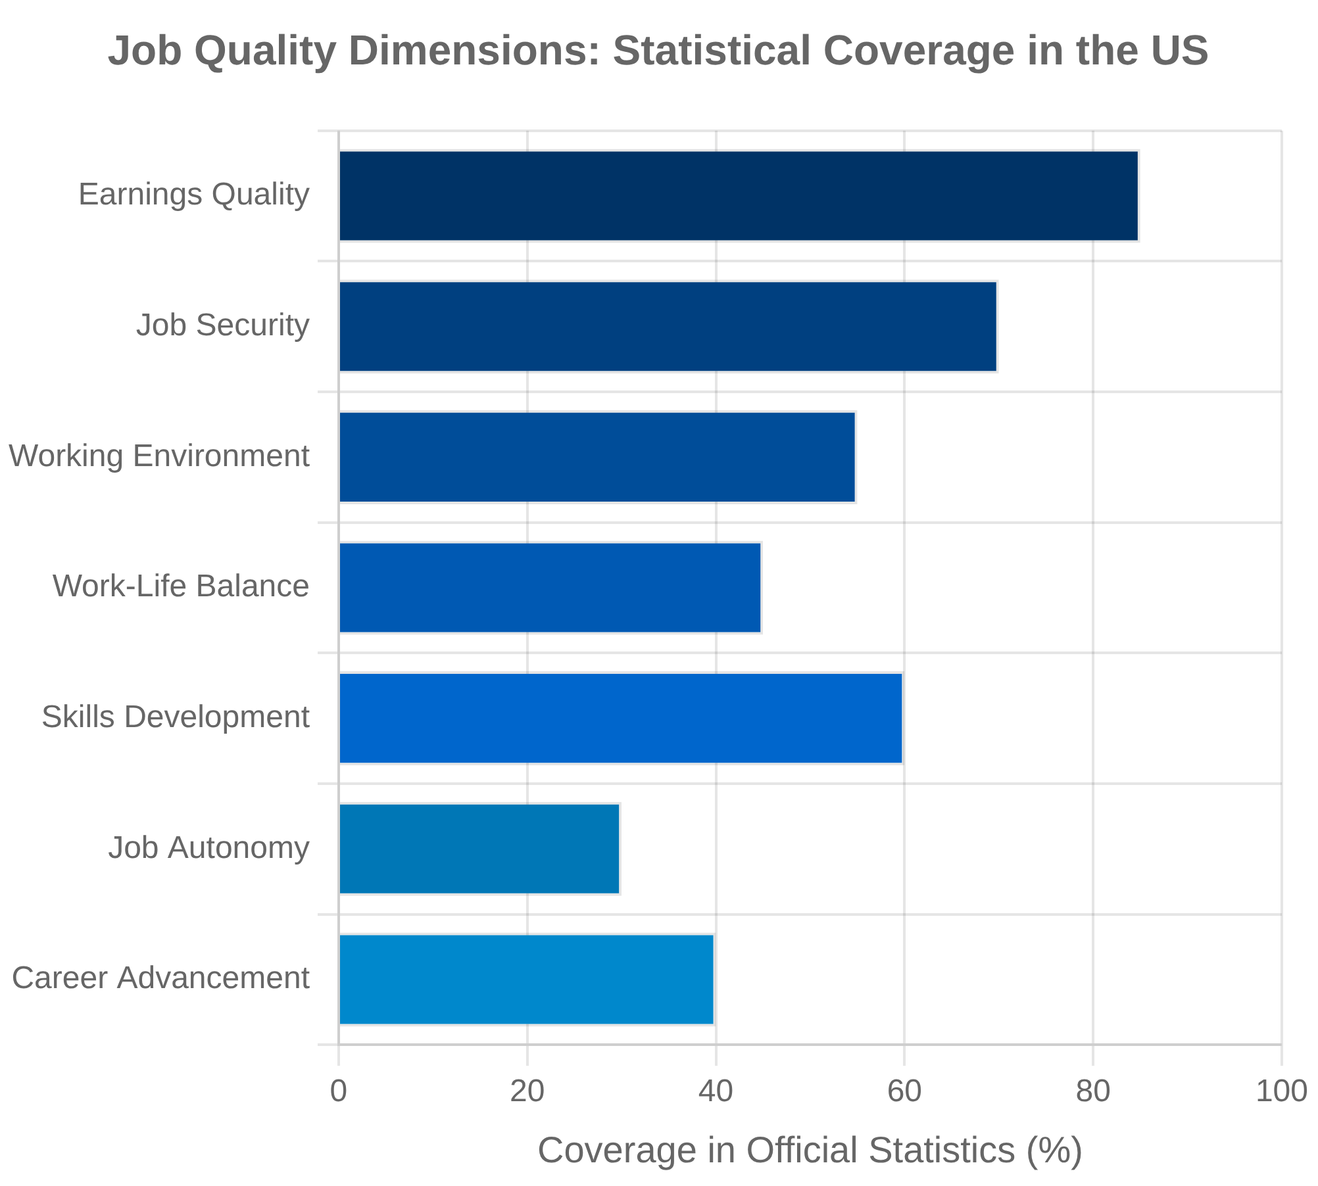


Job Quality and Working Conditions
Beyond Employment Counts
Traditional labor statistics focus on employment counts and wage levels, but comprehensive measurement requires examining job quality dimensions including benefits, security, working conditions, and career advancement opportunities.
Work-Life Balance Measurement
Time use surveys capture working hours, commuting time, and work-life balance. The American Time Use Survey (ATUS) provides data on how Americans allocate their time across various activities, including paid work, unpaid household labor, and leisure.
Skills and Human Capital
Measuring workforce skills, training, and educational attainment helps assess human capital development. The BLS Job Openings and Labor Turnover Survey (JOLTS) and O*NET database provide insights into skill requirements and job characteristics.
Measurement Challenges
Subjective aspects of job quality (satisfaction, meaning, autonomy) are difficult to standardize. Integrating objective and subjective measures remains a statistical challenge, with ongoing research to develop comprehensive job quality indices.

Slide 22

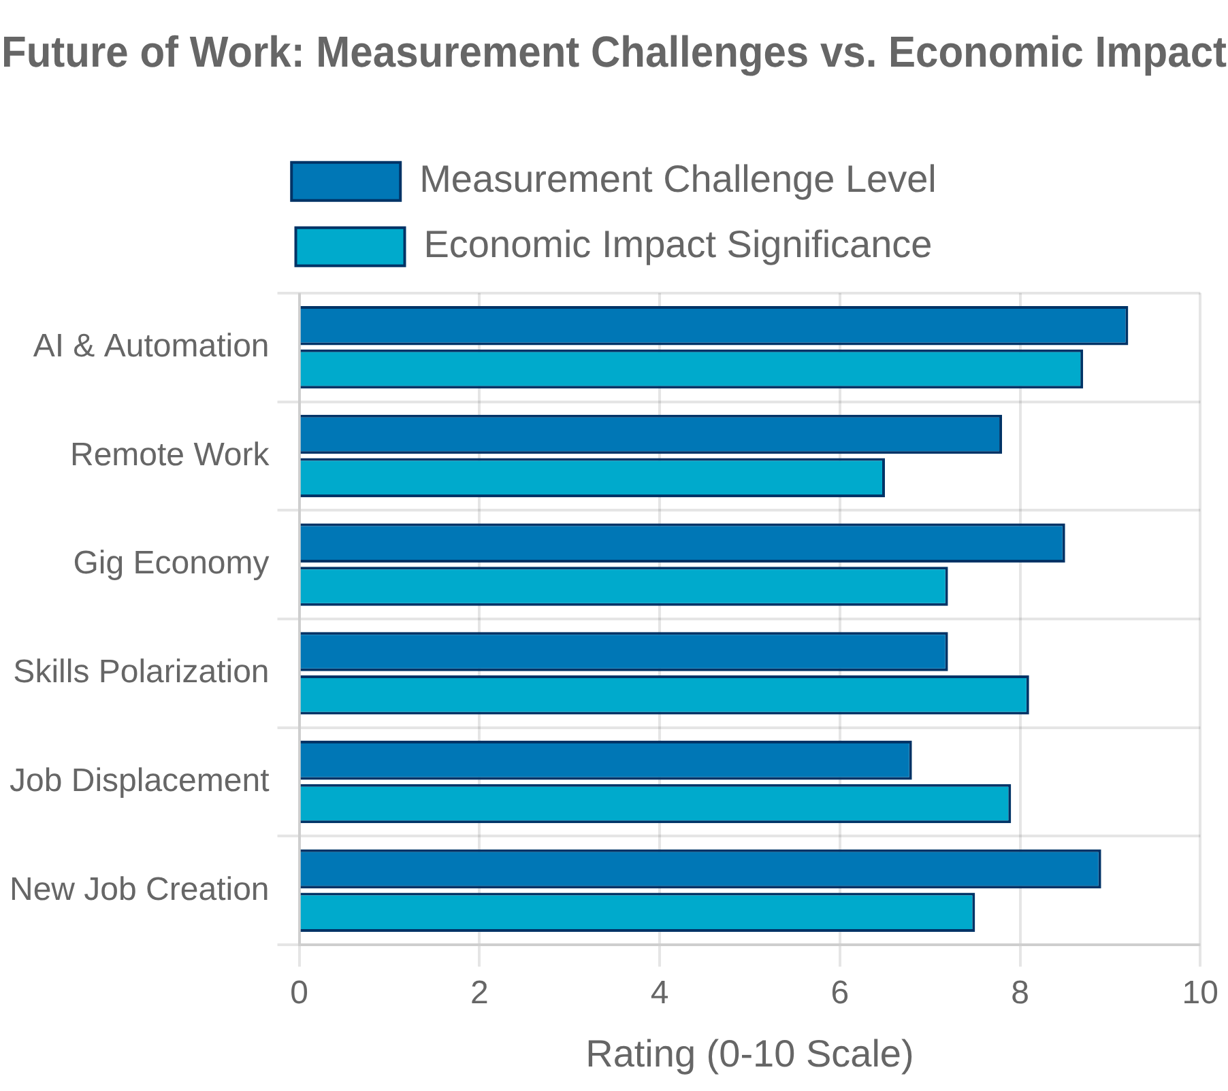


Future of Work and Statistical Challenges
Artificial Intelligence and Automation Impacts
Measuring job displacement, transformation, and creation from AI and automation. Tracking skill shifts and occupational changes as technology reshapes labor markets. Developing new metrics for human-machine collaboration.
Remote Work and Geographic Measurement
Capturing the rise of remote and hybrid work arrangements. Addressing geographic attribution challenges when work location differs from employer location. Measuring productivity impacts of distributed work models.
Gig Economy and Non-Standard Employment
Developing frameworks to measure platform-mediated work and independent contracting. Addressing classification challenges between employees and contractors. Capturing income volatility and work arrangements in household surveys.
Skills Measurement and Human Capital
Creating more granular metrics for skills acquisition and obsolescence. Measuring informal learning and non-degree credentials. Tracking the economic returns to different types of skills and training.

Slide 23


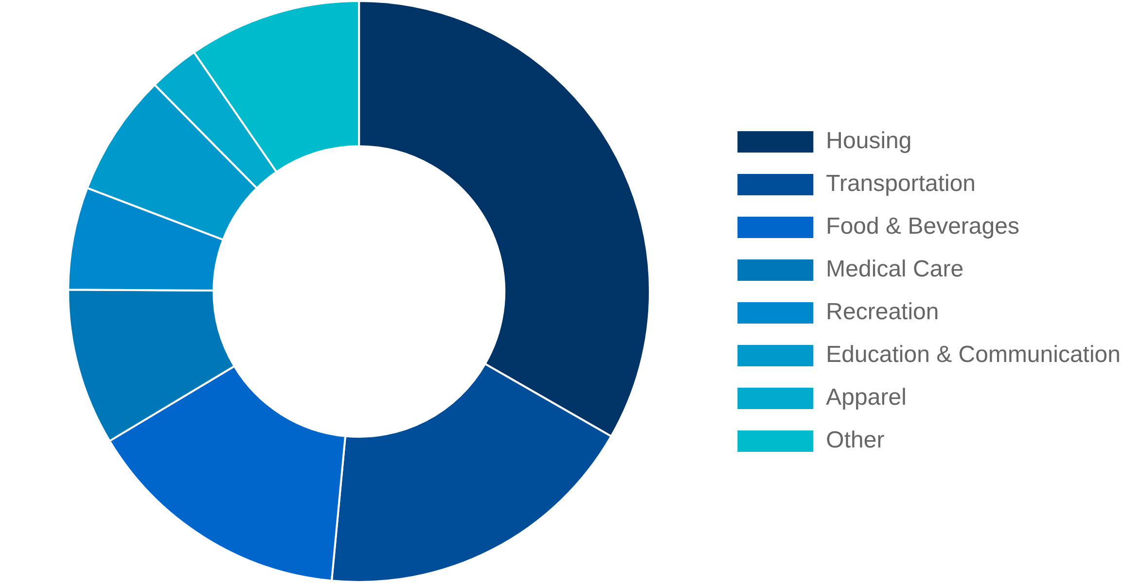


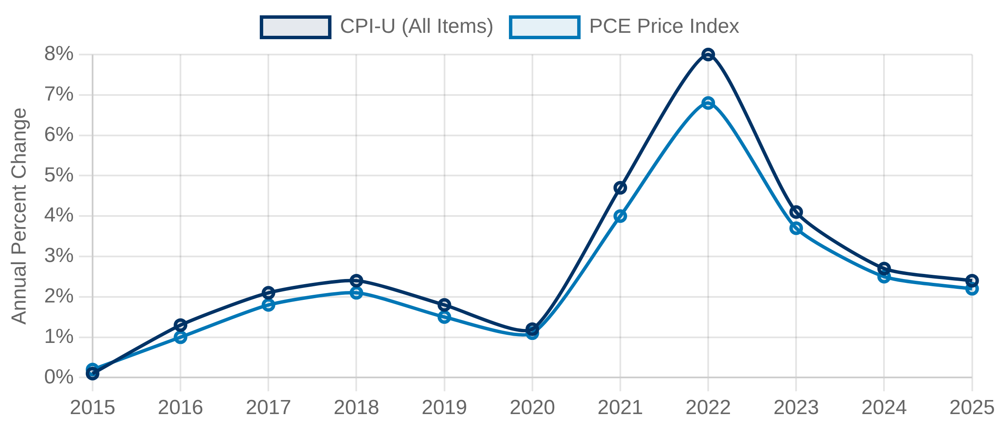
Consumer Price Index (CPI)
CPI Methodology
CPI Basket Composition (2023)
The Consumer Price Index measures the average change over time in the prices paid by urban consumers for a market basket of consumer goods and services.
Based on a fixed basket of goods and services updated every two years
Uses geometric means at the elementary level to account for consumer substitution
Weights derived from Consumer Expenditure Surveys
Measurement Challenges
Substitution bias:
Consumers shift purchases when relative prices
change
Quality change:
Adjusting for improvements in product characteristics
New products:
Incorporating emerging goods and services
CPI vs. PCE Inflation (2015-2025)
Urban vs. rural:
CPI-U covers only urban consumers (87% of population)

Slide 24


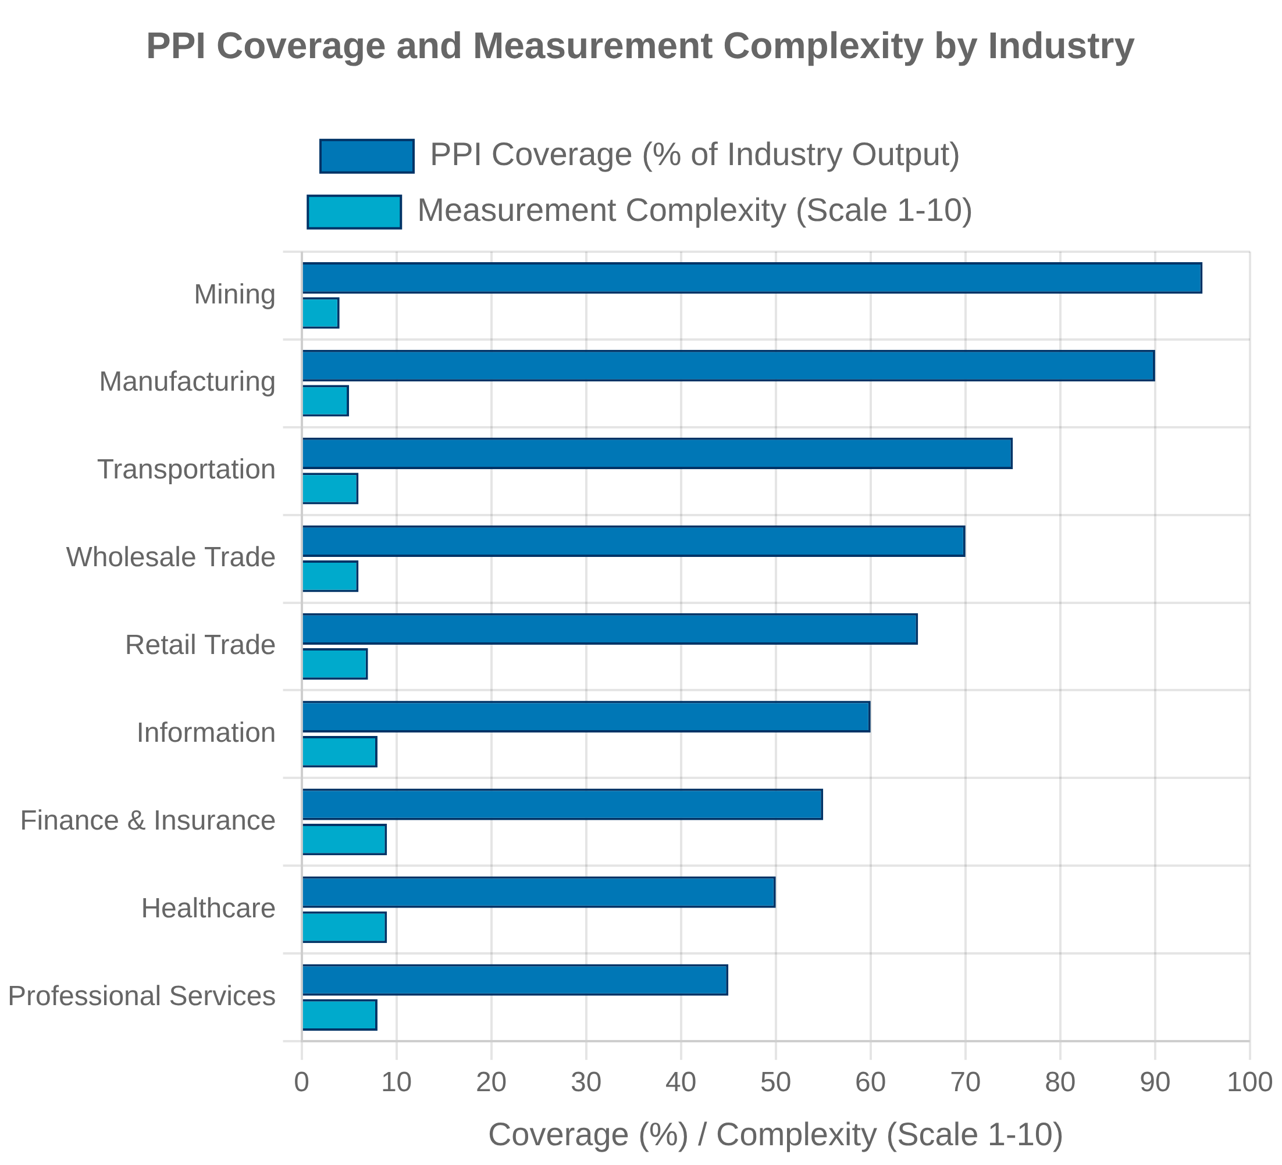


Producer Price Index (PPI)
PPI Structure and Coverage
The Producer Price Index (PPI) measures average changes in selling prices received by domestic producers for their output. The PPI program at the Bureau of Labor Statistics maintains several major classification structures:
Industry-based PPIs: Measure price changes for the entire output of an industry
Commodity-based PPIs: Organize products by similarity of end use or material composition
Final Demand-Intermediate Demand (FD-ID): Tracks price changes for goods, services, and construction sold to final demand and intermediate demand
Input vs. Output Price Measures
The PPI system includes both input and output price indices:
Output PPIs: Measure changes in prices received by producers
Input PPIs: Measure changes in prices paid by producers for inputs
Services Price Measurement Challenges
Measuring service sector prices presents unique challenges:
Difficulty defining and tracking consistent service units over time
Quality adjustment for complex services like healthcare and financial services

Slide 25

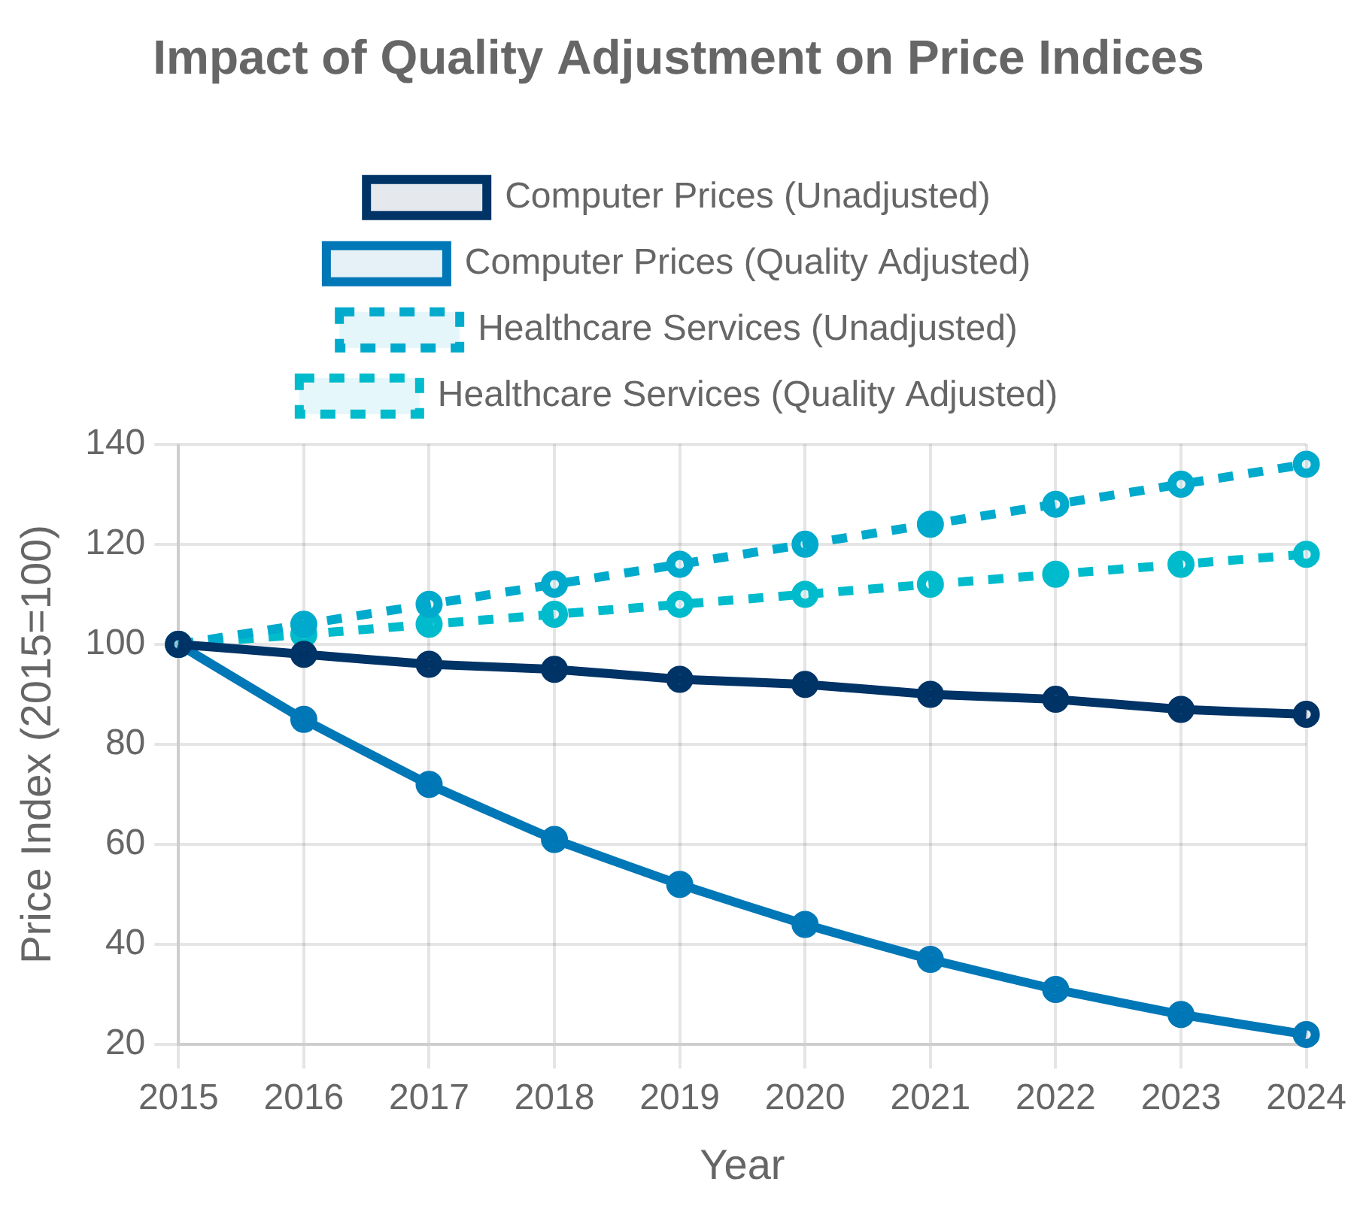

Quality Adjustments and Hedonic Methods
Hedonic Pricing for Technology
Hedonic methods decompose products into their constituent characteristics to estimate the implicit prices of these characteristics. Particularly important for computers, smartphones, and other rapidly evolving technology products.
Quality Change in Services
Services like healthcare and education present unique challenges for quality adjustment. Outcomes-based approaches attempt to measure improvements in health outcomes or educational attainment rather than just inputs.
Methodological Approaches
Matched Model Method:
Compares identical items over time, but misses quality
changes when models are replaced.
Hedonic Quality Adjustment:
Uses regression analysis to estimate the value of
specific product characteristics.
Option Cost Method:
Values quality changes based on the cost of optional
features that become standard.
Production Cost Method:
Values quality changes based on the cost to producers
of implementing improvements.

Slide 26

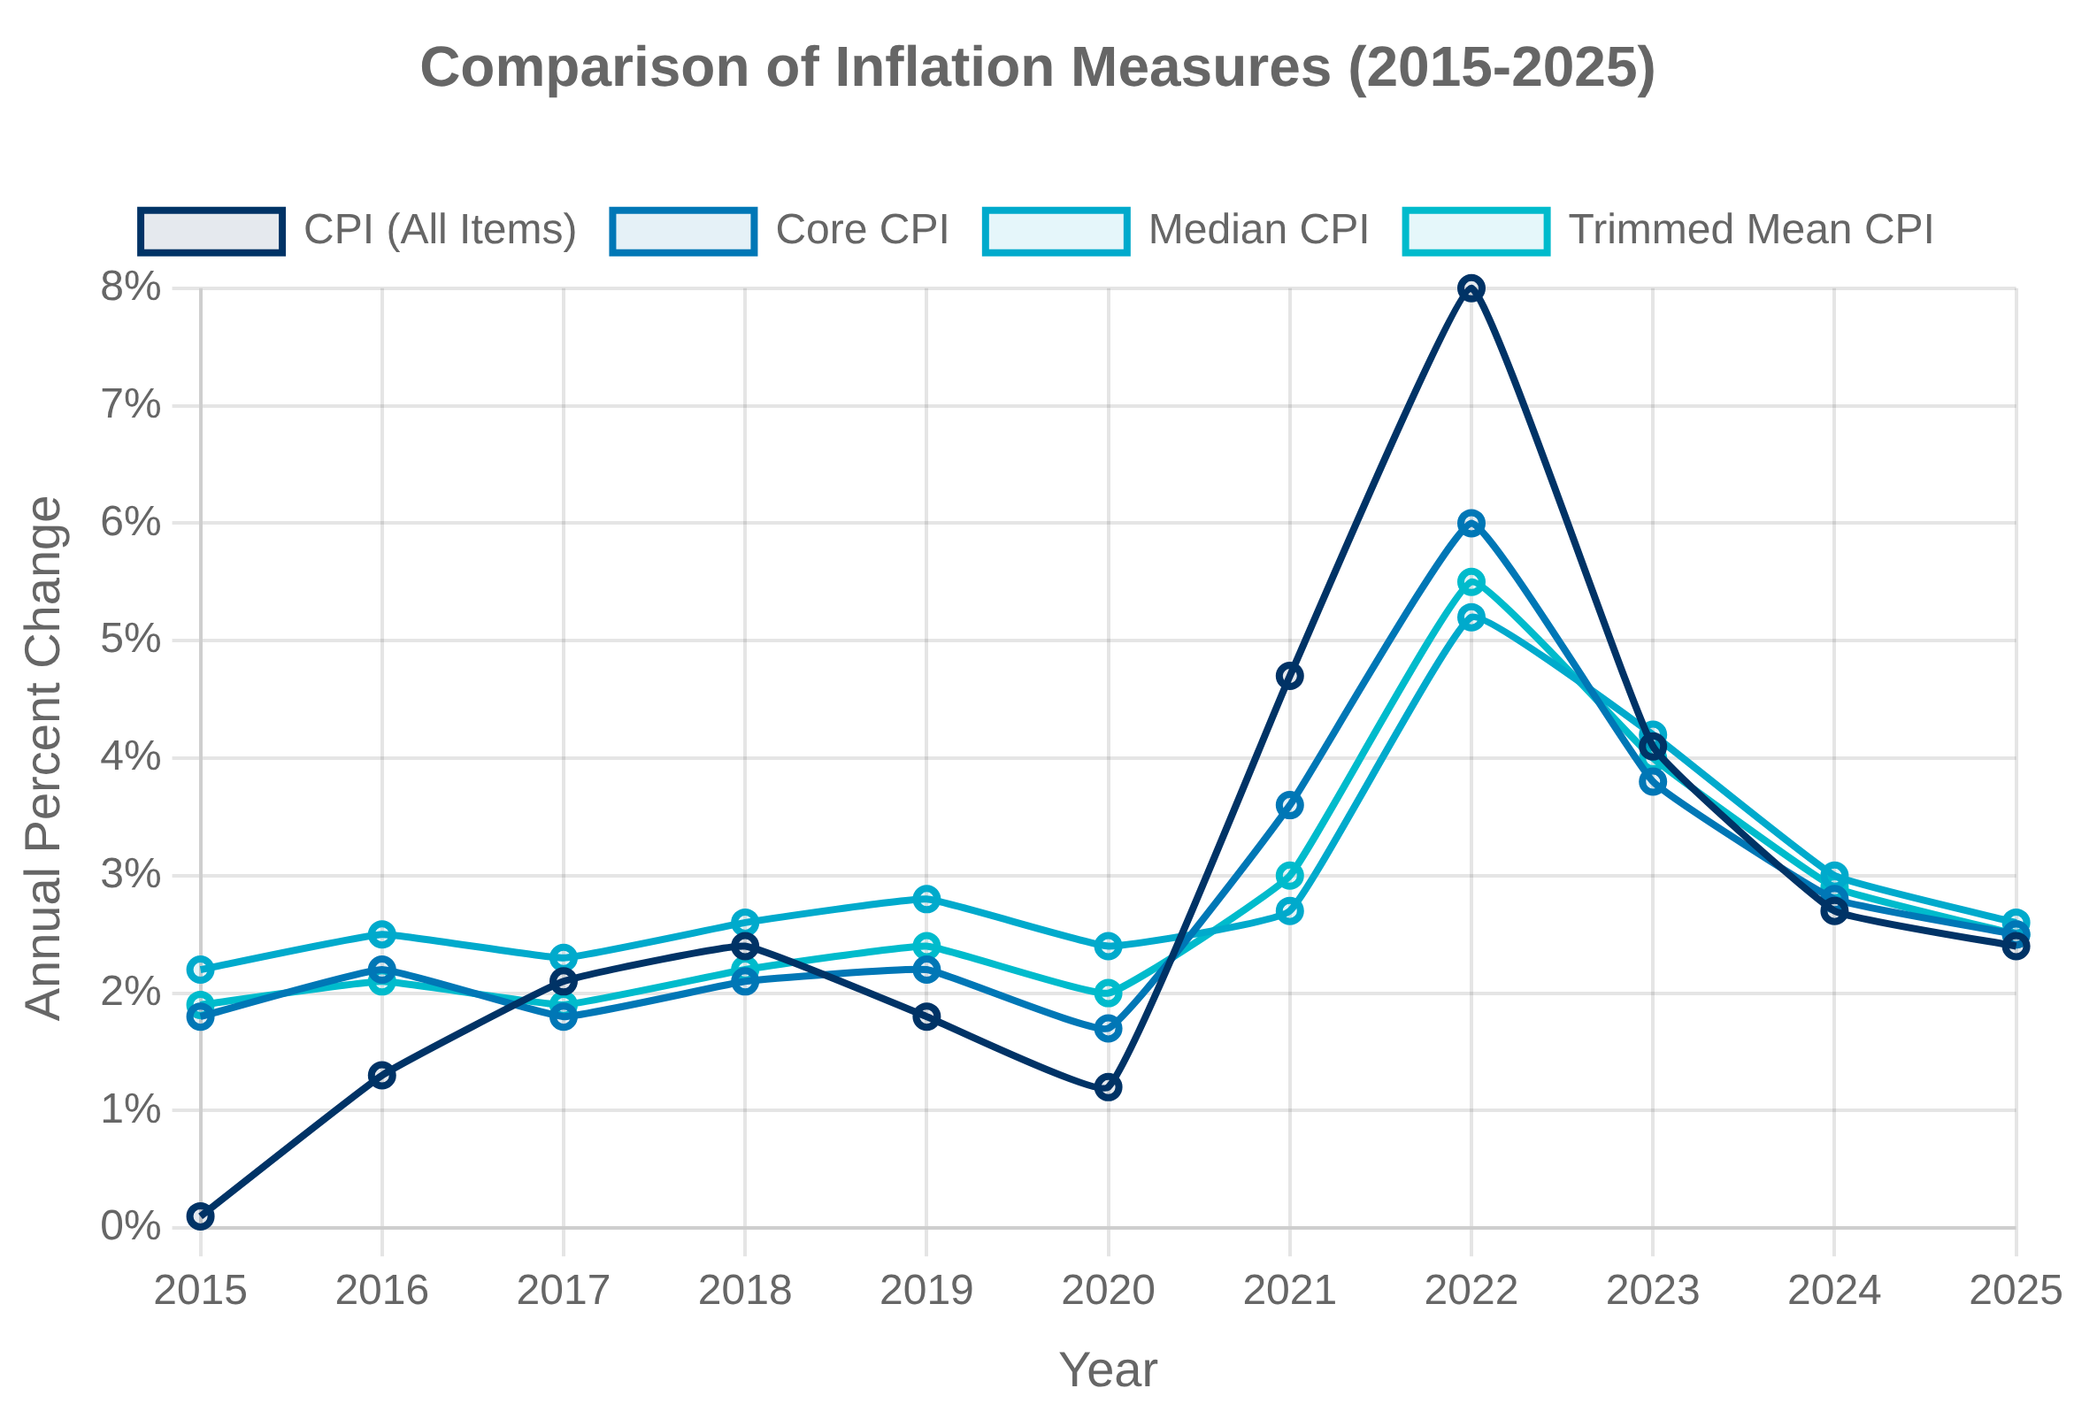

Core Inflation and Alternative Measures
Core Inflation Measures
Core inflation measures aim to capture the underlying trend in inflation by excluding volatile components that may obscure the signal about longer-term price pressures.
Core CPI:
Excludes food and energy prices due to their volatility. Used
by the Federal Reserve to guide monetary policy decisions.
Core PCE:
Personal Consumption Expenditures price index excluding
food and energy. The Federal Reserve's preferred inflation measure for
its 2% target.
Statistical Alternatives
Trimmed Mean:
Removes a percentage of items with the largest and
smallest price changes each month. The Cleveland Fed calculates a 16%
trimmed mean CPI.
Median CPI:
Reports the median price change (50th percentile) across
CPI components. Less affected by outliers than traditional core
measures.
Market-Based Expectations
Financial markets provide forward-looking measures of inflation expectations, including Treasury Inflation-Protected Securities (TIPS) breakeven rates and inflation swap rates.

Slide 27


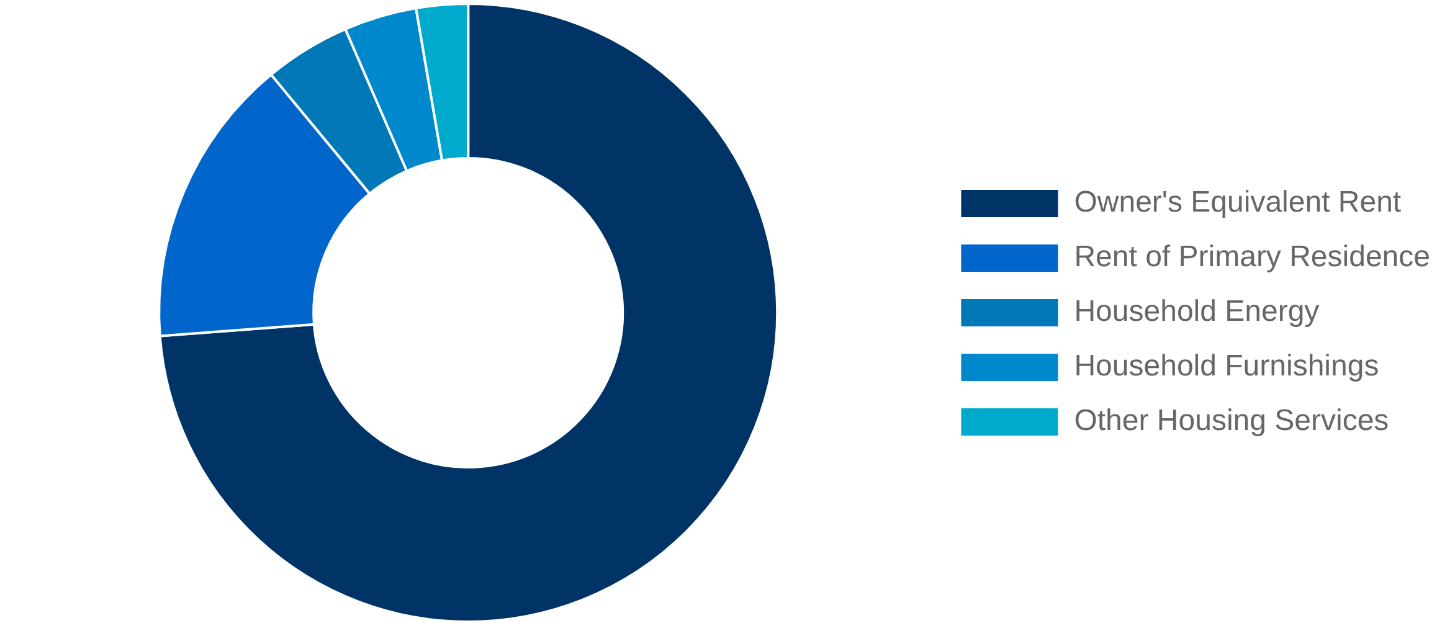

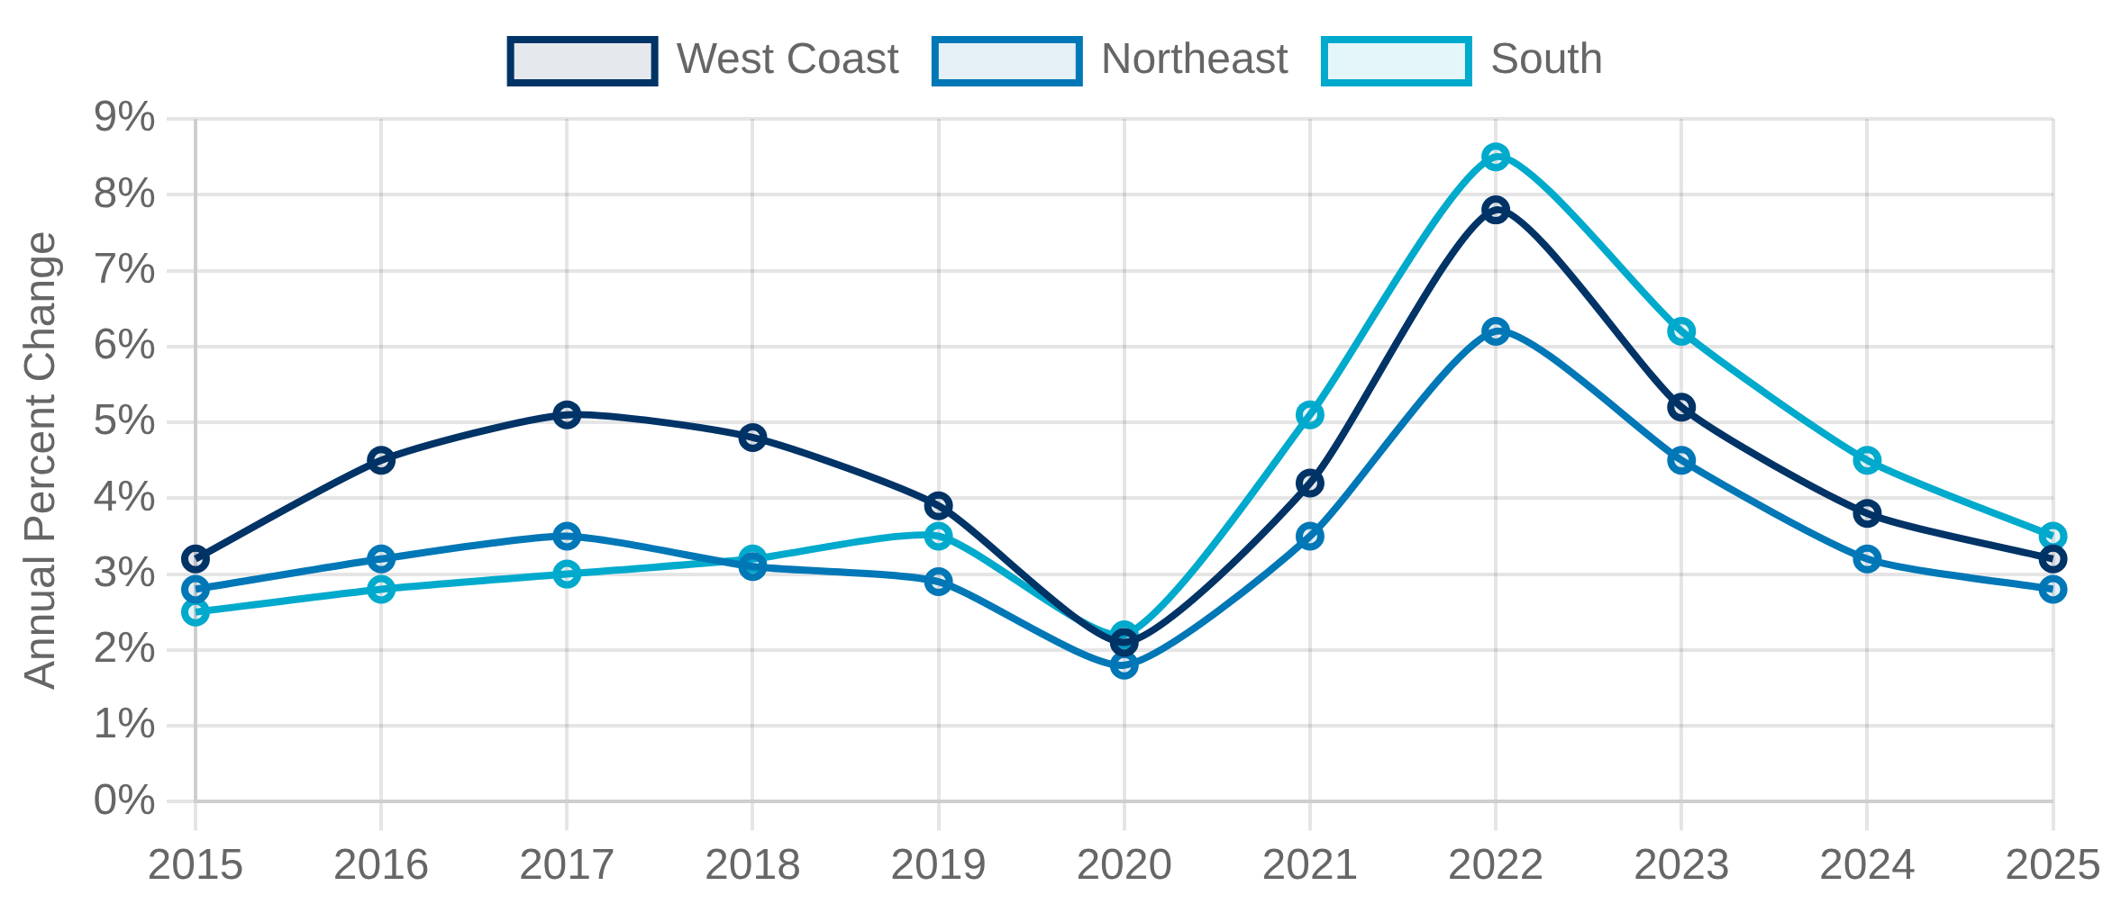


Housing Costs and Shelter Inflation
Owner's Equivalent Rent Methodology
Housing Components in CPI (2023)
The Bureau of Labor Statistics uses Owner's Equivalent Rent (OER) to measure the implicit cost of owner-occupied housing, representing about 24% of the Consumer Price Index.
Based on survey responses from homeowners about how much they would pay to rent their home
Excludes investment aspects of homeownership (property appreciation, mortgage interest, taxes, maintenance)
Regional Housing Price Variations
Housing costs vary dramatically across regions, creating challenges for national inflation measures and policy responses.
Regional Housing Cost Inflation (2015-2025)
Metropolitan areas experience different housing inflation rates, affecting local cost of living
Alternative Approaches
User Cost Method:
Measures total cost of homeownership including
mortgage interest, property taxes, maintenance, and opportunity costs
Acquisition Approach:
Focuses on purchase prices of homes, similar to
how other goods are measured in the CPI
Payments Approach:
Measures actual cash outlays by homeowners,
including mortgage payments

Slide 28
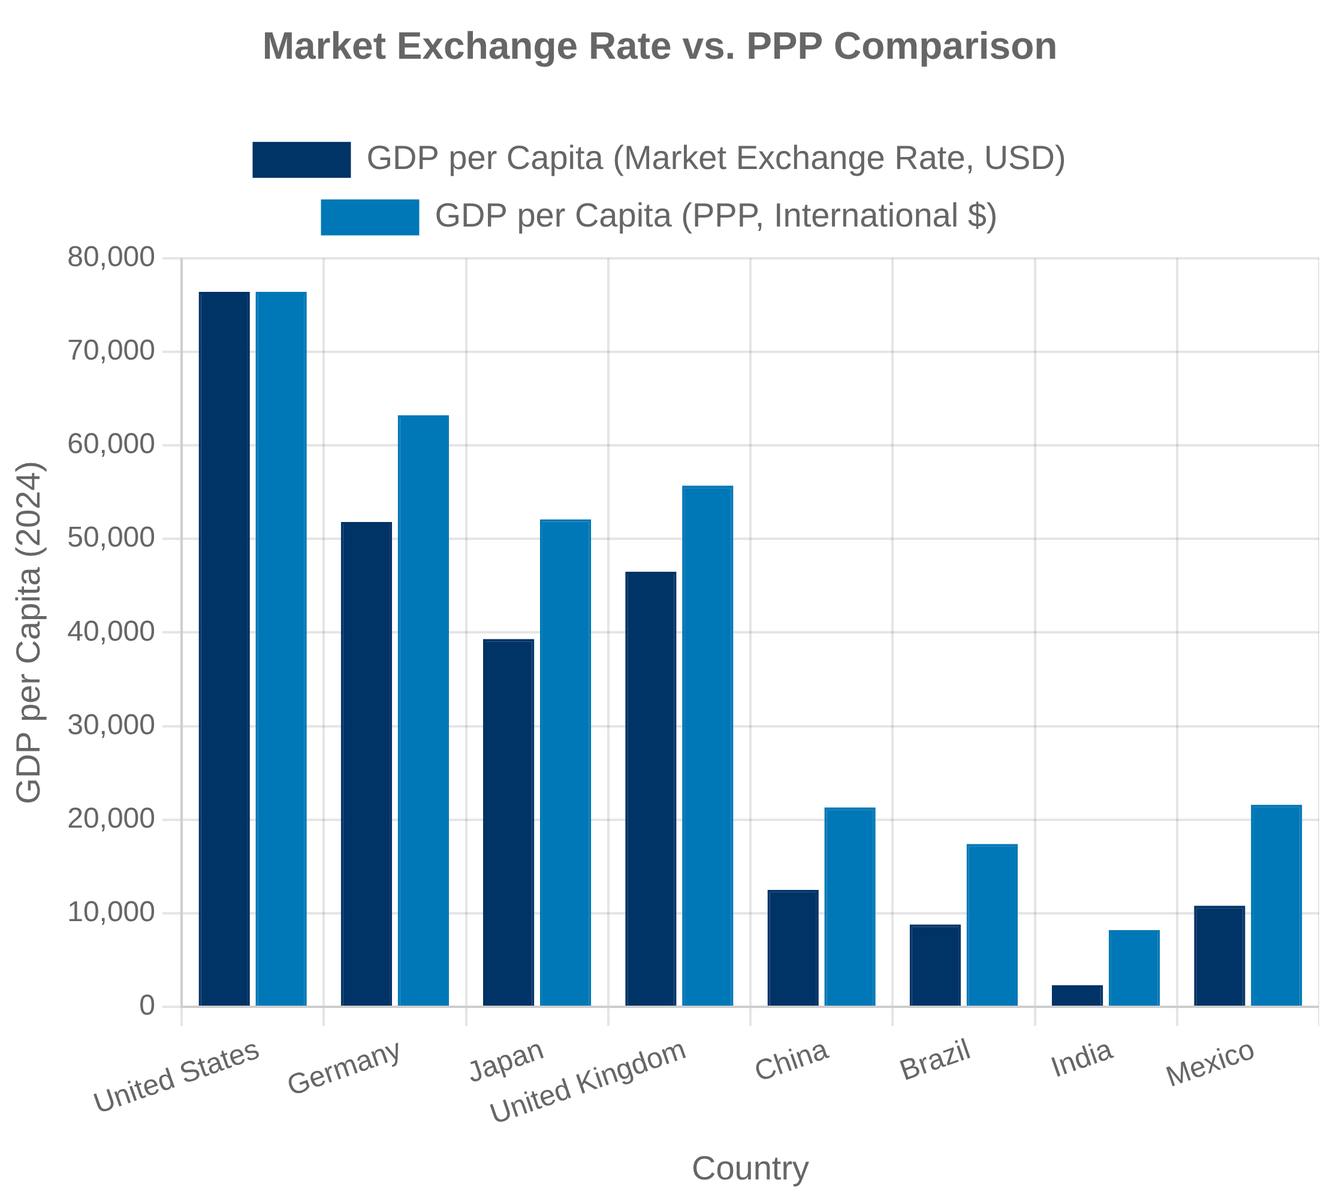


International Price Comparisons
Purchasing Power Parity (PPP)
Purchasing Power Parity (PPP) is a measurement technique used to determine the relative value of different currencies by comparing the prices of similar goods and services in different countries.
Enables more accurate international comparisons of living standards and economic output
Accounts for differences in price levels across countries
Penn World Table
The Penn World Table provides PPP-adjusted national accounts data for over 180 countries, allowing for meaningful cross-country comparisons of real GDP and its components.
Developed by the University of Pennsylvania and Groningen Growth and Development Centre
Exchange Rate vs. PPP-Based Measures
Market exchange rates often fail to reflect differences in purchasing power across countries, particularly for non-traded goods and services like housing, healthcare, and personal services.
PPP calculations require extensive price surveys and face methodological challenges in comparing quality across countries

Slide 29

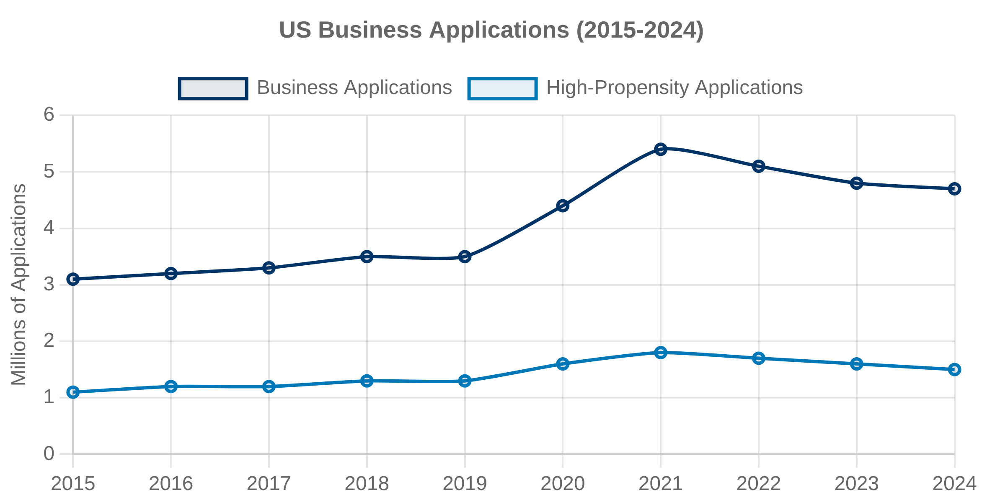

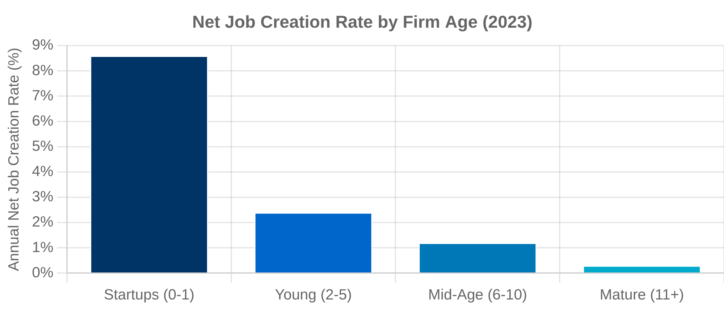
Business Dynamics and Entrepreneurship
Business Formation and Destruction
The Census Bureau's Business Dynamics Statistics (BDS) and Business Formation Statistics (BFS) track establishment births, deaths, and survival rates across the economy, providing critical insights into economic dynamism.
Business applications serve as a leading indicator of future business formations
High-propensity business applications are those with higher likelihood of turning into businesses with payroll
High-Growth Firms and Gazelles
High-growth firms, often called "gazelles," contribute disproportionately to job creation and economic growth. These firms are typically defined as enterprises with at least 10 employees and annualized growth greater than 20% over a three-year period.
Job Creation by Firm Age
Measuring high-growth firms requires longitudinal data linking establishments over time
Regional Business Dynamics
Business formation and growth rates vary significantly across regions, reflecting differences in industry composition, regulatory environments, access to capital, and workforce characteristics.
Metropolitan statistical areas (MSAs) show distinct patterns of entrepreneurial activity

Slide 30

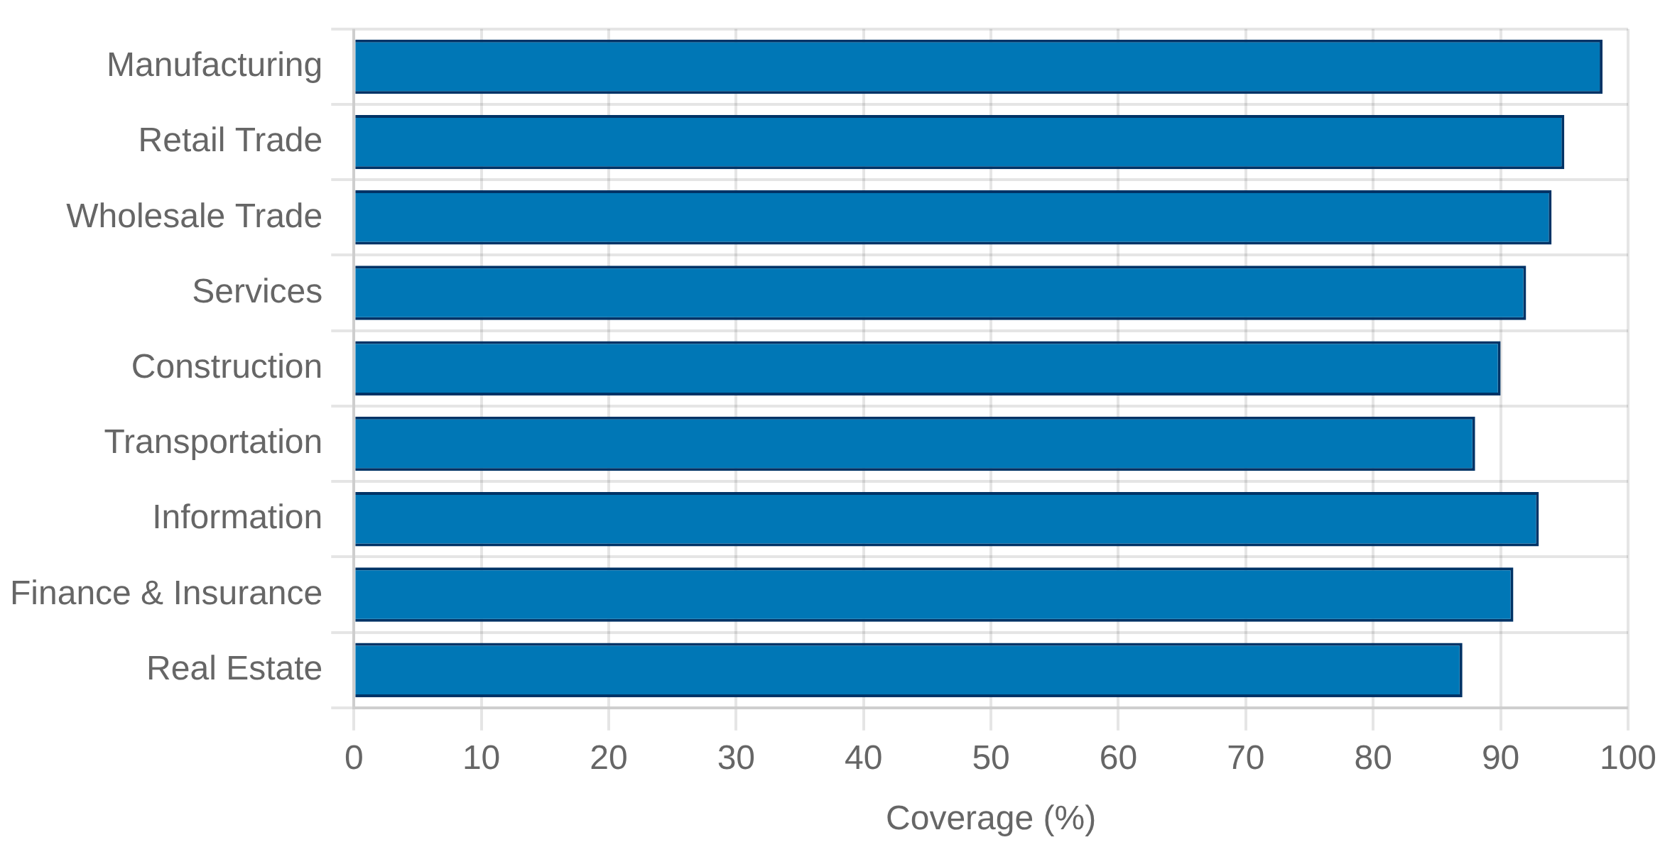

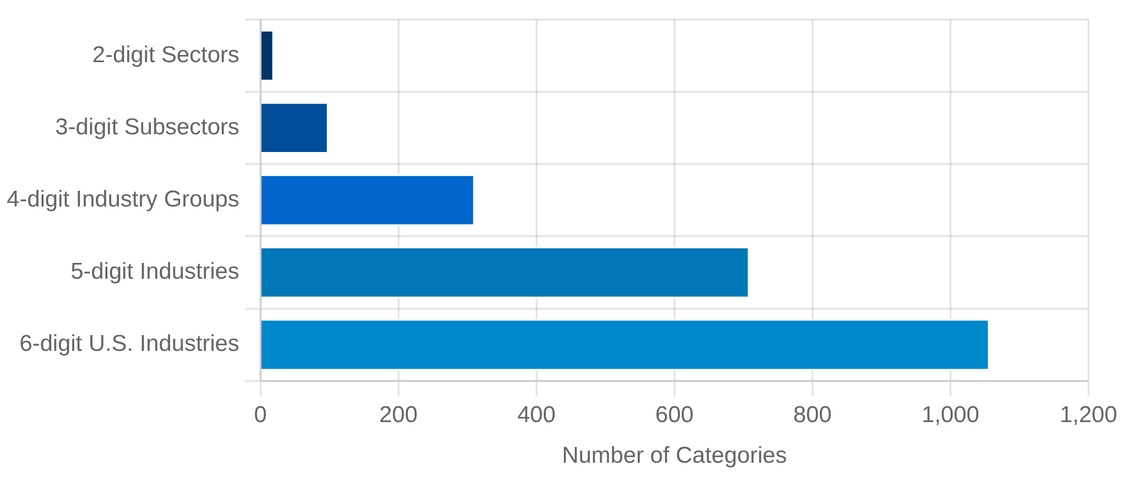

Industry Statistics and Economic Census
Economic Census Methodology
Economic Census Coverage by Sector (2022)
The Economic Census is conducted every five years (years ending in 2 and 7) and provides comprehensive data on business activity, organizational structure, and performance across the U.S. economy.
Covers nearly all industries and geographies, from national to local levels
Collects data on revenue, employment, payroll, and industry-specific metrics
Serves as benchmark for other economic statistics programs
Industry Classification Systems
The North American Industry Classification System (NAICS) is the standard used by federal statistical agencies for classifying business establishments.
Replaced the Standard Industrial Classification (SIC) system in 1997
NAICS Structure
Updated every 5 years to reflect economic changes (latest: NAICS 2022)
Establishment vs. Enterprise Statistics
Industry statistics are collected and reported at different organizational levels:
Establishment:
Single physical location where business is conducted
Enterprise:
Business organization consisting of one or more
establishments under common ownership or control

Slide 31

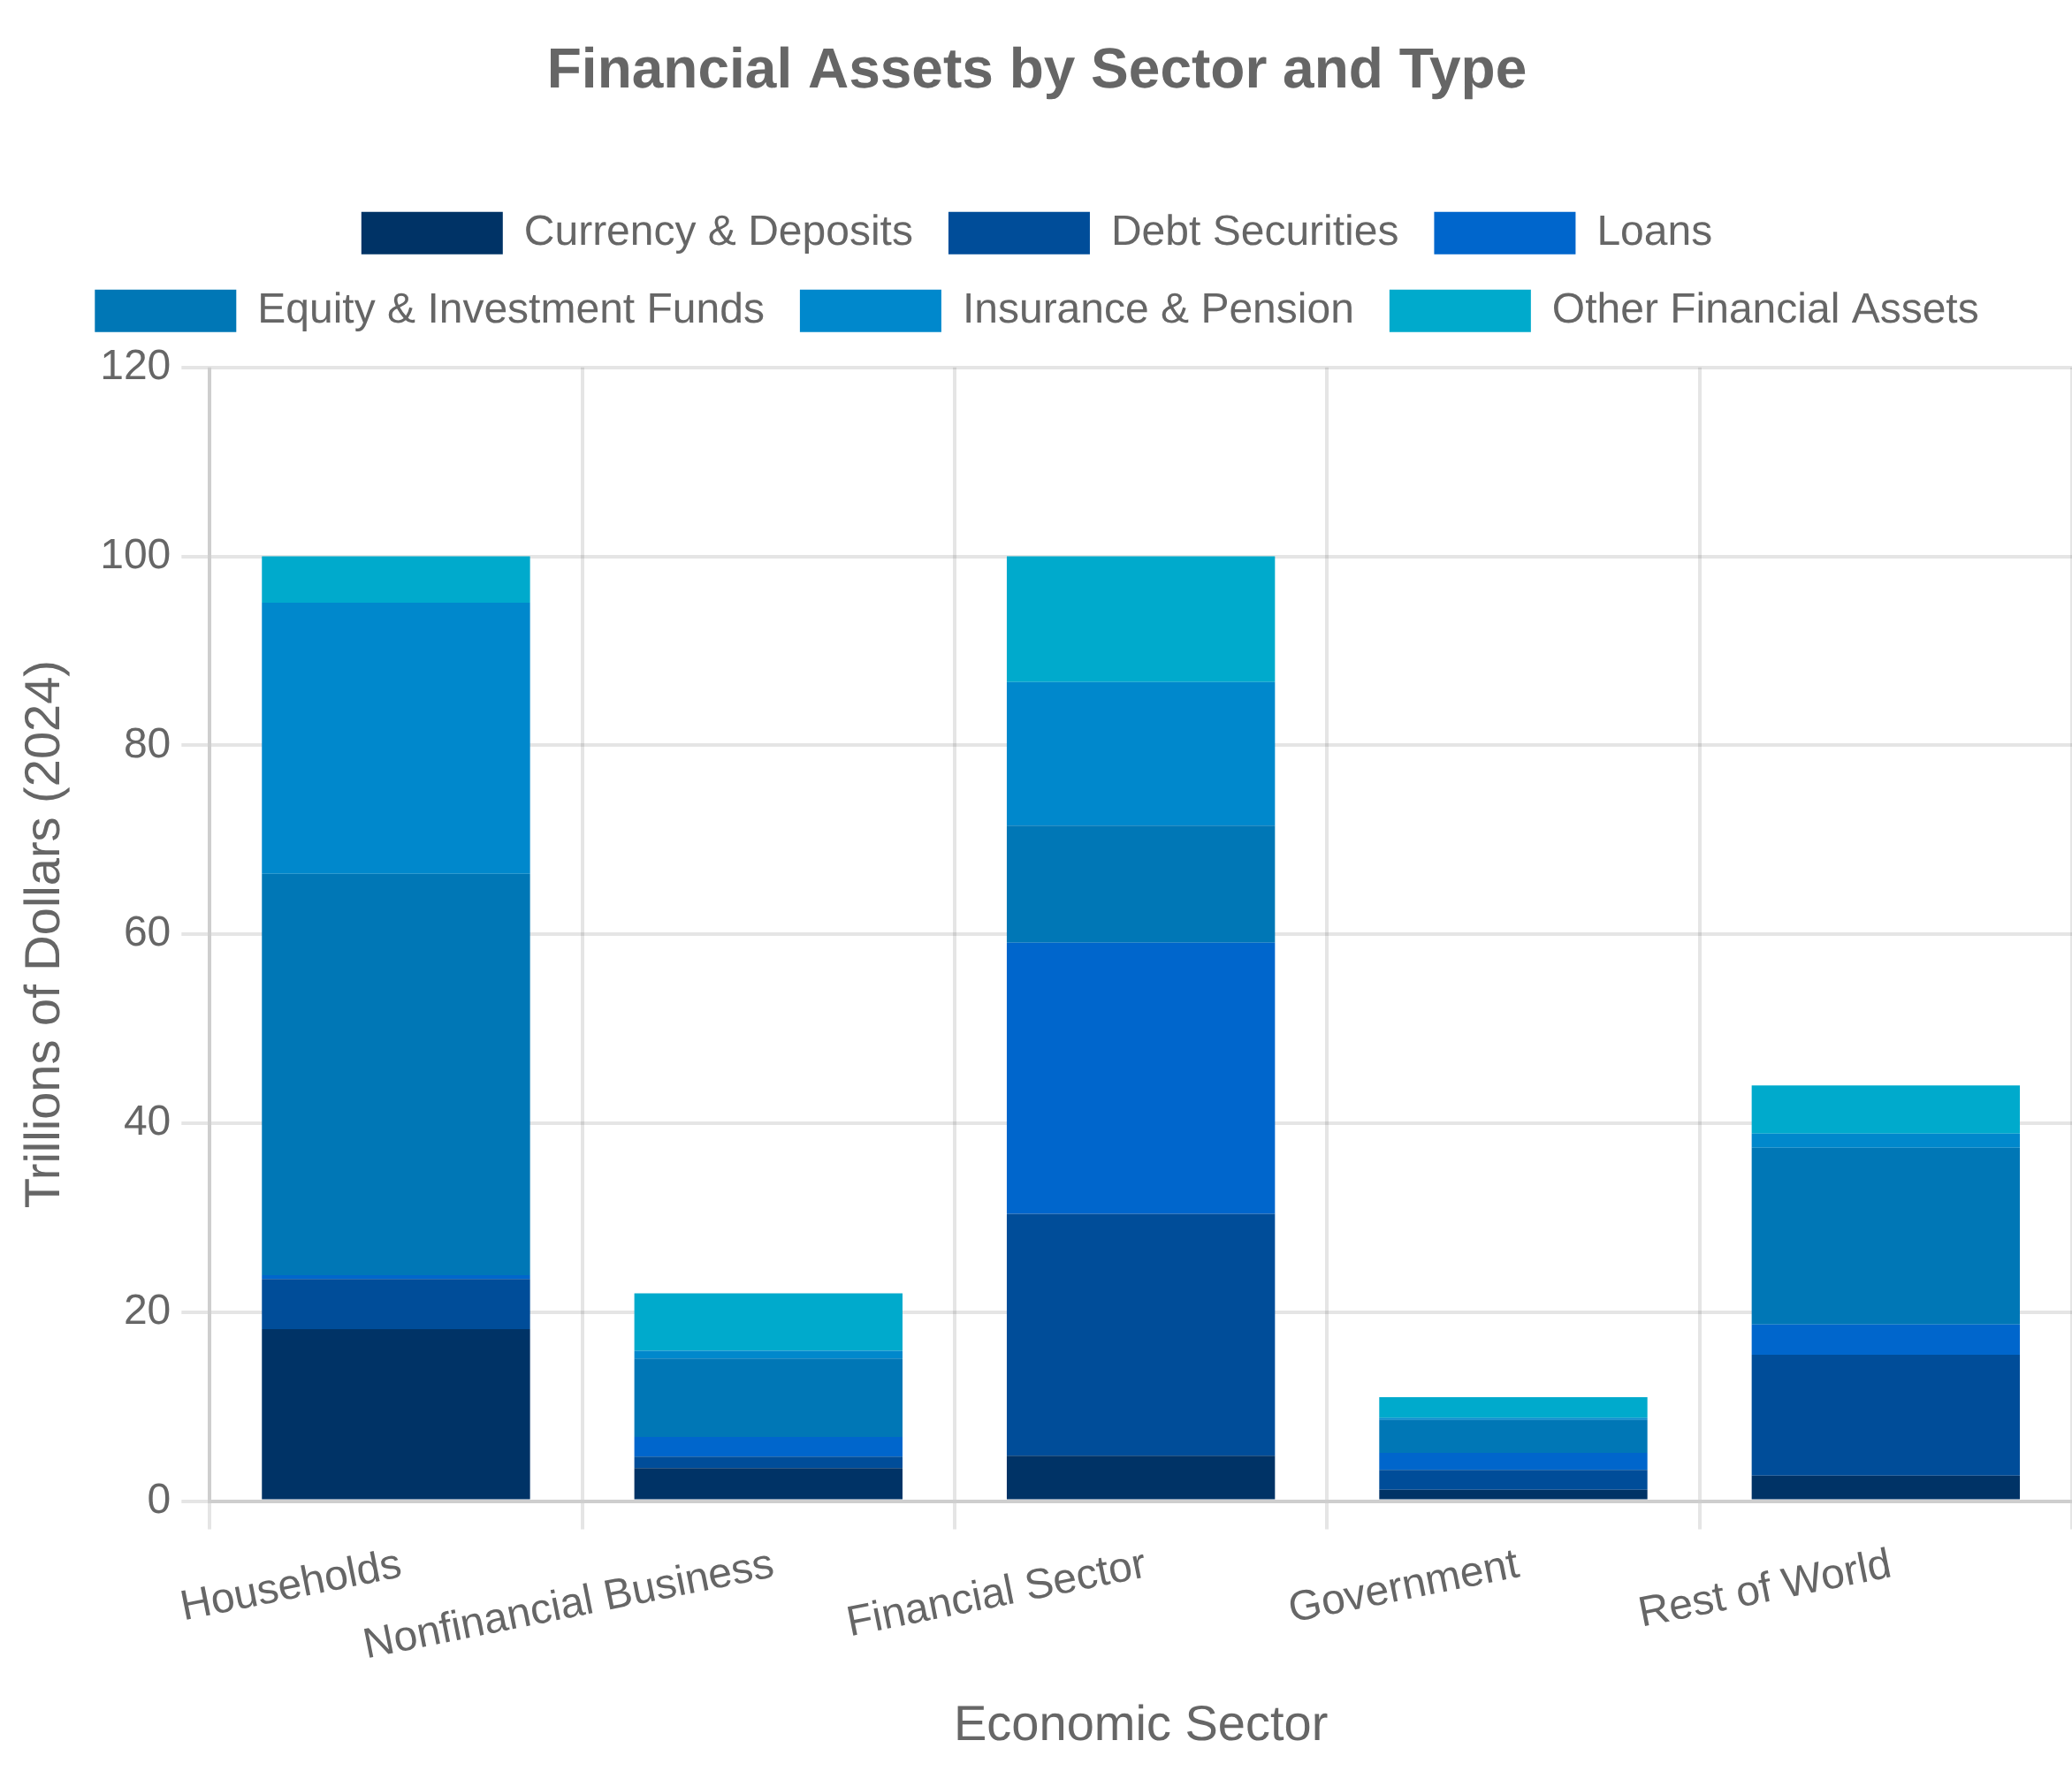


Financial Statistics and Flow of Funds
Federal Reserve's Financial Accounts
The Financial Accounts of the United States, formerly known as the Flow of Funds Accounts, provide a comprehensive framework for tracking the flow of funds through the U.S. economy and the resulting financial positions.
Quarterly data on assets, liabilities, and financial flows for major sectors
Covers households, businesses, governments, and financial institutions
Sectoral Balance Sheets
Sectoral balance sheets provide a comprehensive view of assets, liabilities, and net worth for each major sector of the economy, allowing analysis of financial positions and vulnerabilities.
Household balance sheets track housing wealth, financial assets, and debt
Corporate balance sheets show business investment, financing, and liquidity
Integration with National Accounts
The financial accounts are designed to be consistent with the National Income and Product Accounts (NIPAs), providing a complete picture of both real and financial economic activity.
Saving in the NIPAs corresponds to changes in net worth in the financial accounts
Investment in physical capital in the NIPAs is reflected in nonfinancial assets in the financial accounts

Slide 32


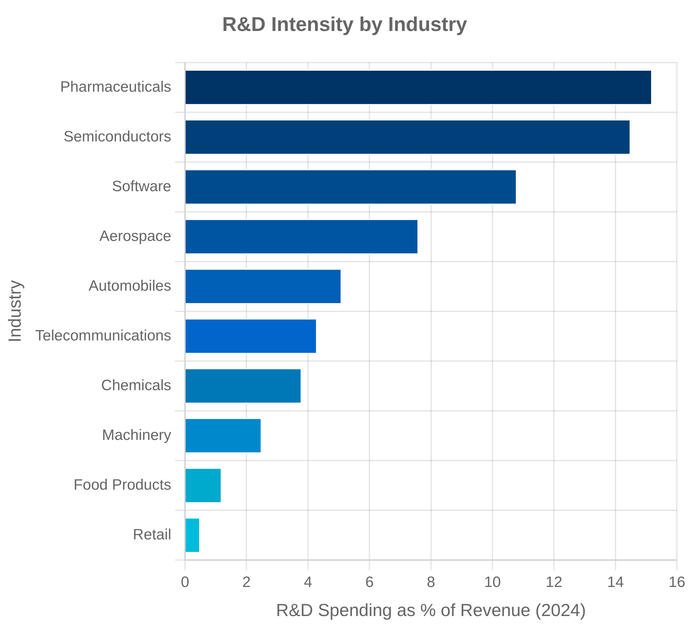

Innovation and R&D Statistics
R&D Measurement
Research and development (R&D) statistics provide critical insights into innovation activities and technological progress in the economy, with several agencies collecting complementary data.
National Science Foundation's Business R&D and Innovation Survey (BRDIS)
Census Bureau's Annual Business Survey (ABS) includes innovation module
BEA's R&D Satellite Account provides comprehensive framework
Intangible Capital Measurement
Beyond traditional R&D, economists have identified a broader set of intangible investments that contribute to innovation and productivity growth but remain partially unmeasured.
Organizational capital: management practices, business processes
Brand equity: advertising, marketing research
Firm-specific human capital: training, skills development
Patent Statistics
Patent data provide valuable indicators of innovation output and knowledge flows, though with important limitations as economic measures.
U.S. Patent and Trademark Office (USPTO) data linked to Census business data
Patent citations used to track knowledge spillovers
Not all innovations are patented; industry coverage varies widely

Slide 33


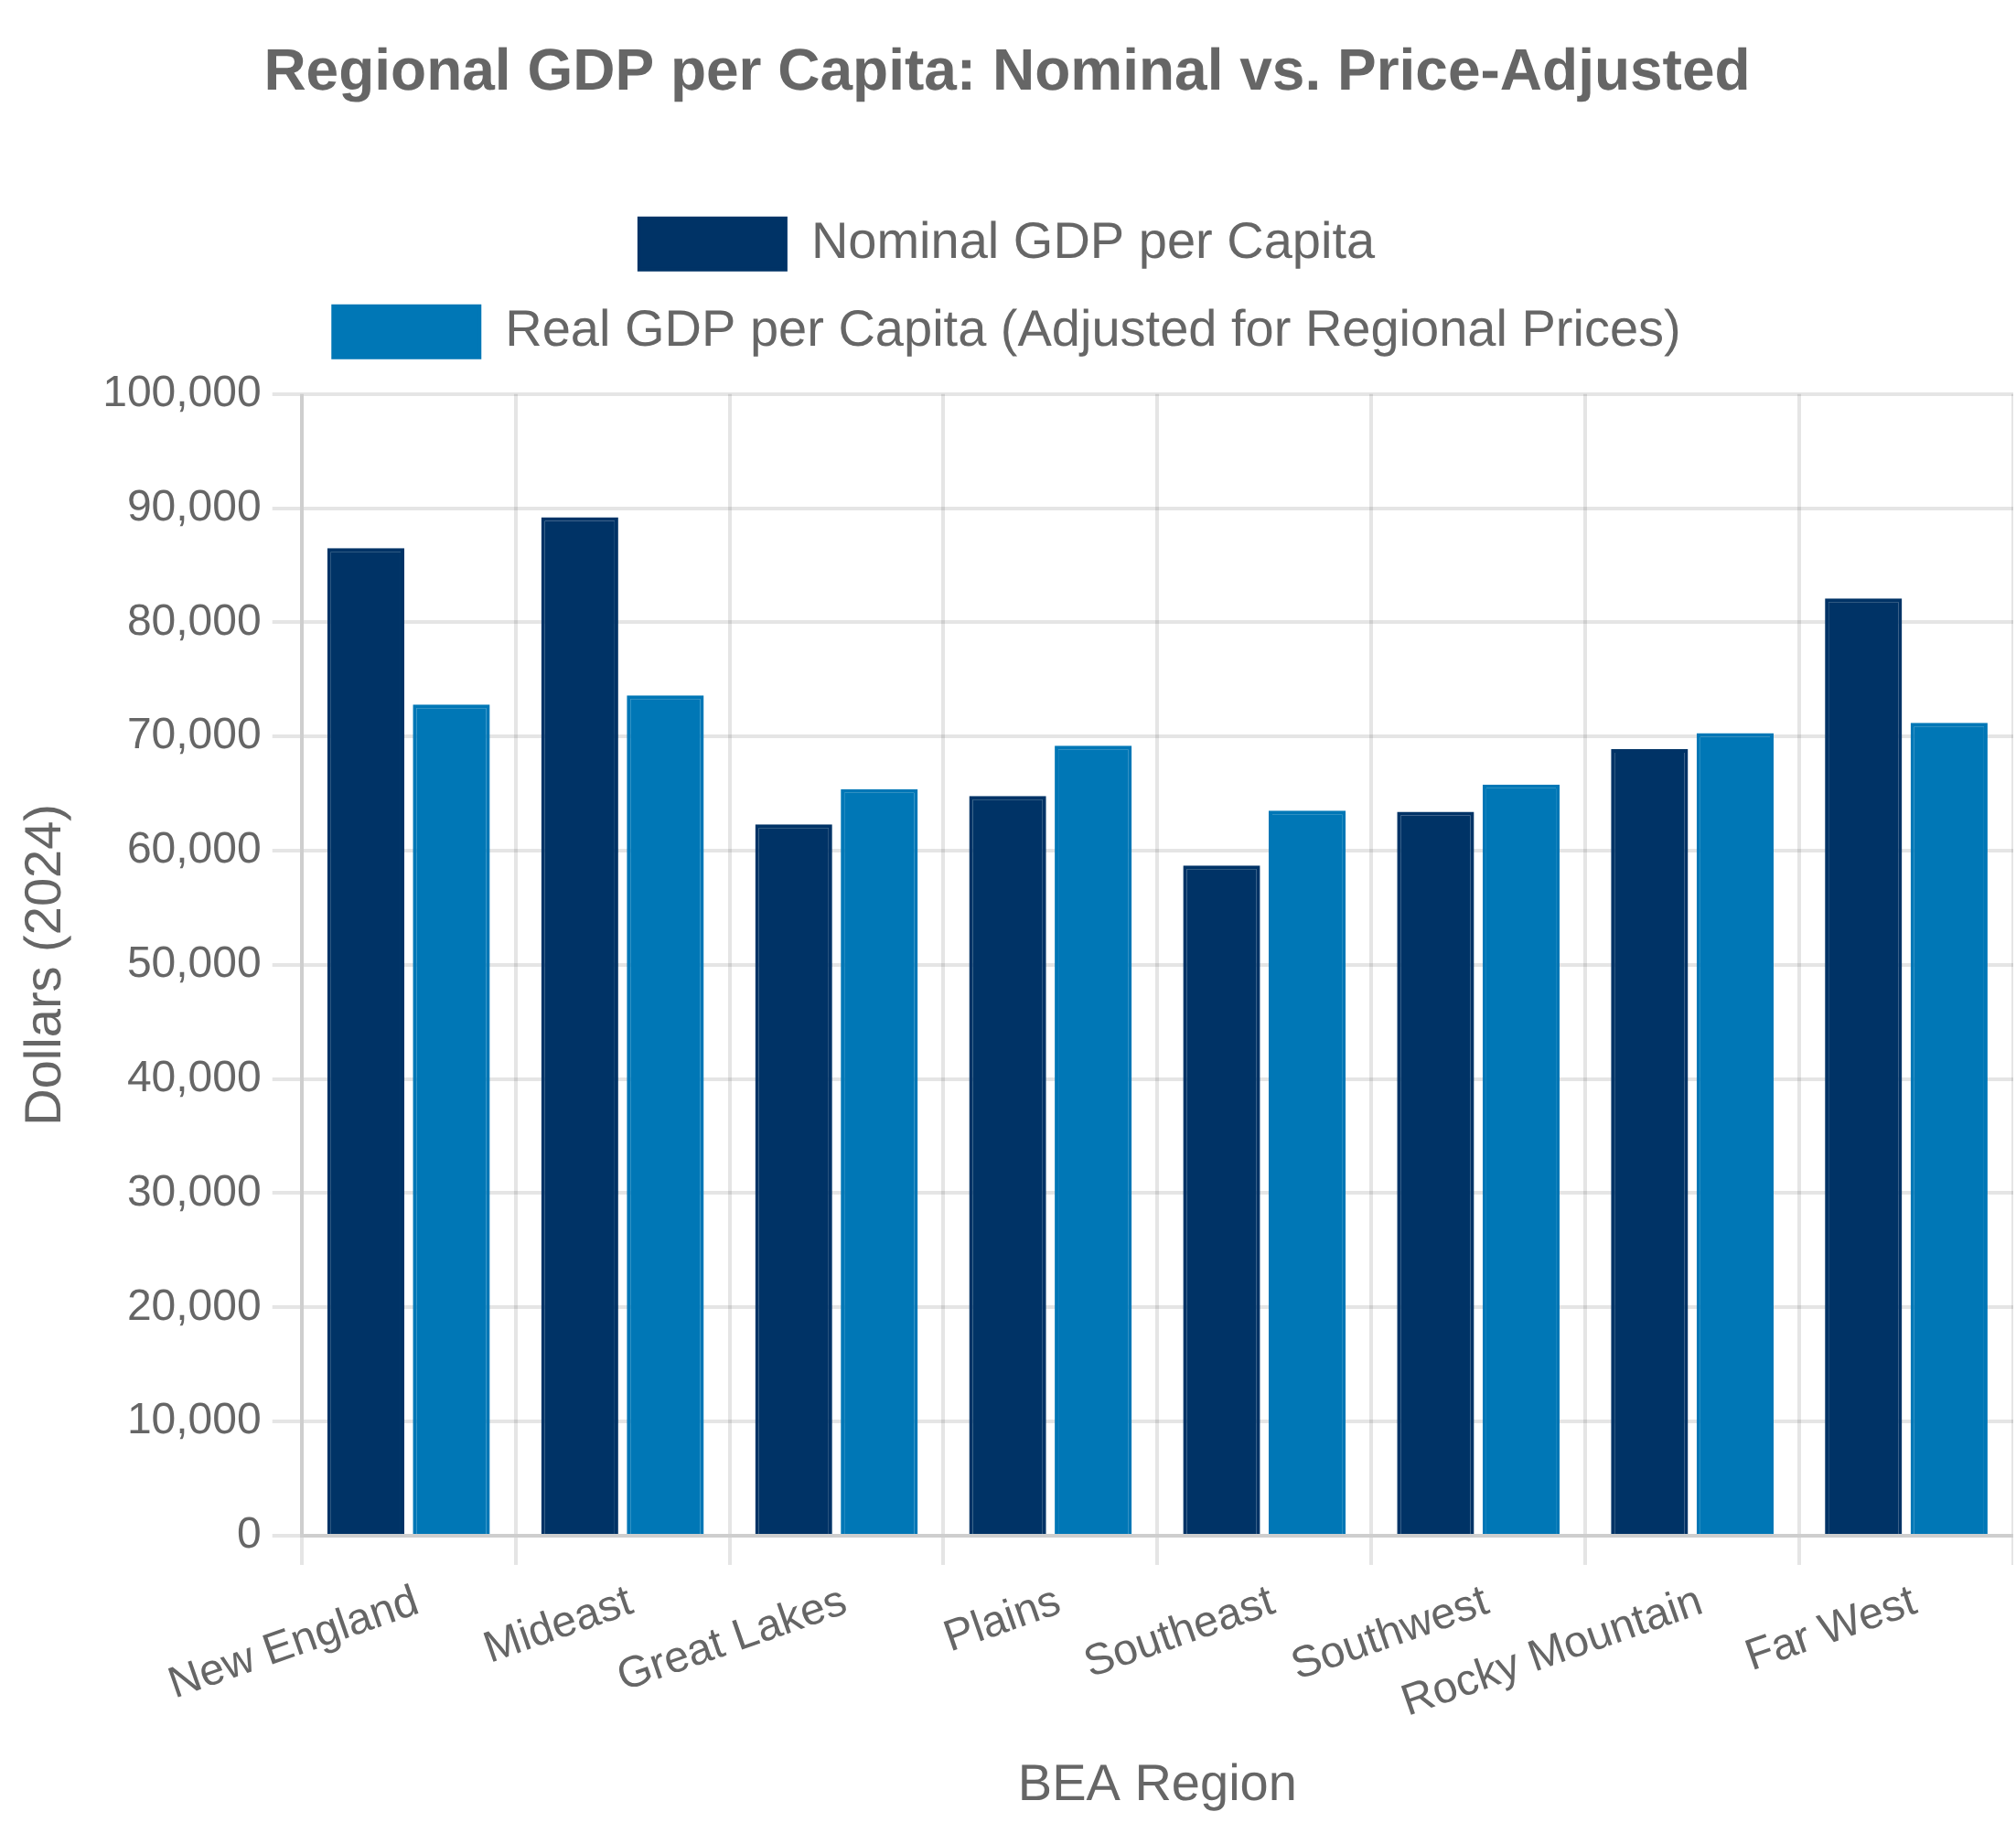


Regional and Metropolitan Statistics
Regional Economic Accounts
The Bureau of Economic Analysis (BEA) produces a comprehensive set of regional economic statistics that provide insights into geographic differences in economic activity and growth.
Gross Domestic Product (GDP) by state and metropolitan area
Personal income and employment by state, county, and metro area
Regional Price Parities (RPPs) measure geographic price level differences
Metropolitan Economic Indicators
Metropolitan Statistical Areas (MSAs) are increasingly important units of economic analysis, with several agencies producing metro-level statistics.
Bureau of Labor Statistics: employment, unemployment, wages by metro area
Census Bureau: population, housing, business patterns by metro area
Federal Reserve: metro-level financial and credit conditions
Urban-Rural Disparities
Economic statistics reveal significant and persistent differences between urban and rural areas, though measurement challenges exist in capturing these disparities.
Varying definitions of "rural" across statistical agencies
Smaller sample sizes in rural areas affect data reliability
Cost-of-living adjustments critical for meaningful comparisons

Slide 34


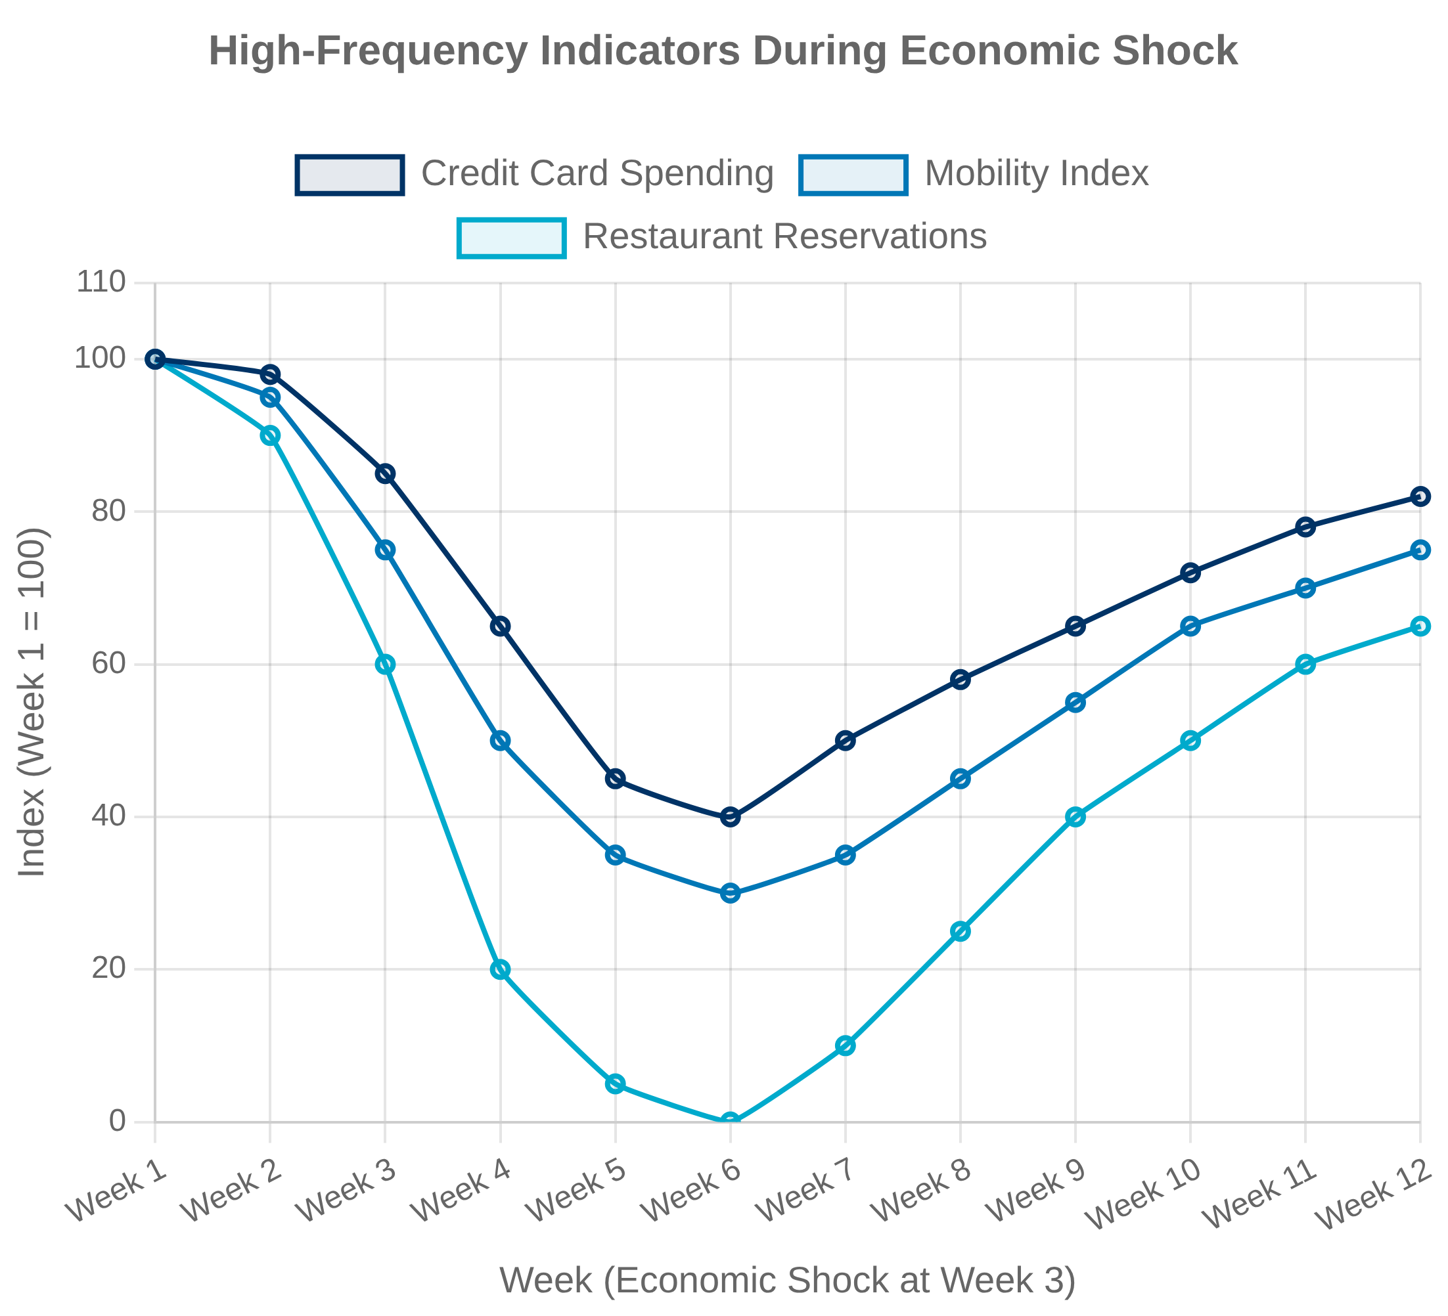
High-Frequency Economic Indicators
Traditional High-Frequency Indicators
Official statistical agencies have long produced a set of weekly and monthly indicators that provide timely insights into economic conditions, though with varying release lags.
Weekly: unemployment insurance claims, retail sales, energy production
Monthly: employment, inflation, industrial production, housing starts
Federal Reserve Bank nowcasting models (e.g., Atlanta Fed GDPNow)
Alternative Data Sources
The COVID-19 pandemic accelerated the development and adoption of alternative high-frequency indicators based on private sector and administrative data.
Credit and debit card transactions for real-time consumer spending
Mobile device location data for mobility and business activity
Job posting websites for labor market conditions
Methodological Challenges
High-frequency indicators present unique methodological challenges that must be addressed to ensure their reliability and usefulness.
Seasonal adjustment of weekly data is particularly difficult
Representativeness concerns with alternative data sources
Balancing timeliness against accuracy and reliability

Slide 35
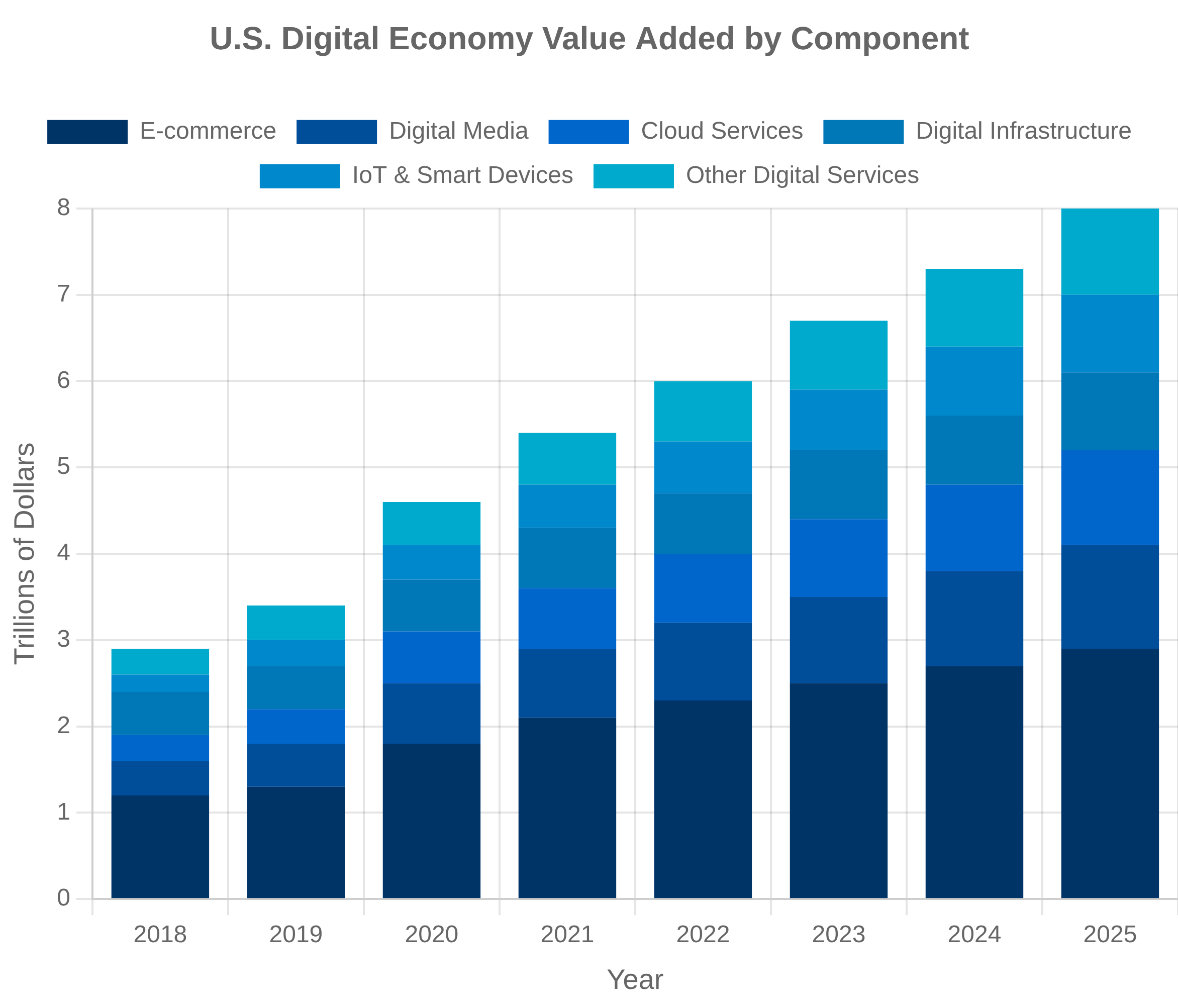



Digital Economy Measurement
E-commerce and Digital Platforms
The Bureau of Economic Analysis (BEA) has developed a digital economy satellite account to measure the contribution of digital goods and services to GDP, including e-commerce, cloud computing, and digital media.
Digital economy estimated at 10.3% of U.S. GDP in 2023, growing faster than the overall economy
E-commerce sales tracked through Census Bureau's E-Commerce Report, showing continued growth in online retail and wholesale
Free Digital Services
Many digital services are provided at zero monetary price, creating challenges for GDP measurement which traditionally captures market transactions.
Social media, search engines, and digital content create consumer value not fully captured in GDP
Experimental approaches include imputing value based on advertising revenue, time spent, or willingness to pay
Data as an Asset
Data has emerged as a critical economic asset, but its valuation and treatment in economic accounts remains challenging.
Current national accounts do not fully recognize data as a produced asset
Ongoing research on capitalizing data collection, storage, and analytics in national accounts

Slide 36

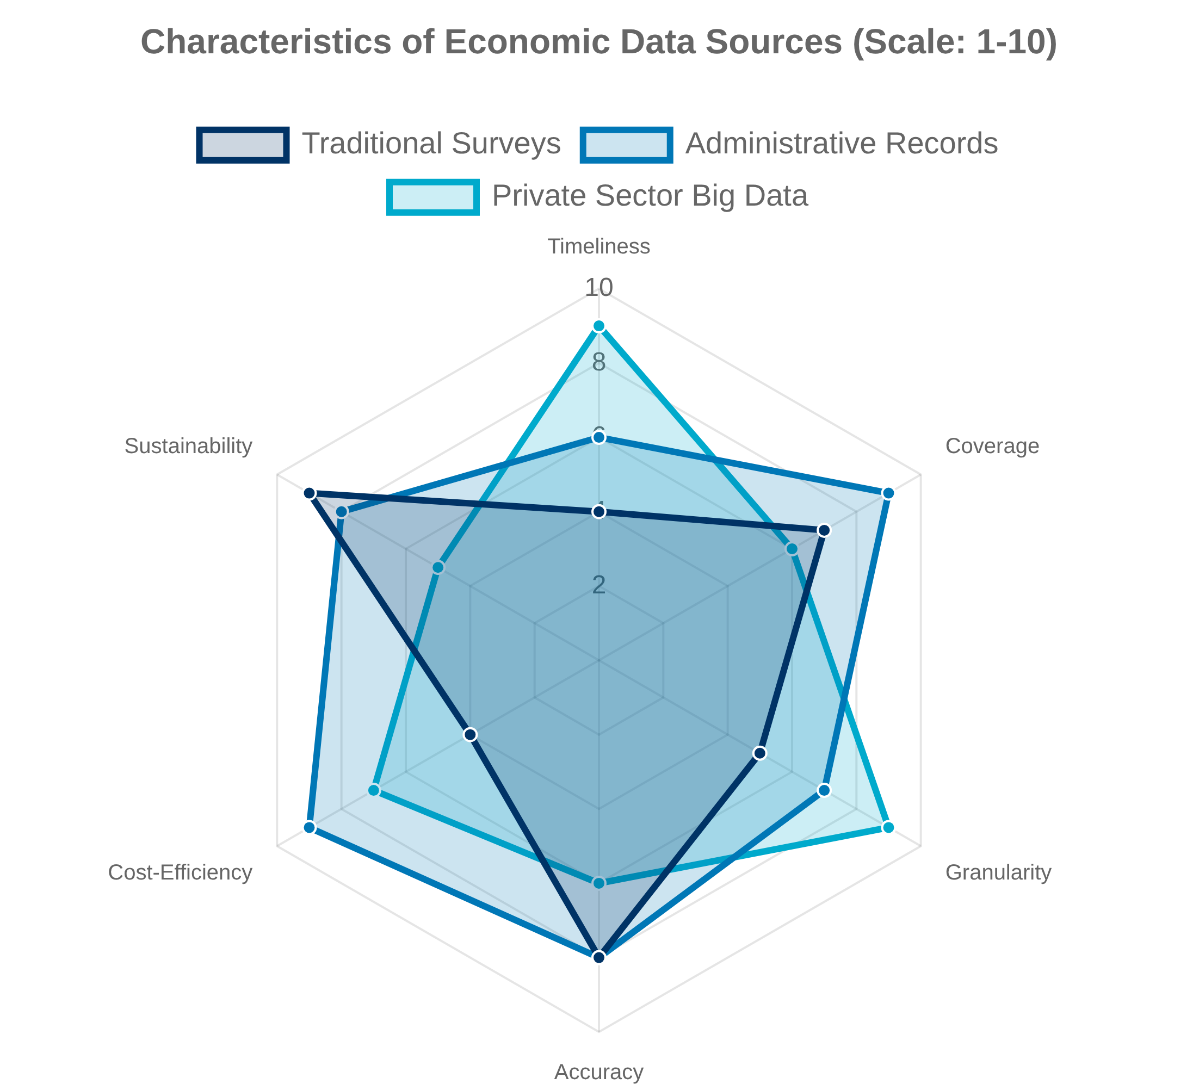


Big Data and Alternative Data Sources
Administrative Records
Statistical agencies are increasingly leveraging administrative data from government programs to enhance traditional survey-based statistics, reducing respondent burden while improving coverage and timeliness.
Tax records provide comprehensive income and employment data
Unemployment insurance records enhance labor market statistics
Private Sector Data Partnerships
Statistical agencies are forming partnerships with private companies to access new data sources that can provide more granular, timely insights into economic activity.
Credit card and point-of-sale data for real-time consumption tracking
Satellite imagery for agricultural production and construction activity
Privacy and Data Access Challenges
The use of big data and alternative data sources raises important privacy concerns and technical challenges that statistical agencies must address.
Differential privacy techniques balance data utility and confidentiality
Legal frameworks for data sharing and access need modernization

Slide 37


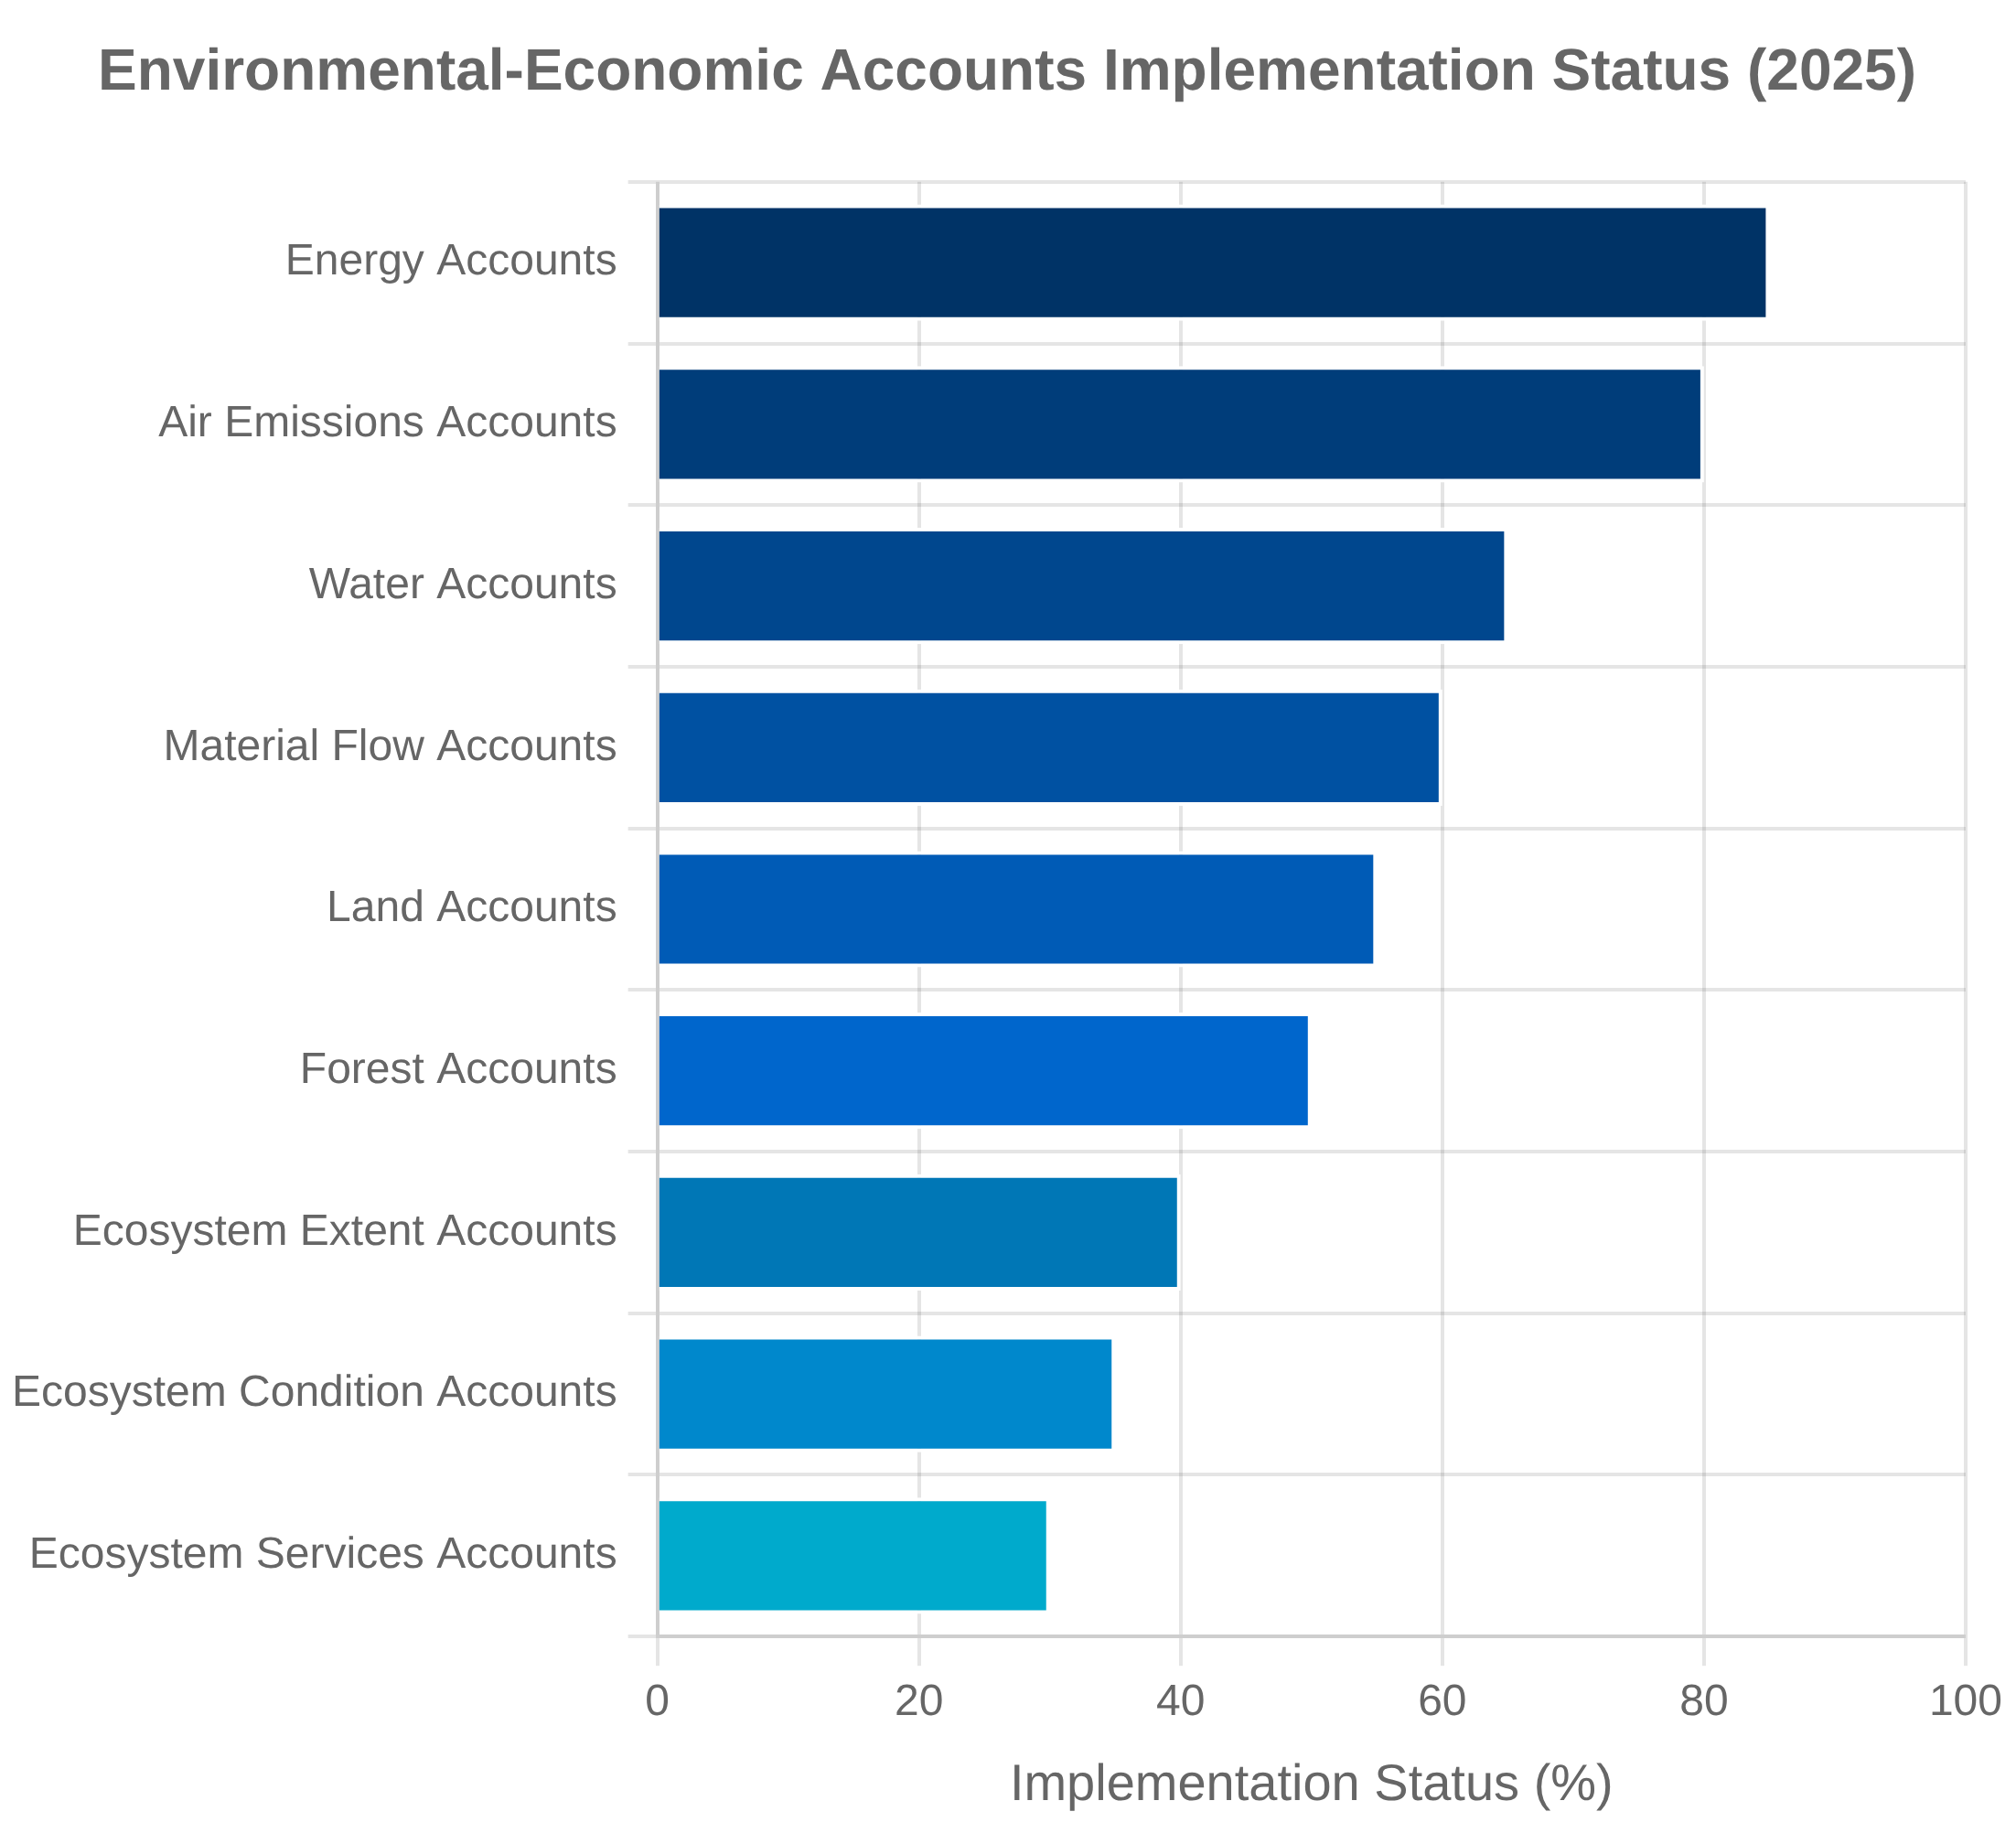


Environmental and Sustainability Accounting
Environmental-Economic Accounts
The System of Environmental-Economic Accounting (SEEA) provides an internationally agreed framework to measure the relationship between the environment and the economy, complementing traditional GDP measures.
SEEA Central Framework tracks natural resources, emissions, and environmental protection expenditures
SEEA Ecosystem Accounting measures ecosystem extent, condition, and services
Natural Capital Measurement
Natural capital accounting aims to measure the stocks of natural resources and ecosystem assets that provide benefits to people and the economy.
BEA's Outdoor Recreation Satellite Account measures the economic contribution of outdoor activities
Experimental accounts for land, water, minerals, and ecosystem services under development
Climate Statistics and Carbon Accounting
Statistical agencies are developing new measures to track climate change impacts and the transition to a low-carbon economy.
Carbon footprint metrics track emissions embedded in production and consumption
Green jobs and environmental goods and services statistics measure the clean economy

Slide 38

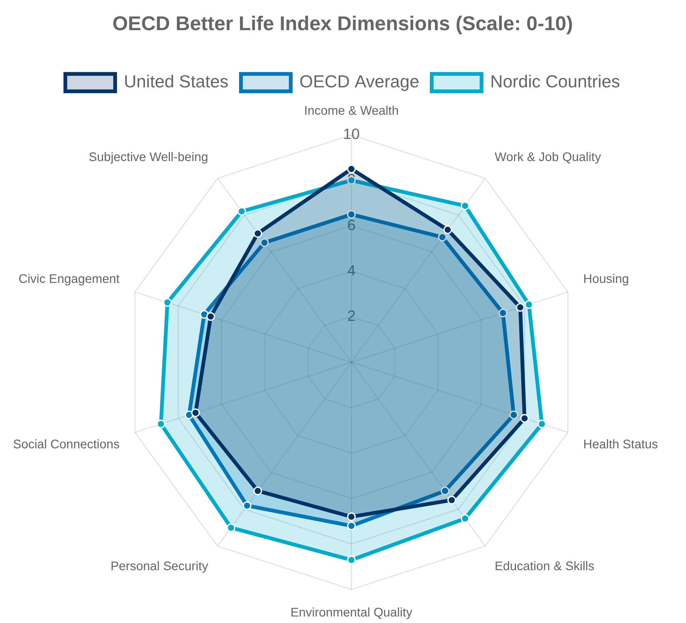


Well-being and Quality of Life Indicators
"GDP measures everything except that which makes life worthwhile." — Robert F. Kennedy, 1968
Beyond-GDP Measurement
Following recommendations from the Stiglitz-Sen-Fitoussi Commission, statistical agencies are developing broader measures of economic performance and social progress that go beyond traditional GDP.
Household-focused measures that better reflect living standards
Distributional accounts that show how growth is shared across society
Subjective Well-being Metrics
Subjective well-being measures capture people's self-reported evaluations of their lives and experiences, providing insights not available from objective indicators alone.
Life satisfaction and happiness surveys now conducted by many statistical agencies
Experienced well-being captures emotions and feelings during daily activities
Social Capital Indicators
Social capital measures capture the networks, norms, and trust that enable collective action and cooperation in society, which are critical for economic and social well-being.
Trust in institutions and interpersonal trust metrics
Social connection and community engagement indicators

Slide 39

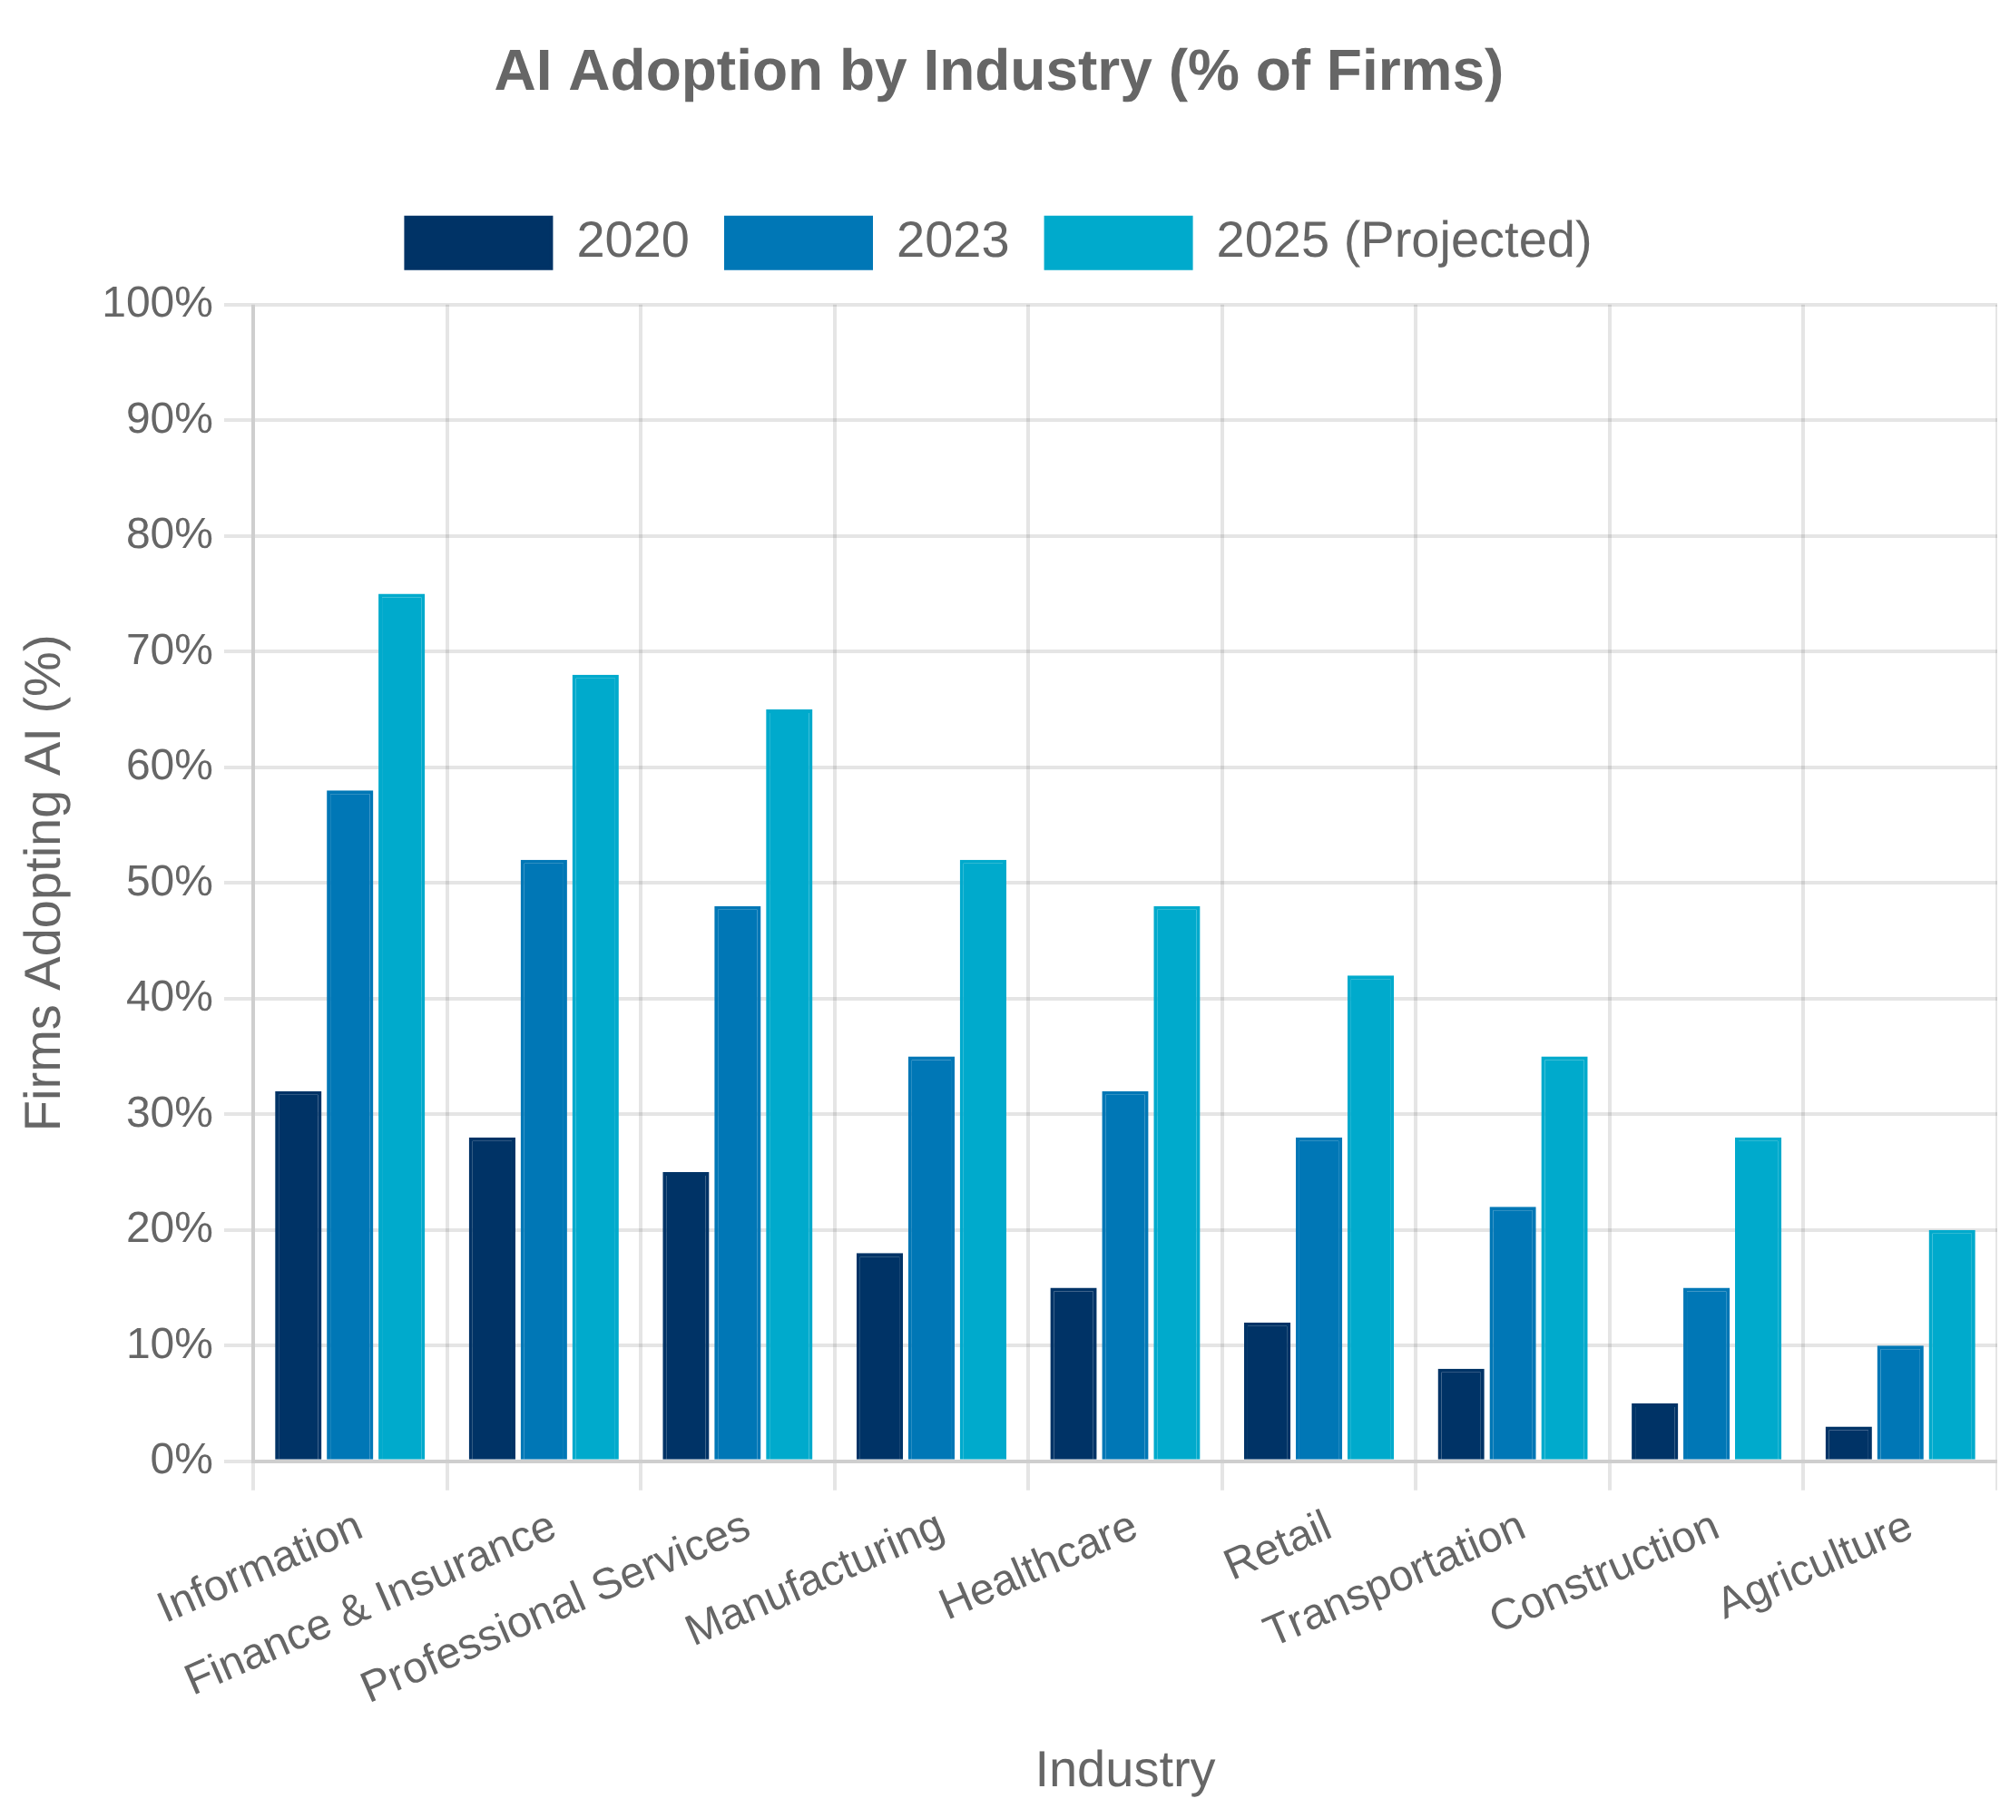


Artificial Intelligence and Economic Measurement
AI Adoption Metrics
Statistical agencies are developing new metrics to track the adoption and diffusion of AI technologies across industries and firms, providing insights into the pace and pattern of technological change.
Census Bureau's Annual Business Survey now includes questions on AI adoption
BEA working to identify AI-related investment in national accounts
Productivity Measurement Challenges
AI technologies present unique challenges for productivity measurement, including lags between adoption and productivity gains, complementary investments, and quality improvements.
Difficulty measuring quality improvements in AI-enhanced products and services
Challenges capturing intangible investments in AI capabilities
AI in Statistical Production
Statistical agencies themselves are adopting AI technologies to improve data collection, processing, and analysis, potentially transforming how economic statistics are produced.
Machine learning for data editing, imputation, and quality control
Natural language processing for coding and classifying text responses
Computer vision for processing satellite imagery and other visual data

Slide 40

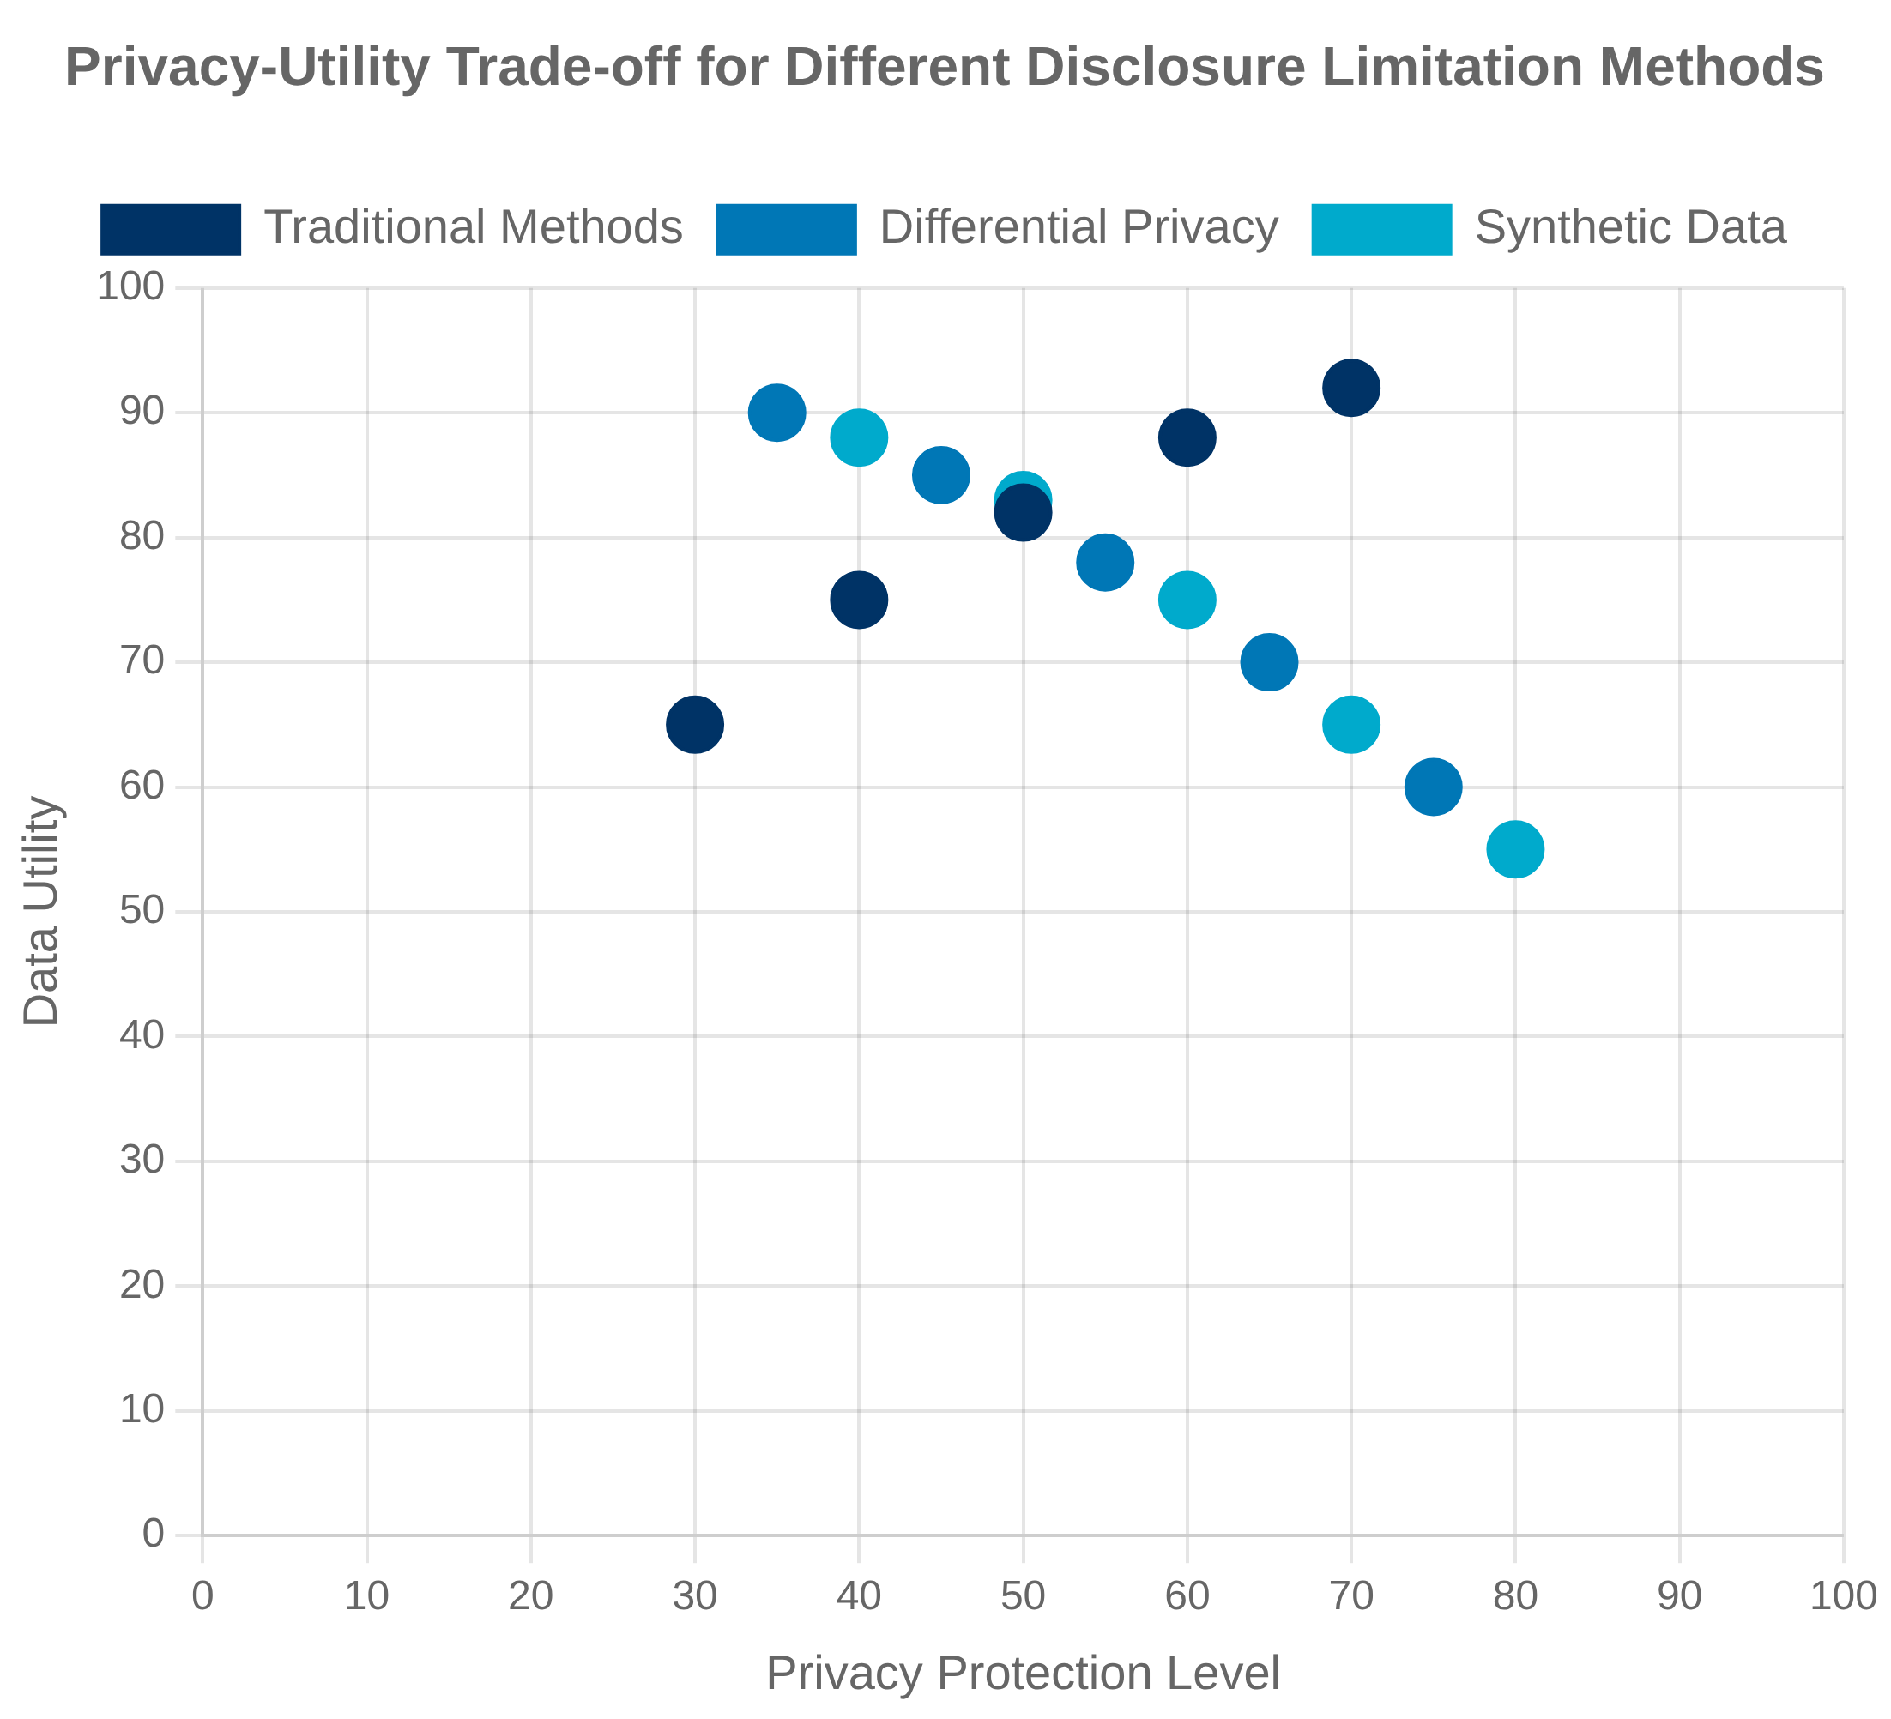

Privacy, Confidentiality, and Data Access
Statistical Disclosure Limitation
Statistical agencies employ a range of disclosure limitation methods to protect the confidentiality of respondent data while still providing useful information to the public and researchers.
Traditional methods include cell suppression, top-coding, and data swapping
Synthetic data approaches create artificial datasets that preserve statistical properties
Differential Privacy
Differential privacy provides a mathematical framework for quantifying privacy loss, allowing agencies to make explicit trade-offs between privacy protection and data utility.
Census Bureau implemented differential privacy for the 2020 Decennial Census
Ongoing debate about appropriate privacy-utility balance for economic statistics
Research Data Access
Statistical agencies are developing secure access mechanisms to allow researchers to work with confidential microdata while maintaining privacy protections.
Federal Statistical Research Data Centers provide secure access to restricted data
Remote access systems and secure computing environments expanding researcher access
Evidence-Based Policymaking Act of 2018 established new data sharing frameworks

Slide 41


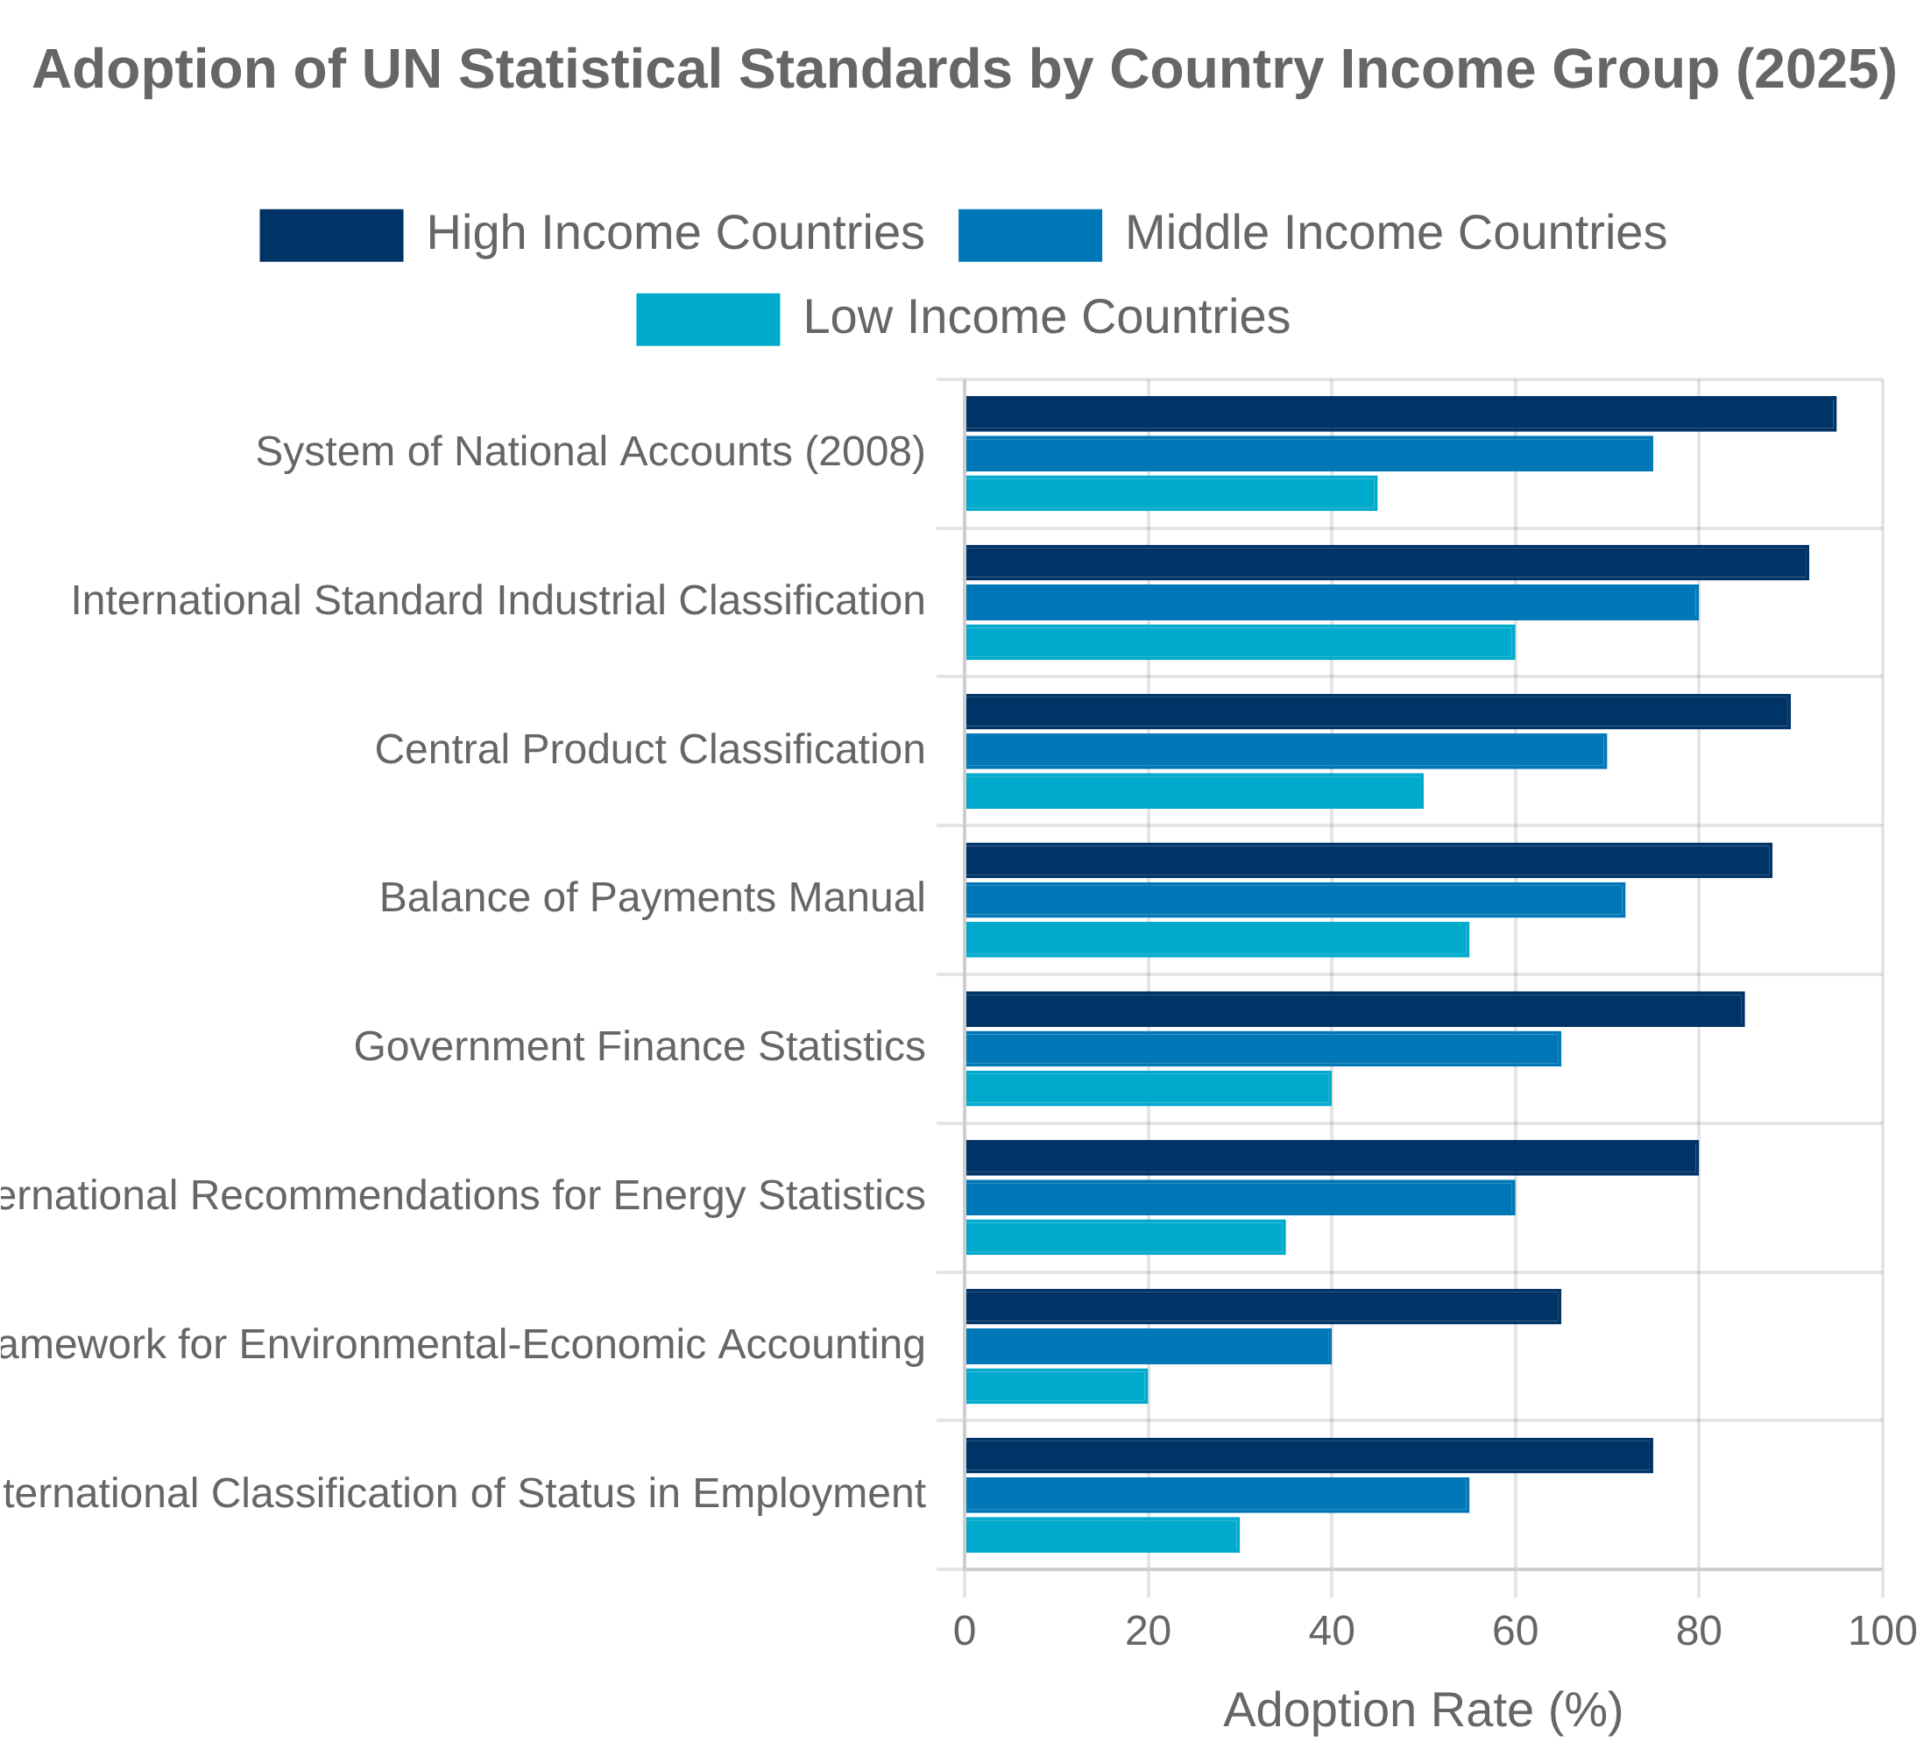


UN Statistical Commission and Global Standards
Role in International Standards
The United Nations Statistical Commission (UNSC) is the highest decision-making body for international statistical activities, responsible for setting statistical standards and developing concepts and methods for implementation at the national and international levels.
Established in 1947, meets annually with representatives from national statistical offices
Oversees work of UN Statistics Division and specialized statistical committees
System of National Accounts 2025 Update
The UNSC is overseeing the update to the System of National Accounts (SNA), with the 2025 revision addressing emerging measurement challenges in the modern economy.
Enhancing treatment of digitalization, globalization, and well-being
Improving guidance on informal economy, unpaid household activities, and environmental accounting
International Coordination
The UNSC coordinates statistical work across international organizations to ensure coherence, avoid duplication, and promote the integration of statistical systems.
Committee for the Coordination of Statistical Activities (CCSA) aligns work of over 45 international organizations
Global Statistical Geospatial Framework integrates geographic and statistical information

Slide 42


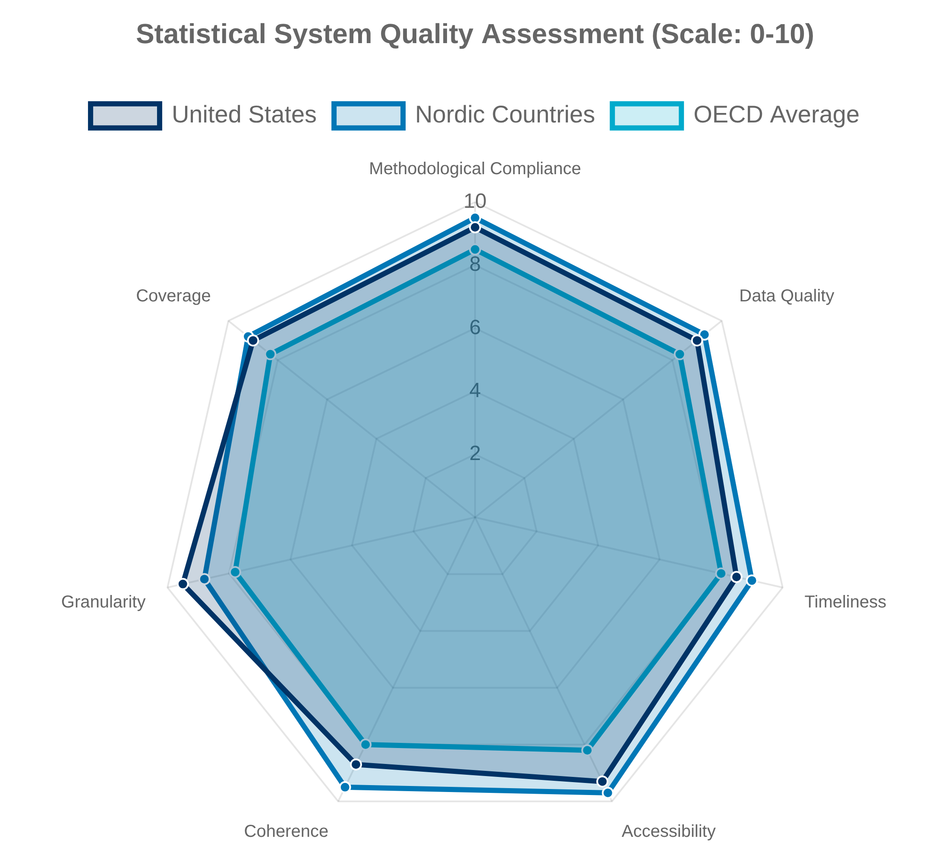

OECD and Advanced Economy Practices
Statistical Guidelines and Manuals
The Organisation for Economic Co-operation and Development (OECD) develops detailed methodological guidelines for economic statistics that complement UN frameworks while addressing the specific needs of advanced economies.
Productivity Measurement Manual provides guidance on productivity statistics
Handbook on Measuring the Digital Economy addresses emerging measurement challenges
Best Practices and Innovation
The OECD serves as a forum for sharing statistical best practices and innovations among advanced economies, facilitating the diffusion of new methods and approaches.
Committee on Statistics and Statistical Policy coordinates work across member countries
Working Party on National Accounts addresses SNA implementation issues
Cross-Country Comparability
The OECD works to enhance the comparability of economic statistics across member countries, enabling meaningful international benchmarking and policy analysis.
Harmonized definitions and methodologies for key economic indicators
Regular peer reviews of national statistical systems
Standardized metadata reporting to document country-specific practices

Slide 43


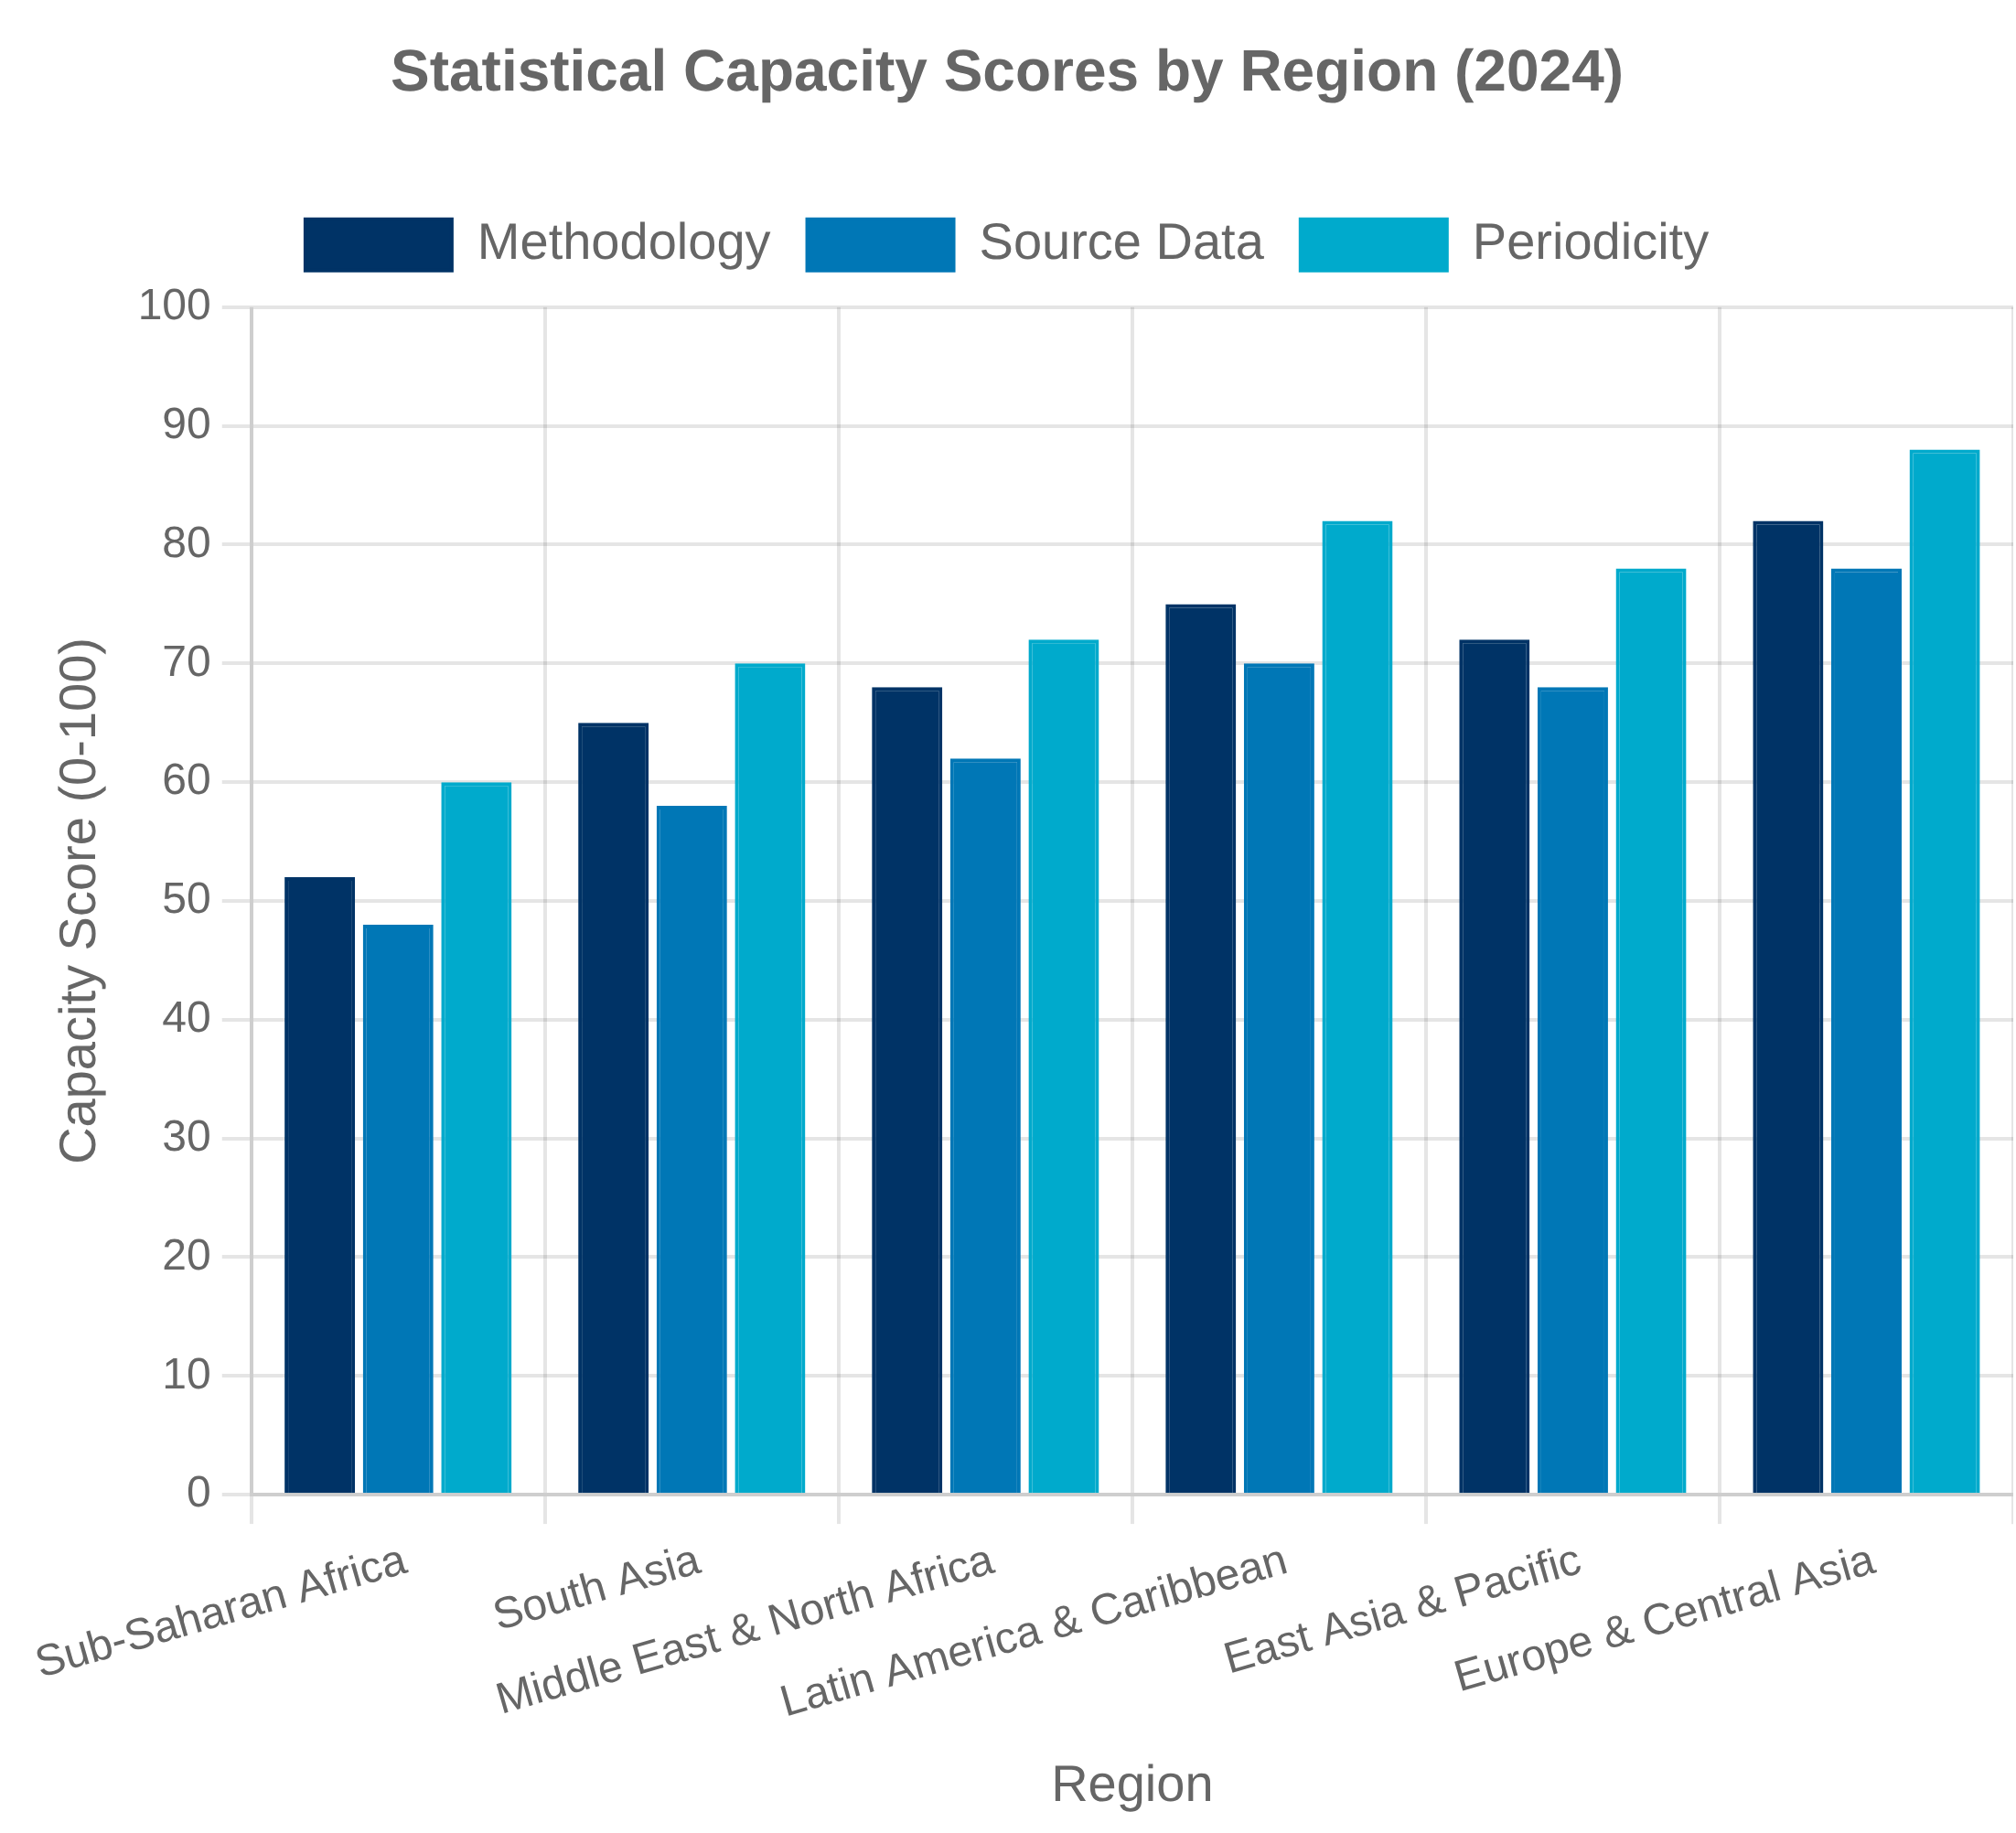


Developing Country Statistical Capacity
Capacity Challenges
Developing countries face significant challenges in producing comprehensive, timely, and reliable economic statistics due to resource constraints, institutional limitations, and technical capacity gaps.
Limited financial resources for data collection and processing
Shortage of trained statistical personnel and analytical expertise
Inadequate IT infrastructure and data management systems
Capacity Building Initiatives
International organizations and bilateral donors support statistical capacity building through technical assistance, training programs, and financial support.
World Bank's Trust Fund for Statistical Capacity Building
IMF's Data for Decisions (D4D) Fund
UN Statistical Division's capacity development programs
Innovative Approaches
New technologies and methodologies offer opportunities to leapfrog traditional statistical development pathways and address data gaps more efficiently.
Satellite imagery and remote sensing for agricultural and economic activity
Mobile data collection and survey technologies

Slide 44
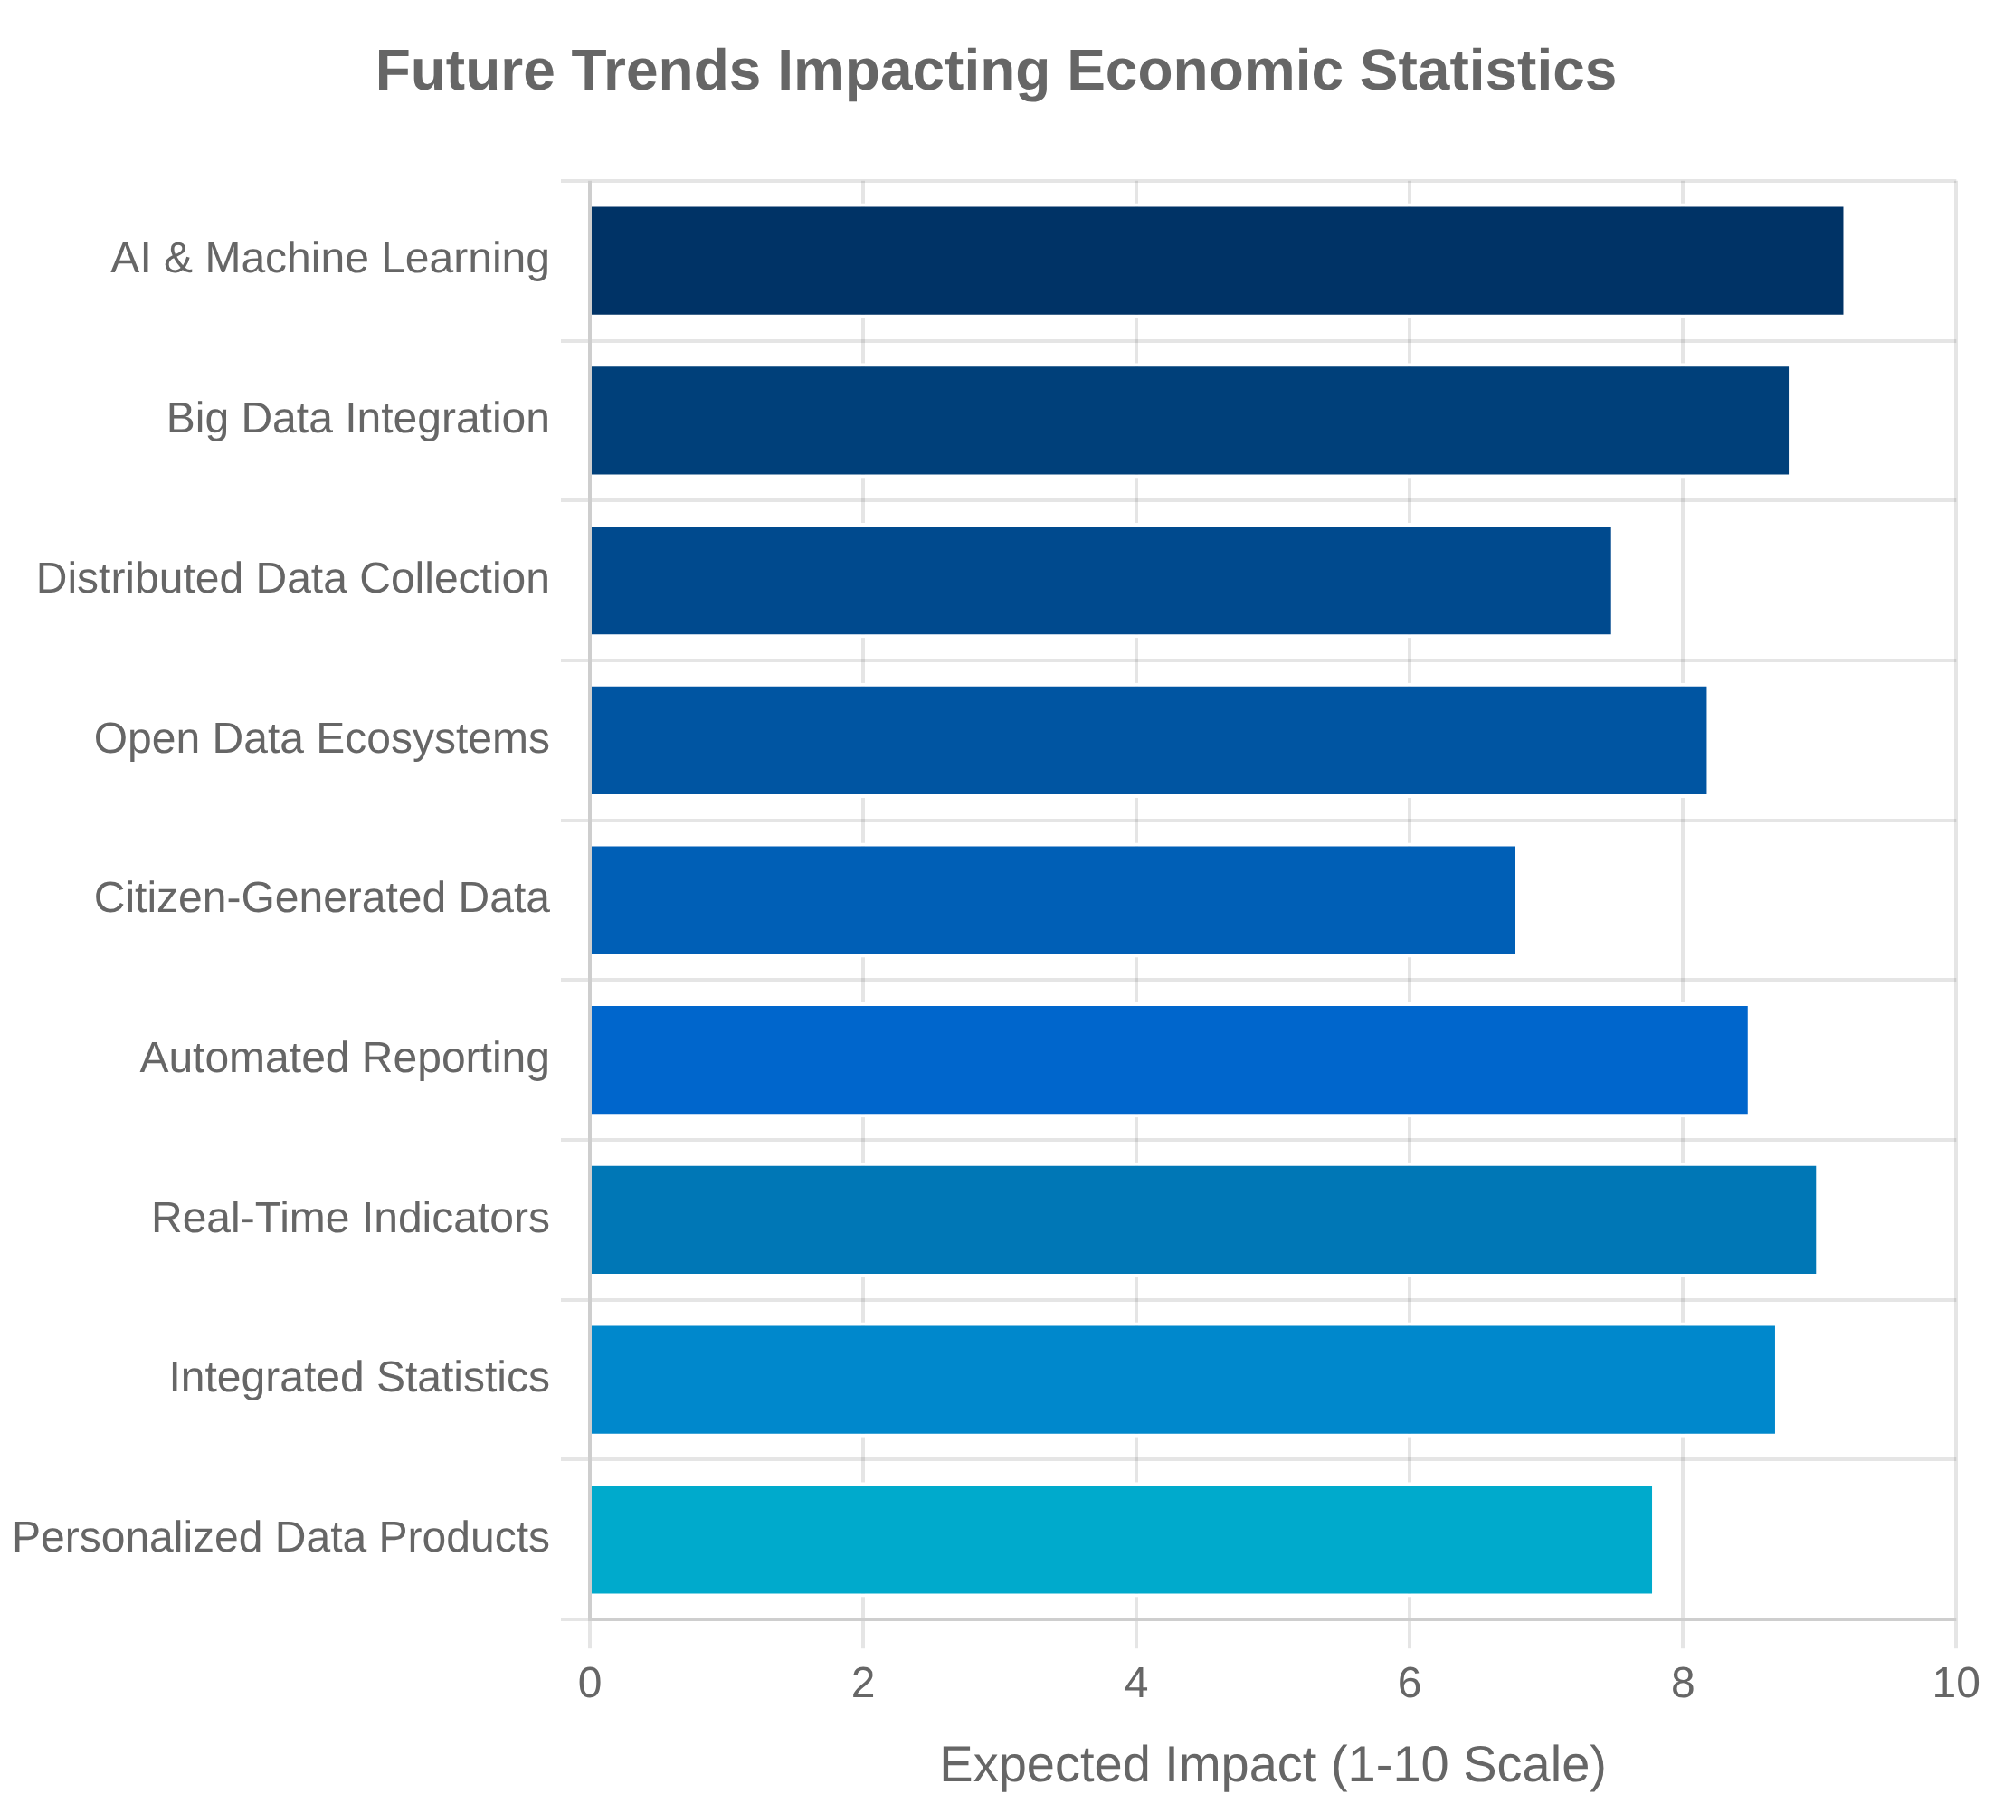


Future of Economic Statistics
Technological Opportunities
Emerging technologies are transforming how economic statistics are collected, processed, and disseminated, offering opportunities for more timely, granular, and comprehensive measurement.
AI and machine learning for data processing, editing, and imputation
Big data integration for real-time economic monitoring
Blockchain and distributed ledger technologies for secure data sharing
Evolving User Needs
User expectations for economic statistics are evolving, with increasing demand for more timely, granular, and relevant information to support decision-making.
Greater emphasis on distributional information and inequality metrics
Demand for integrated economic, social, and environmental indicators
Statistical Agency Transformation
Statistical agencies are transforming their operations, skills, and organizational structures to adapt to the changing data landscape and user expectations.
Shift from data producers to data stewards and integrators
Development of new skills in data science, AI, and advanced analytics
Increased collaboration with private sector data providers and academia

Slide 45
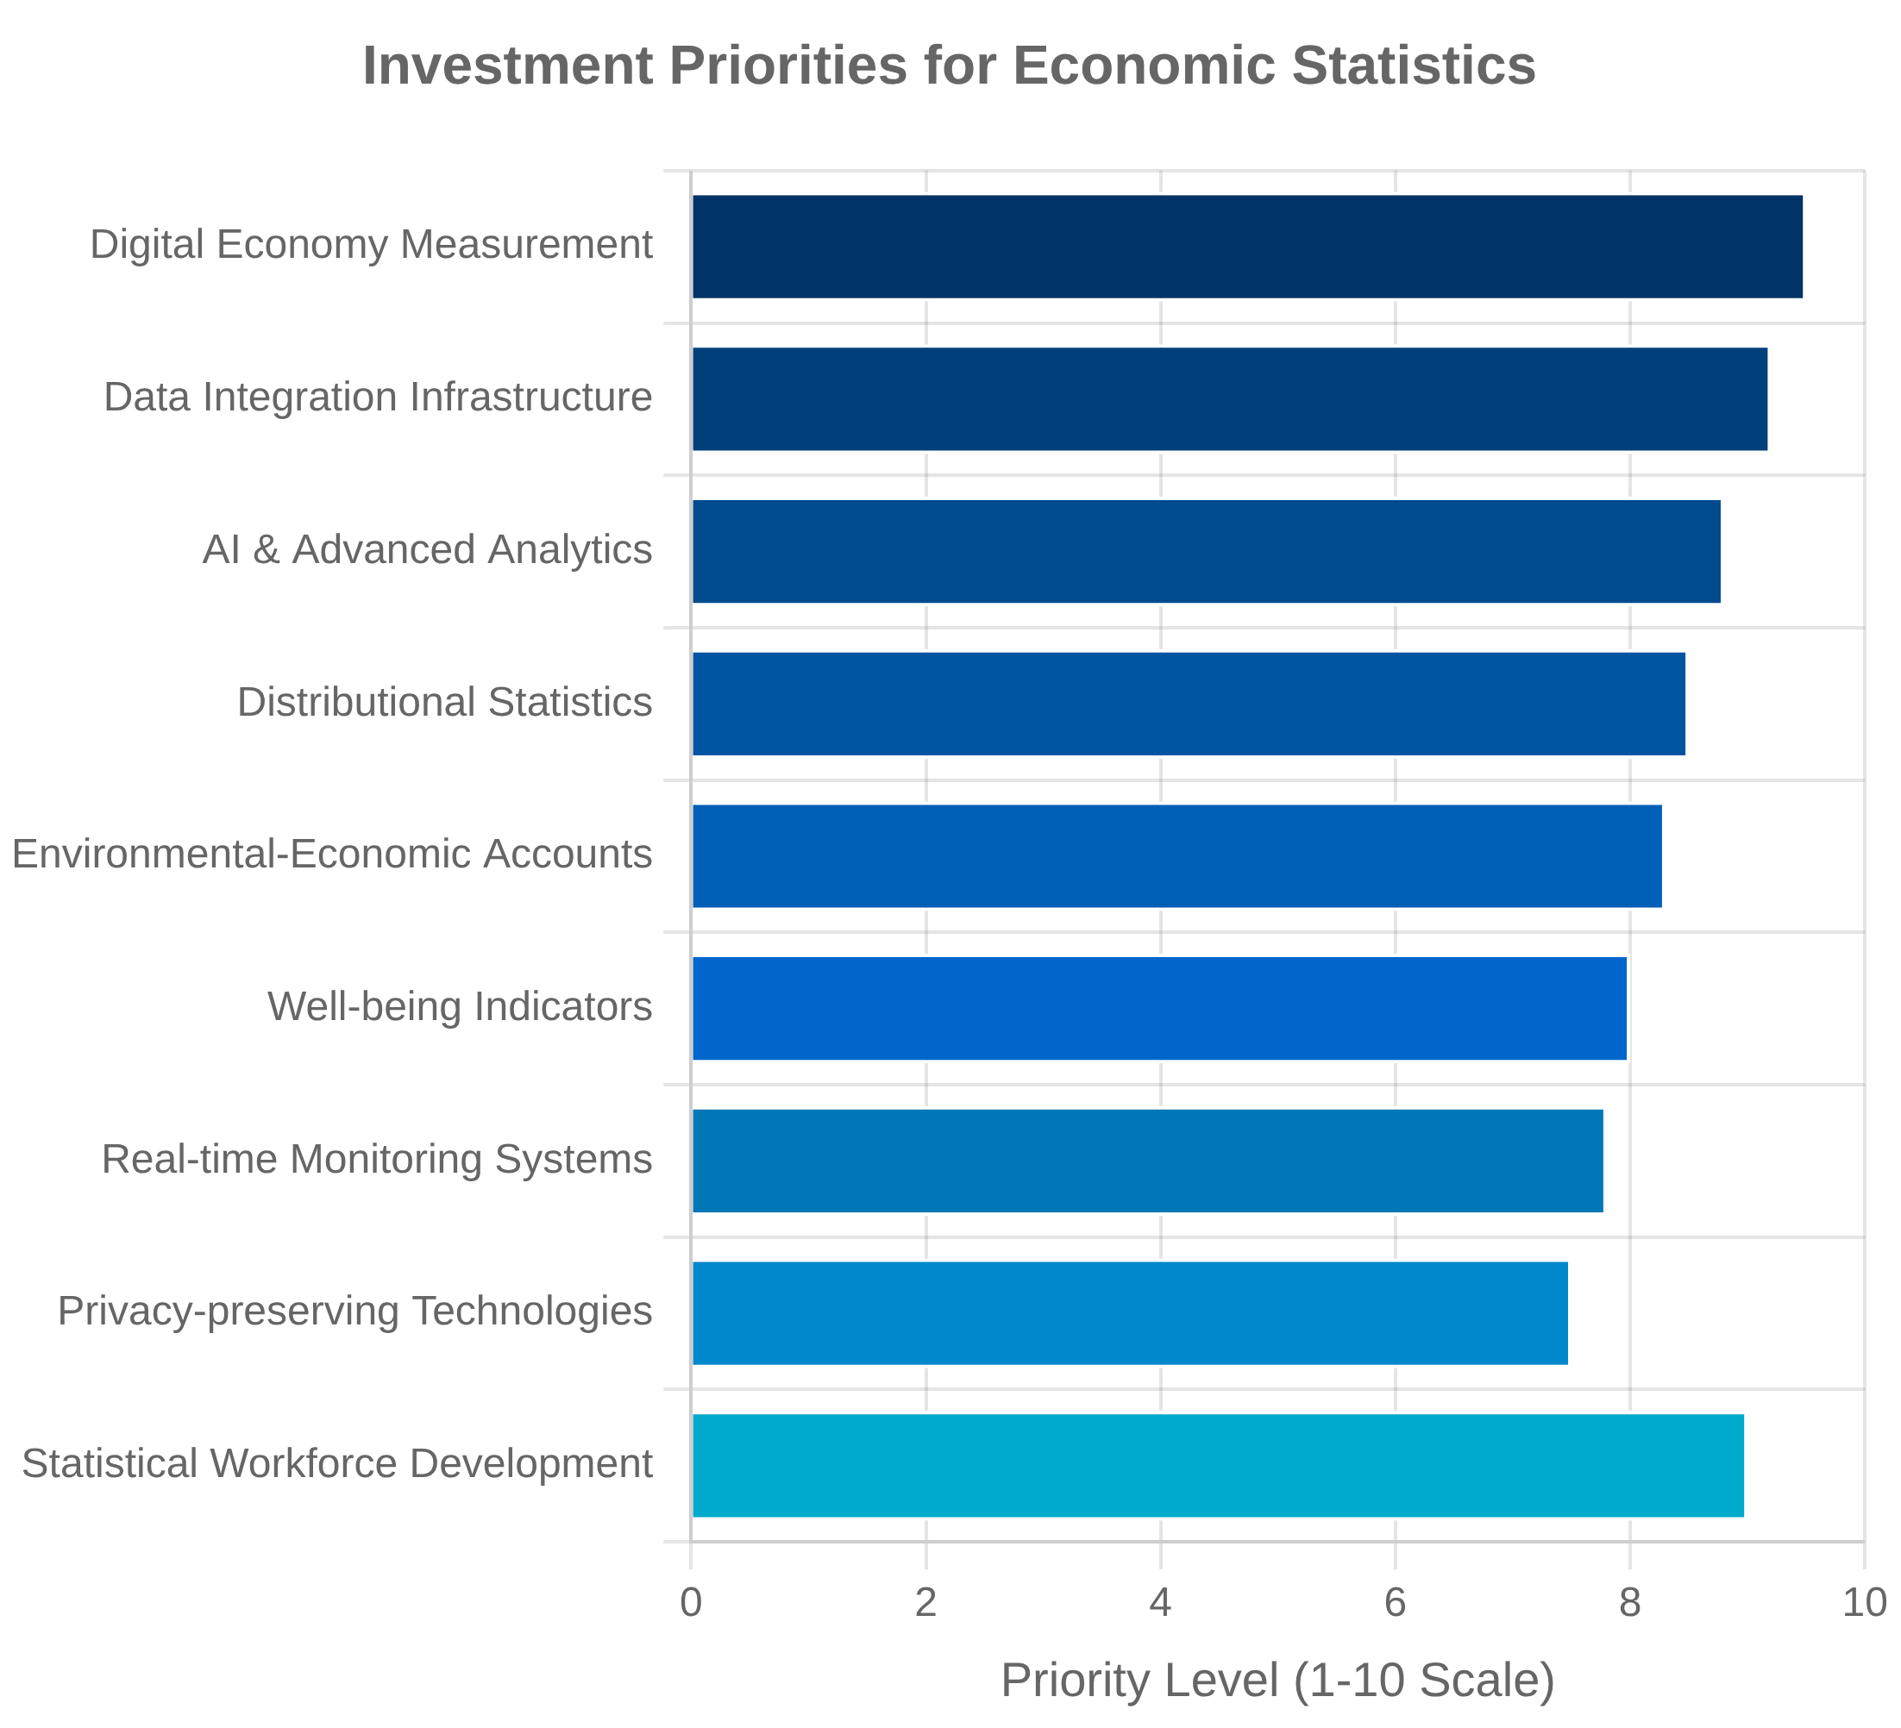




Key Takeaways and Recommendations
"What we measure affects what we do; and if our measurements are flawed, decisions may be distorted." — Stiglitz-Sen-Fitoussi Commission
Economic statistics are critical infrastructure for evidence-based policymaking, business decisions, and public understanding of the economy.
The U.S. statistical system has evolved to address emerging measurement challenges, but significant gaps remain in measuring the digital economy, inequality, well-being, and sustainability.
International coordination through the UN Statistical Commission and OECD is essential for maintaining comparable statistics across countries and addressing global measurement challenges.
Technological innovation offers opportunities to transform economic measurement through big data, AI, and new data collection methods, but requires investment in skills and infrastructure.
Sustained investment in statistical agencies and research on economic measurement is essential to ensure statistics remain relevant and accurate in a rapidly changing economy.

